Slide 1
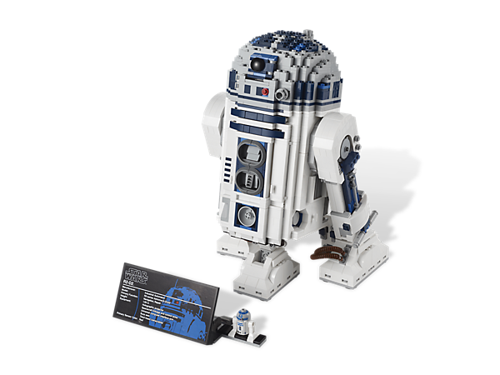
International LEGO Design Project
Matt Guthrie, Christopher Kreps, Ryan Borth

Slide 2
Objectives
To construct and assemble an assigned project in Catia
Conduct a complex project with multiple teams operating in others countries
Identify and overcome potential logical and organizational issues through collaborative measures
Establish uniform methods and procedures for the creation of parts and assemblies

Slide 3
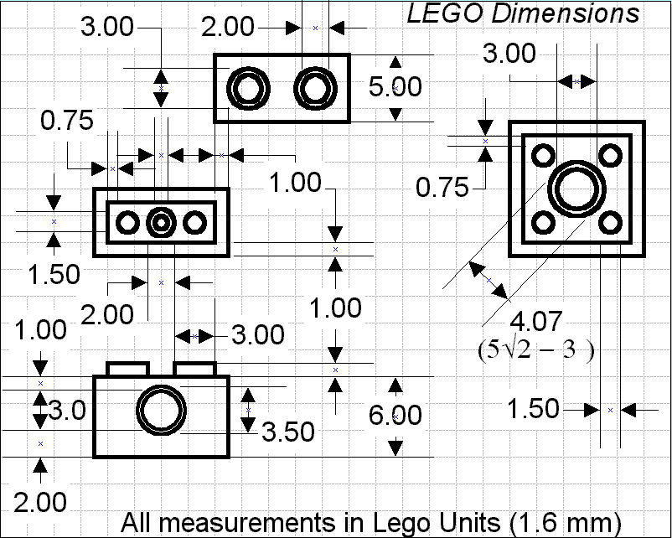
Dimensional Standards
Designing parts to a universal standard can cause problems during collaboration.
The problem was eliminated by implementing the use of a standard measurement between all teams
Since all LEGO parts are modular, all measurements could be interpreted from the following dimensioning system.

Slide 4
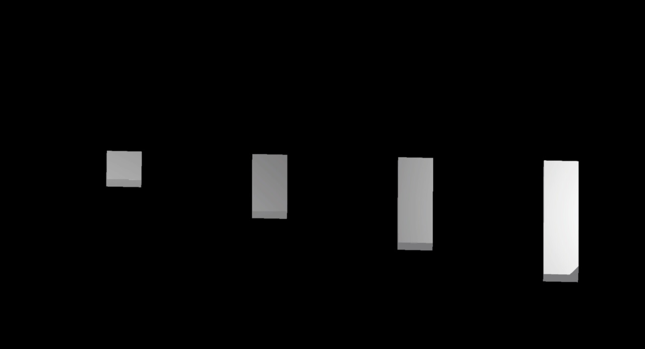
Standard Parts
A majority of parts are vary similar to each other.
The process of making parts is simplified by making one part, and then using a design table with logic statements to construct similar versions
Notice how all of the parts are similar, but some dimensions are scaled differently

Slide 5
Unique Parts
Unique parts are designed individually and are seldom based off of other parts.
To verify and understand the dimensions, many physical sub-assemblies was constructed from actual LEGOs.

Slide 6
Assemblies
The snap command was used to position the parts in the assemblies
The parts are not constrained, like in a normal assembly, but positioned relative to each part
This process allows for the use of less memory and ease of file exchange

Slide 7
Subassembly Example

Slide 8
Collaboration
An online tool named “Smartsheet” was used to denote who was working on which part and tracked the current progress of all parts and assemblies instantly
Dropbox was also used to share all finished work between schools

Slide 9
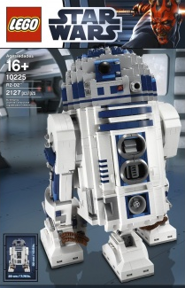
Master Bill of Materials (MBOM)
The MBOM helped to establish a naming system and also identified which parts were needed for each sub-assembly
The LEGO book was also used to identify sub-assemblies and parts

Slide 10
Final Render

