Slide 1
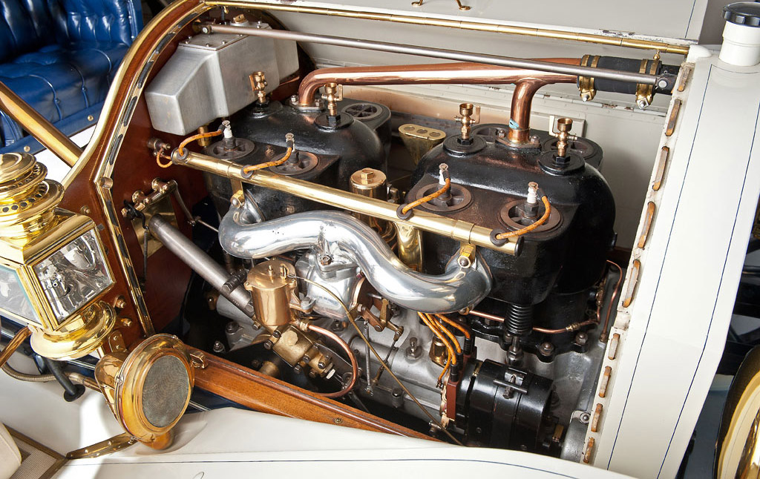
1911 1/6 Scale Simplex Engine
Greg Atkinson, Ben Upper, Derek Arrotta

Slide 2
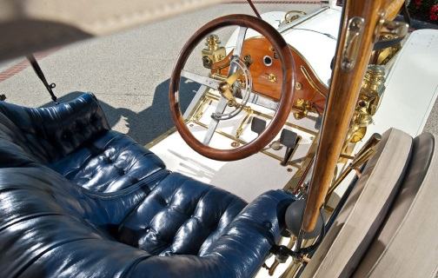
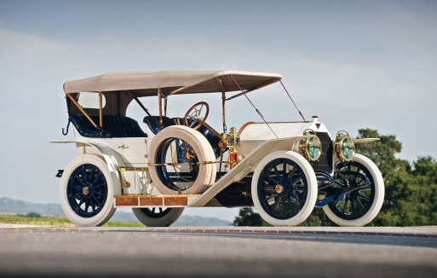
Objective
We started with a 30 page drawing package that includes over 100 parts and a few assembly drawings.
Tasks:
Find inconsistencies along the way and confer with the Shop Attendant about them (Russ).
Model all parts for the Simplex engine and Assemble them

Slide 3
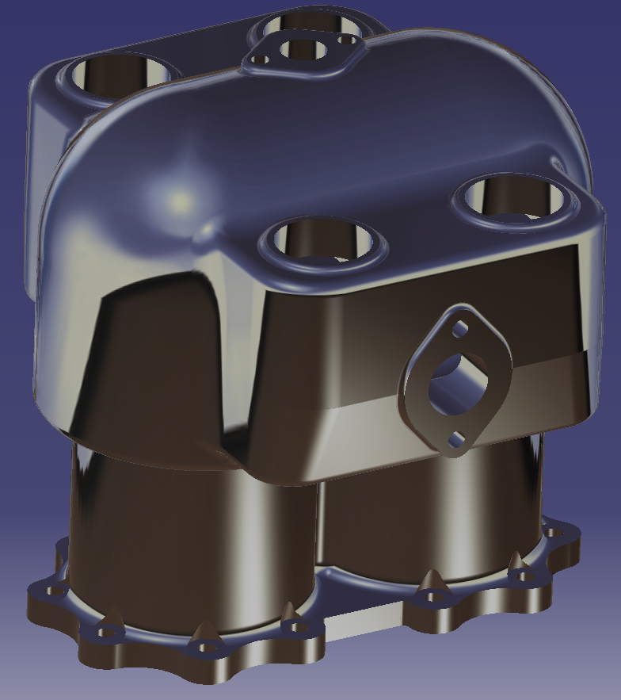
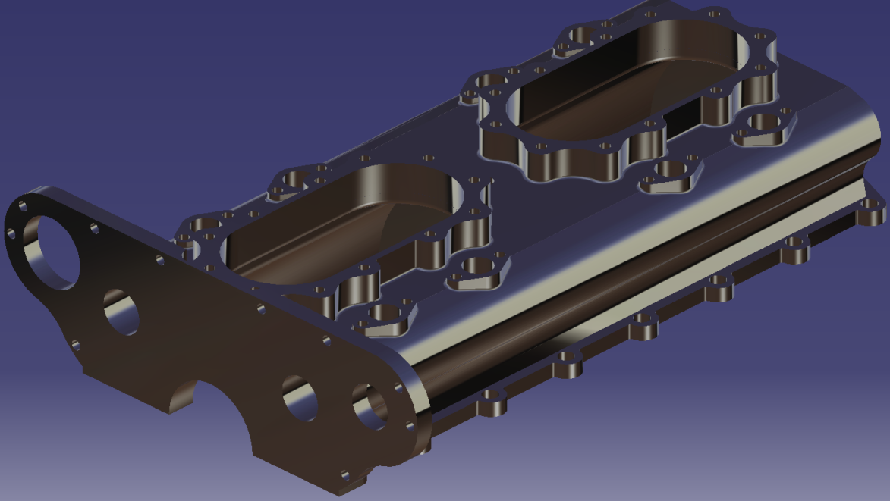
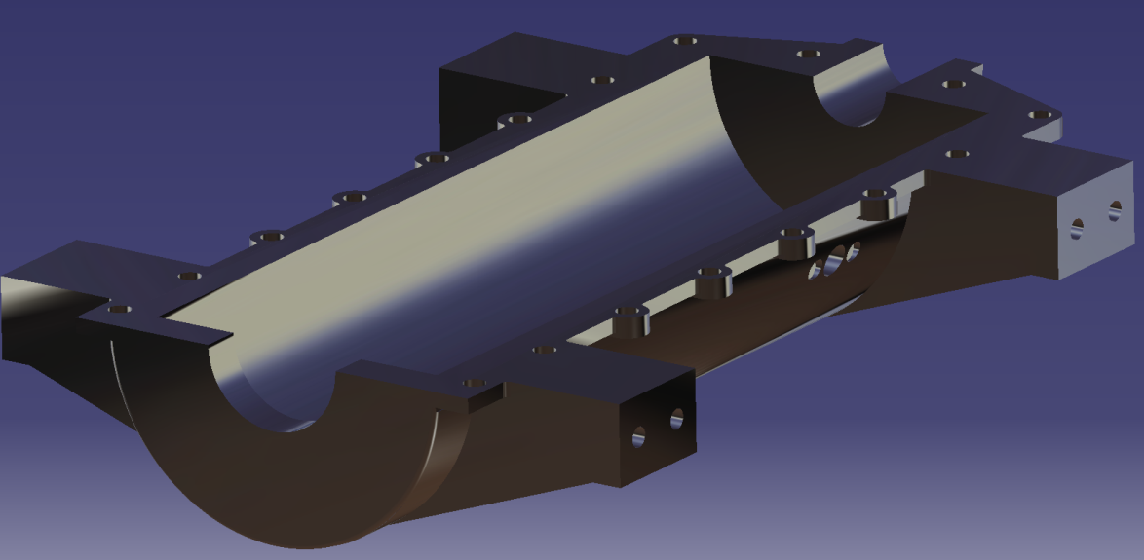
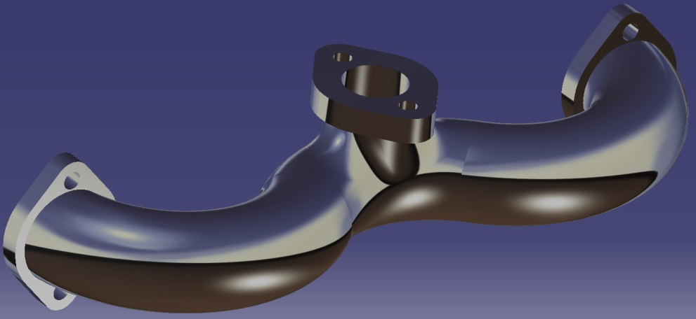
Render: Main Parts
Upper Crankcase
Cylinder T-block
Intake Manifold
Lower Crankcase

Slide 4
Render: Assembly
As we created the parts we would assemble them along the way.
This allowed us to recognize inconsistencies in part matching so we could fix them on the spot, instead of dealing with numerous errors in the end.

Slide 5
Render: Assembly Internal
Detailed view of the internal parts that we have made so far.
The valve assembly was the hardest to put together thus far.

Slide 6
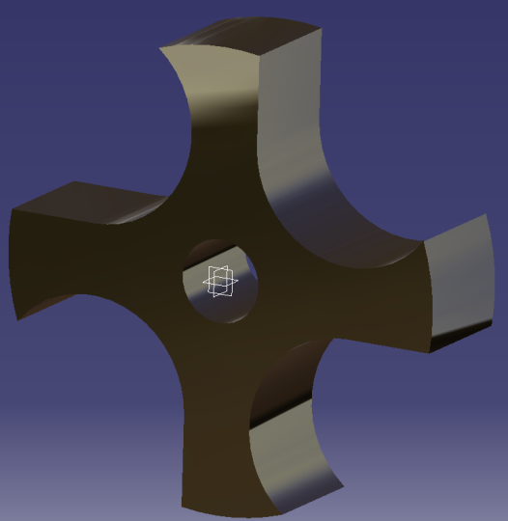
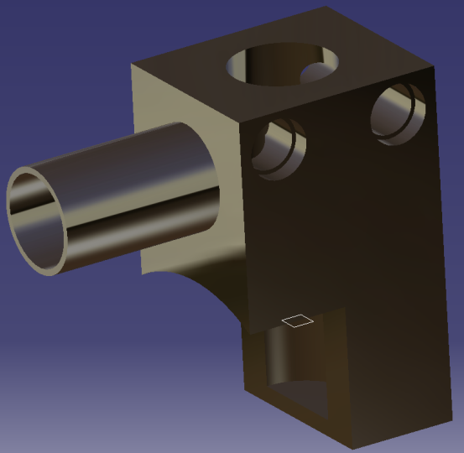
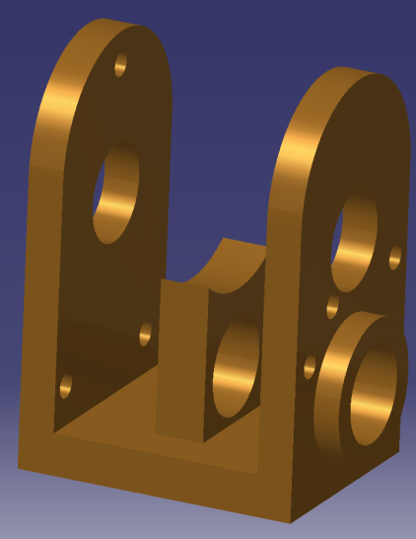
Items Remaining
Build and Assemble Carburetor
Finish Water Pump Parts and Assemble
Assemble Distributor and add it to Engine Assembly
Water Pump Impeller
Water Pump Part
Distributor Body

