Slide 1
RC-22 Twin-cylinder Engine
Andrew Roybal
David Pick
Ali Alfayez

Slide 2
Objective
Model and assemble the parts required to build a RC-22 Twin-cylinder Engine
All parts are given with dimensions in a drawing package.
Identify appropriate sub-assemblies.

Slide 3
Assembly and Part Renderings
Expanded Carburetor sub-assembly
Breaker box

Slide 4
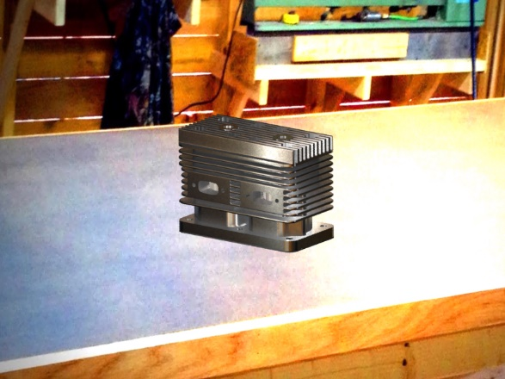
Cylinder and Cylinder Assembly

Slide 5
Crankshaft Assembly and the Reed Plate Holder Rendered

