Slide 1
Laser Cut Airfoil
Ryan Chapman
Jessica Drouin
Dan Mikkelson

Slide 2
Objective
Use Catia to design and model a GOE-447 type airfoil
Create laser cut scaled model of airfoil
Test lift and drag in wind tunnel

Slide 3
Catia Sketches

Slide 4
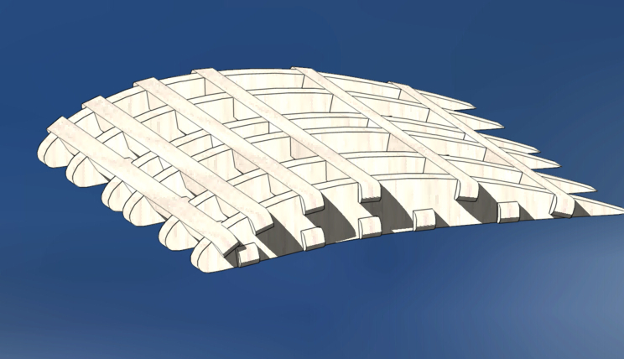
Catia Assembly

Slide 5
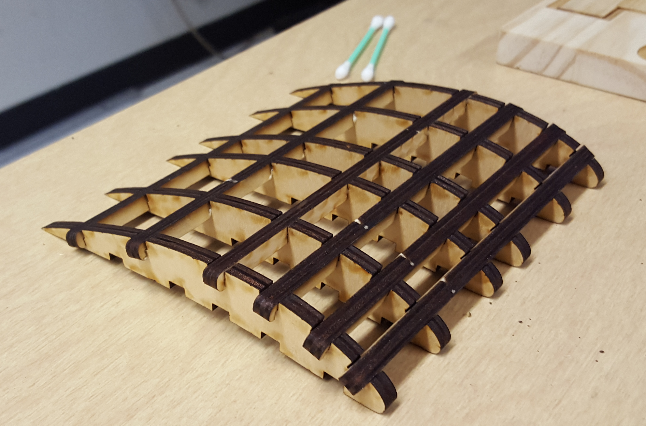
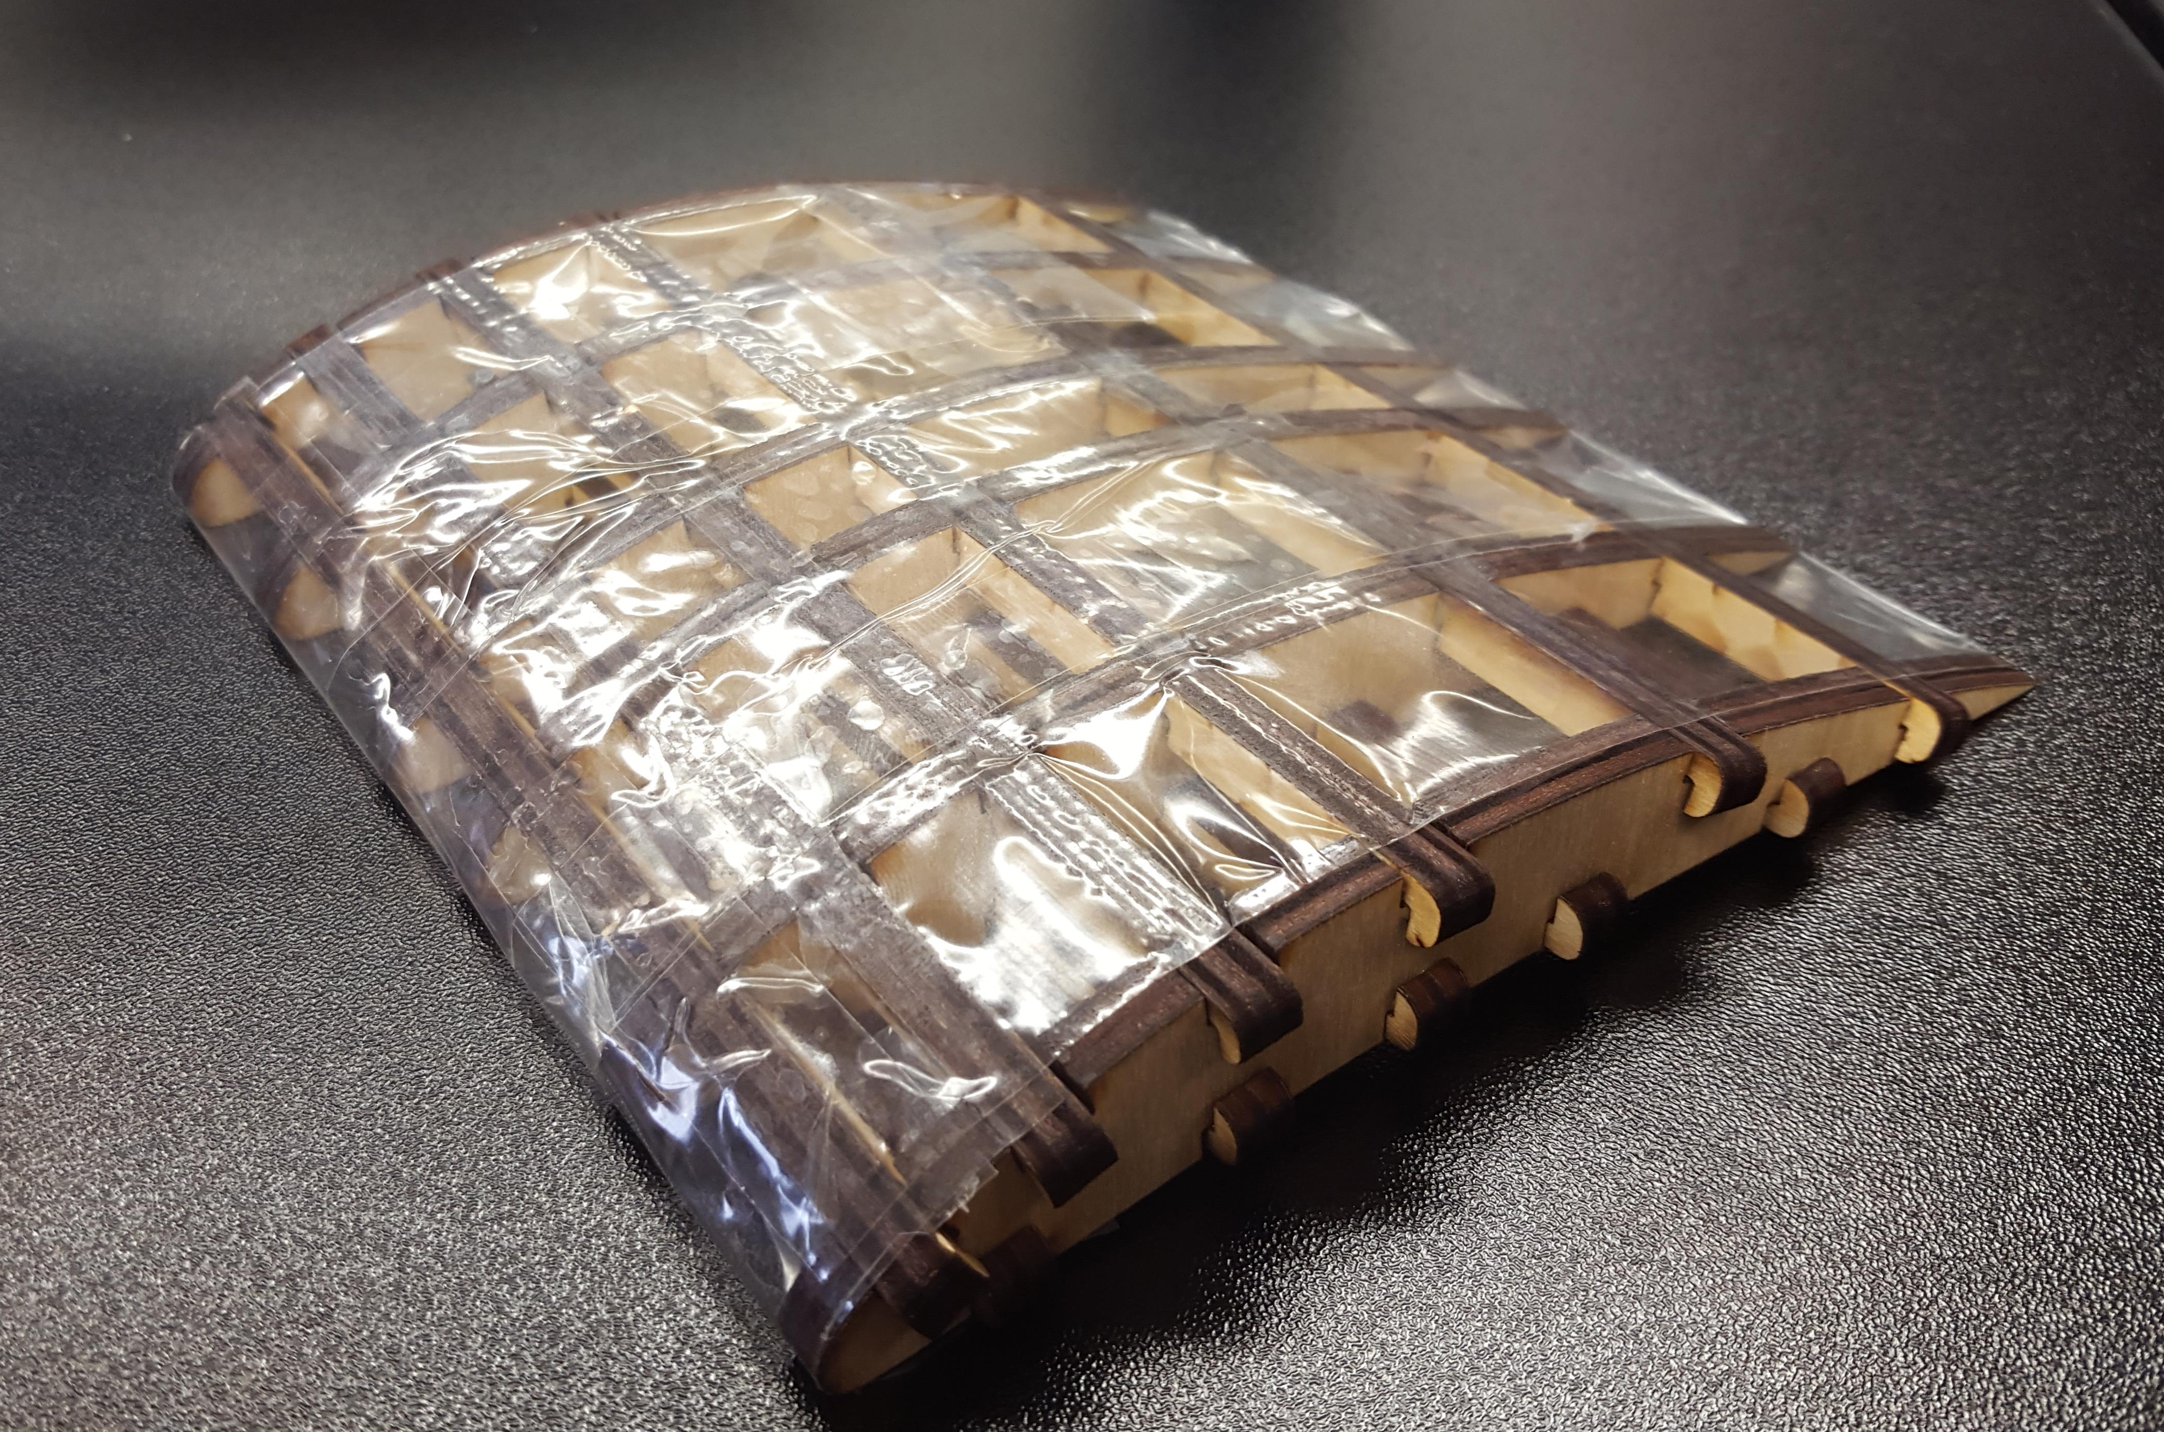
Laser Cut Airfoil
Left: Assembled airfoil after laser cut.
Below: Assembled airfoil wrapped with packing tape for skin.

Slide 6
Wind Tunnel Testing
Above: Results from wind tunnel testing. Constant velocity with variable angle of attack. Also, wanted to test lift, but sensor for lift was not working.

