Slide 1
Handheld 3D Scanner Tutorial
Abdullah Alobaysi, Jonathan Gomes, Nathan Pabst, Parker Matthews

Slide 2
Objective
ME Dept. recently acquired handheld 3D scanning device that few people know how to use
Create tutorial for anyone to use to gain rudimentary knowledge about handheld scanner and learn basics
PDF and video final deliverables to pass on to future scanner users

Slide 3
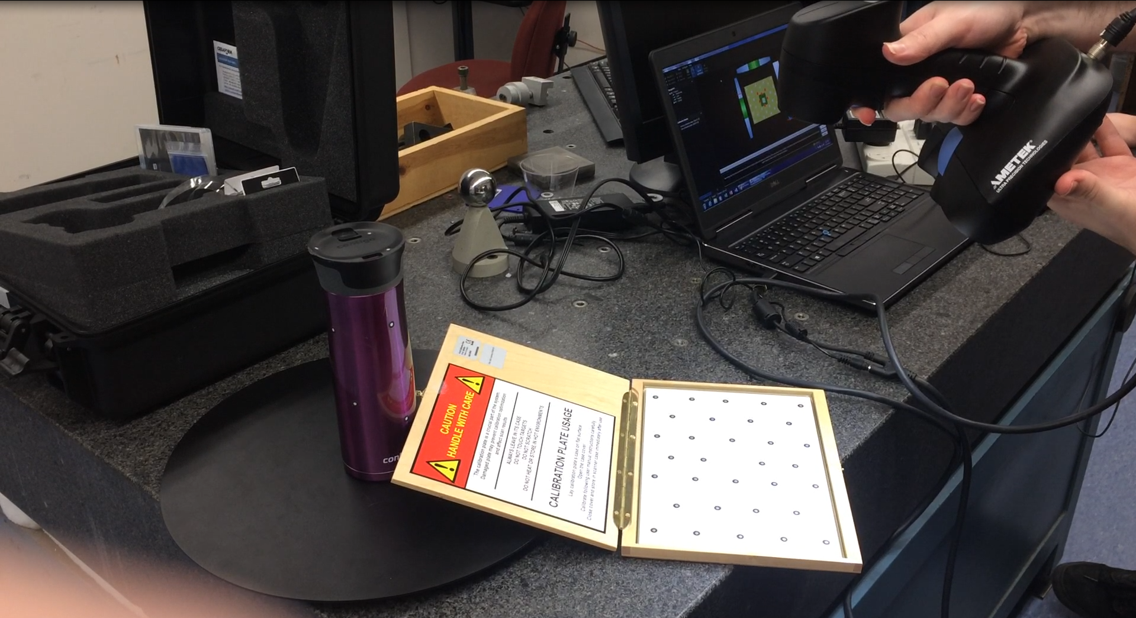
Calibration
Scanner has to be calibrated before each use

Slide 4
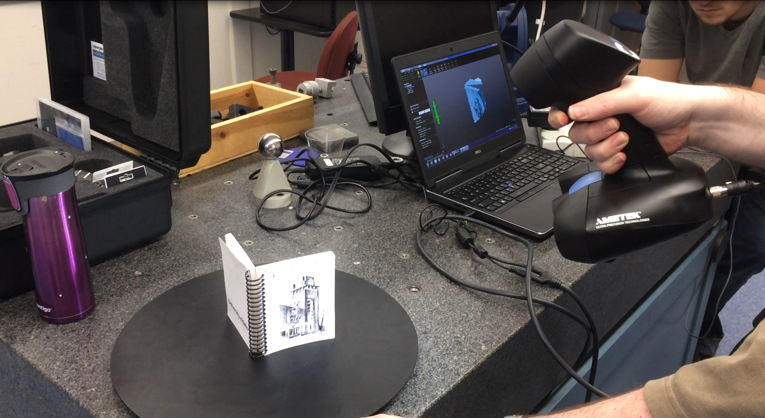
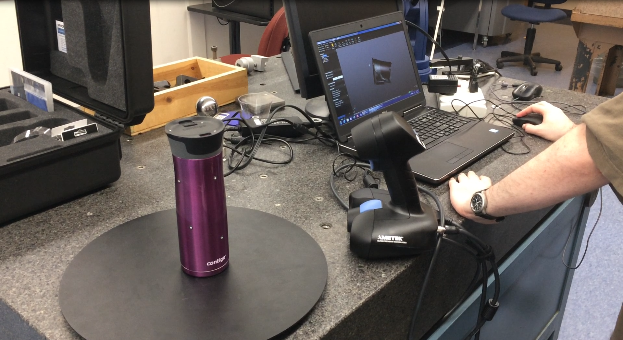
Scanning
Slow, steady scanning of object from all angles (keep 2 targets in sight always)

Slide 5
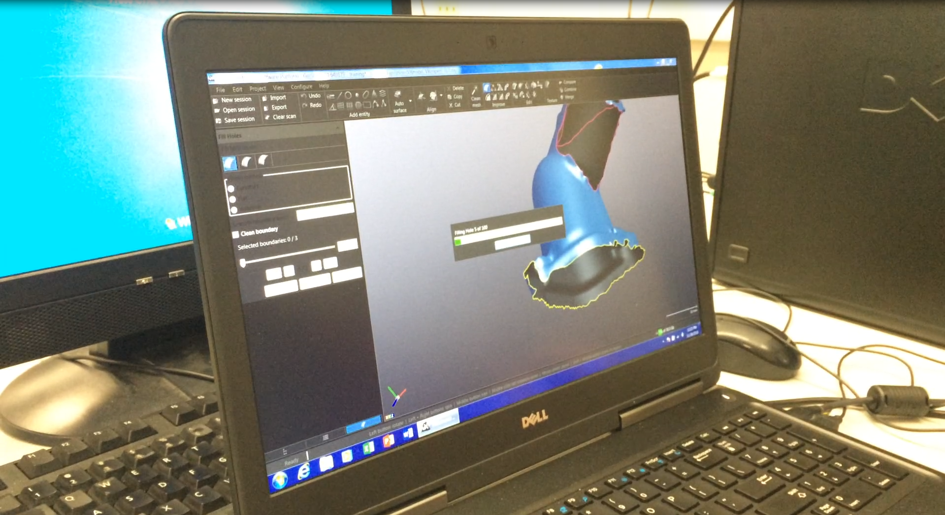
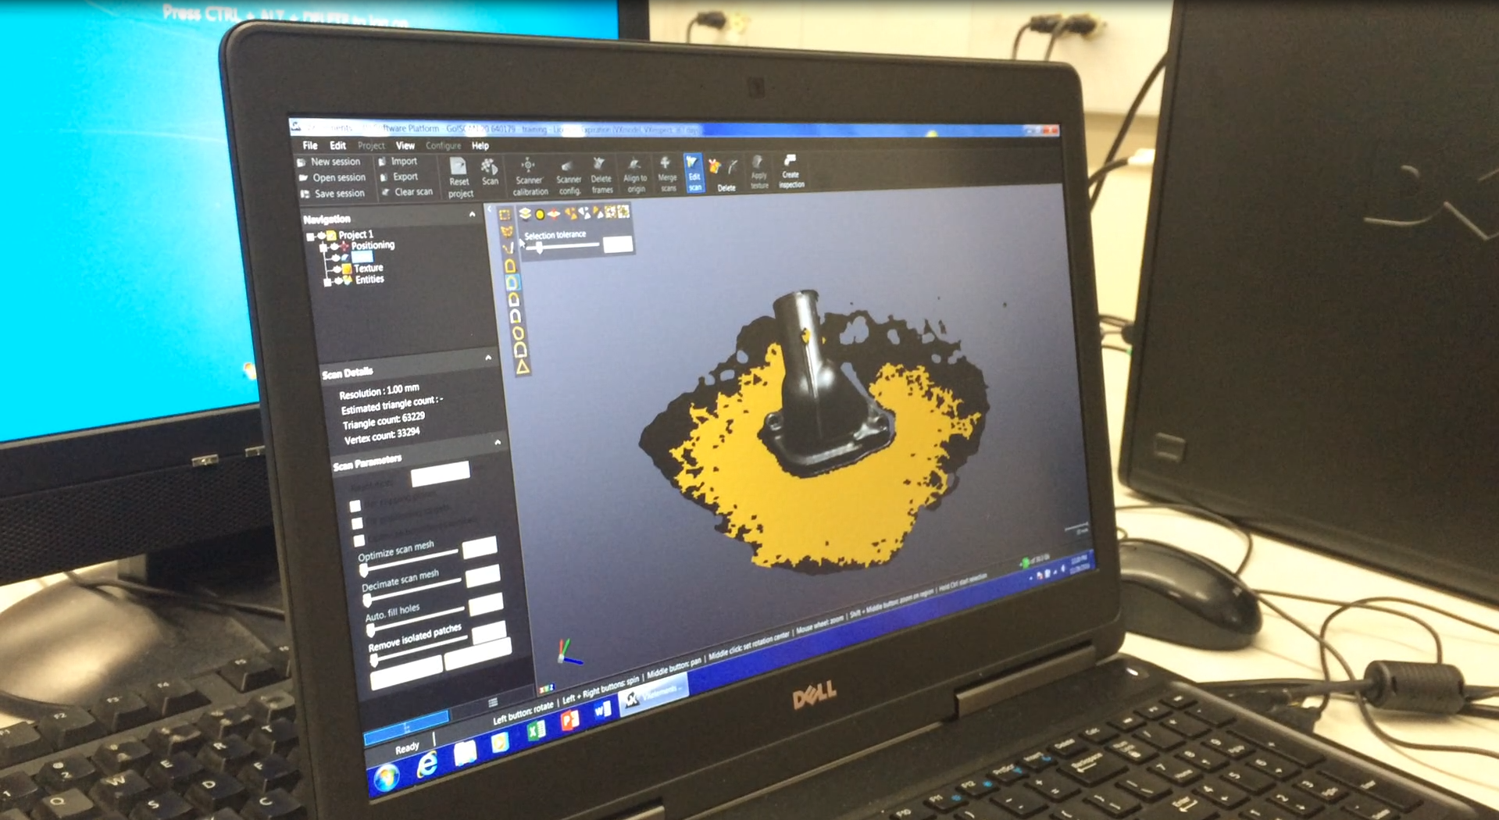
Filling/Trimming
Fill holes in model, delete isolated material

Slide 6
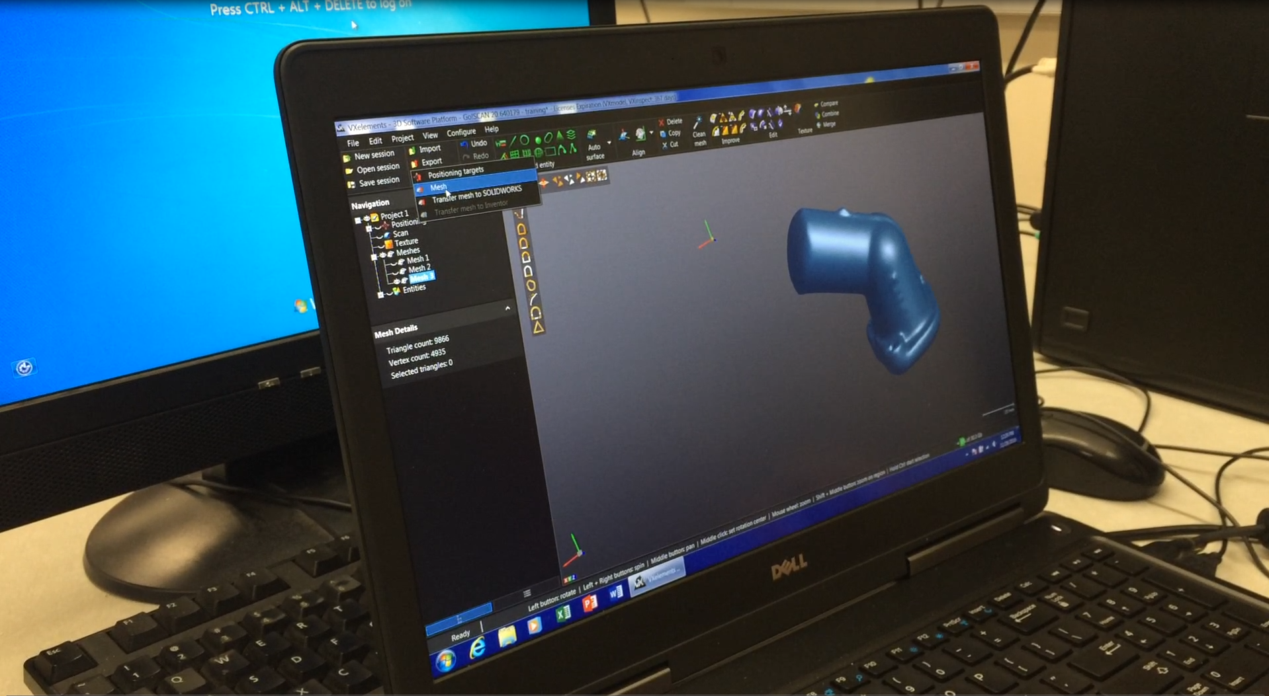
Export
Export as mesh, DO NOT export to SW!
Will fail if the model is not properly edited

Slide 7
Project Achievements
ME Dept. will be able to more effectively train students in the use of the handheld 3D scanning device.
Students will be able to reference a more complete database of knowledge, as well as short demonstration videos, on the use of the handheld 3D scanning device, and creating digital models that can be imported into software such as Solidworks and Catia.

