Slide 1
Cassani Tractor Transmission William Overstreet Collin Mabe

Slide 2
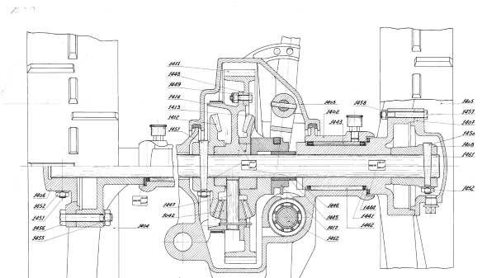
Problem Statement
The Introduction to Computer Aided Design class does a final project every semester from old drawings. Finding good complete drawings that are functional can be a challenge. We didn’t know if this particular drawing package was complete or if the pieces fit together. Judging the overall difficulty of part creation was of interest as well.

Slide 3
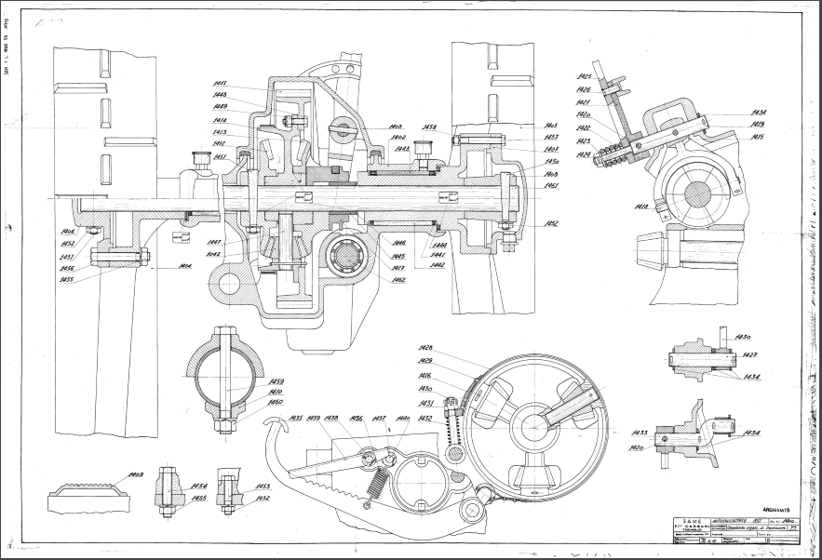
Full Assembly Drawing

Slide 4
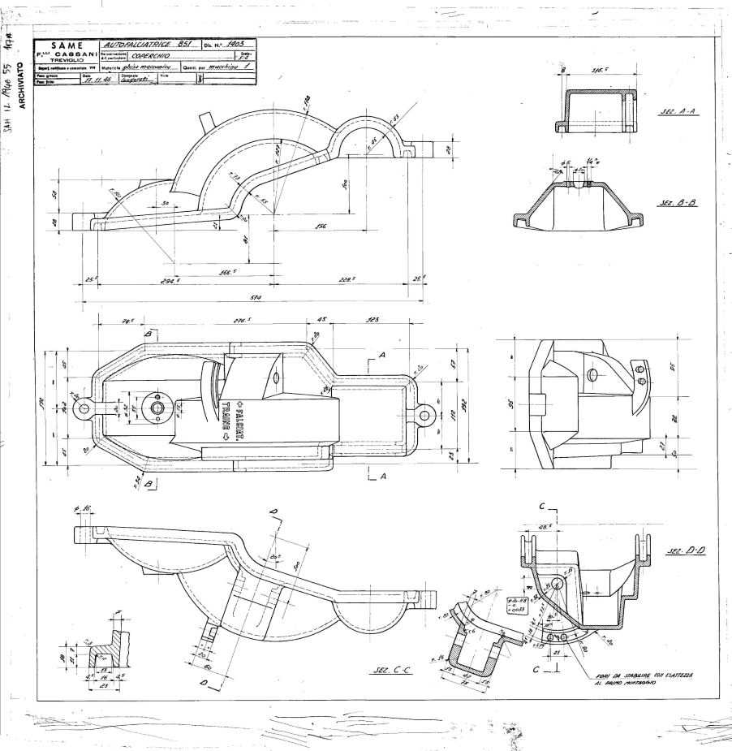
Part highlight I (Part 1403)
Issues and Assumptions:
This part could be a project by itself basically.
Started by revolving 3 circular shapes using the section views provided in the drawing.
Then used extrude cuts to make cuts in the correct places.
We could have spent hours and hours on this part trying to make it more accurate but decided that we just needed it to fit over the other parts and do what it was supposed to so it isn’t quite correct.

Slide 5
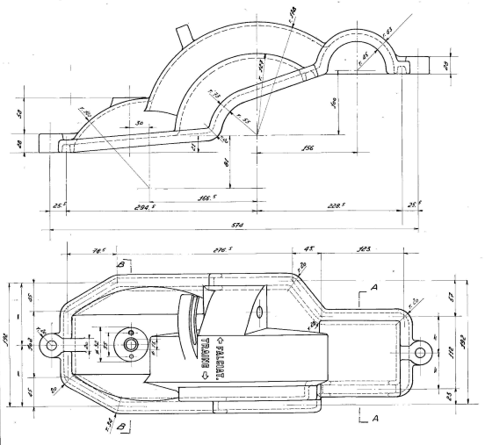
Part highlight I (Part 1403)

Slide 6
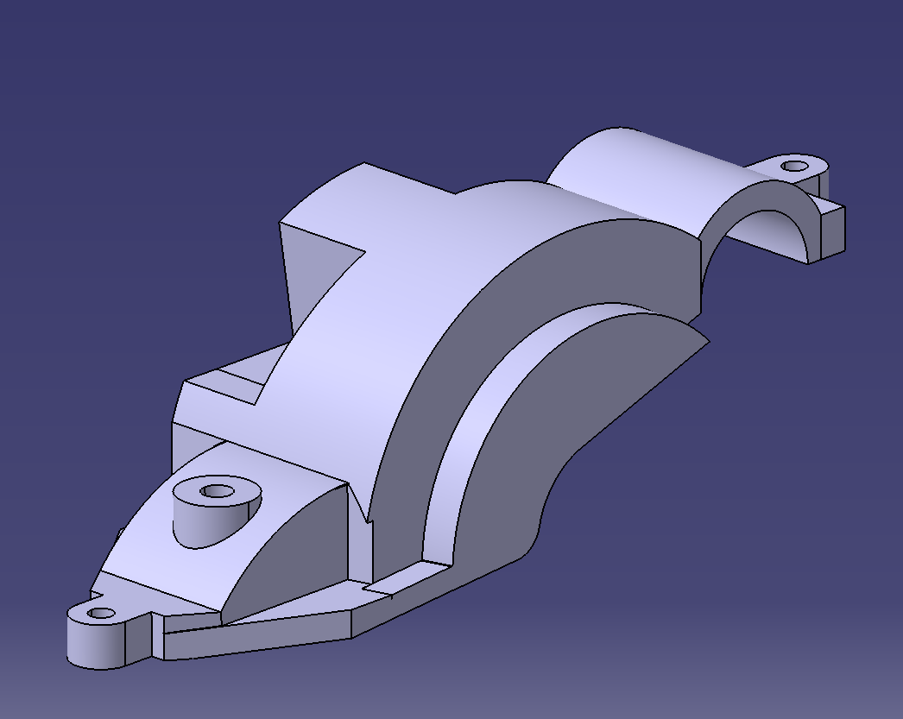
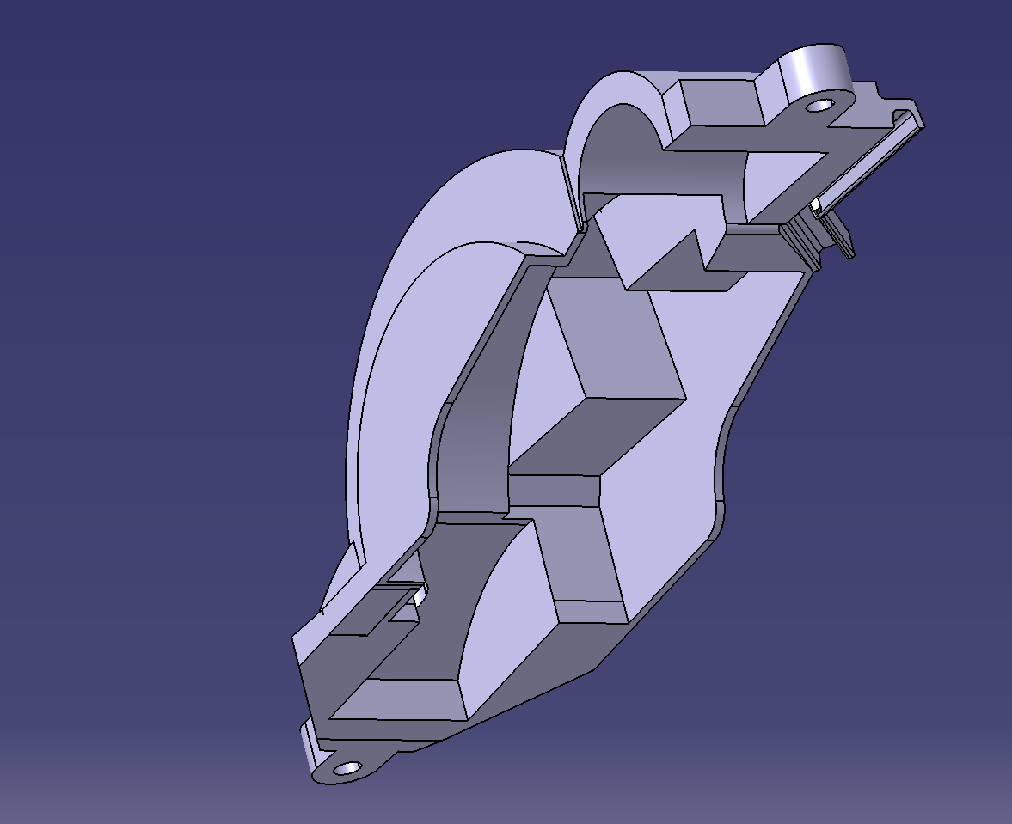
Part highlight I (Part 1403)
Issues and Assumptions:
We simplified this part significantly so that it would serve its purpose for the model and the other pieces would fit in and around it.
We left off the trim that goes all the way around because it was taking so long to do. The Rib feature also didn’t work as planned and each part of the profile would have had to be done separately.
Using shell to create the inside did not work as planned. The inside had to be cut out using a series of Pockets drawn on planes inside the material.

Slide 7
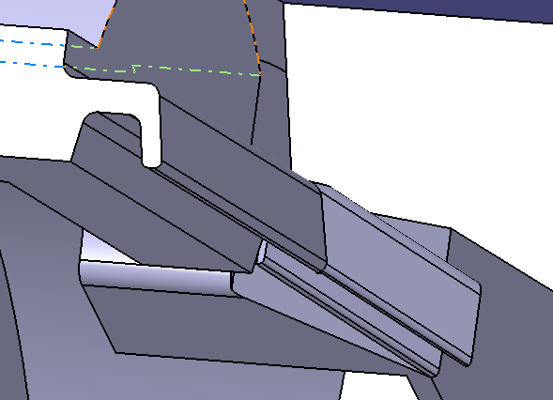
Part highlight I (Part 1403)
Issues and Assumptions:
Though the profile around the edges doesn’t go all the way around in the model. It can be shown it is possible here on the back side. Though, this proves to be difficult and very time consuming.
It was especially difficult to line up the edges of the profiles at different angles. Here you can see the corner doesn’t quite match up.
Though a small feature, it would be our recommendation that this profile on this particular part be ignored if used for a ME 301 Project.

Slide 8
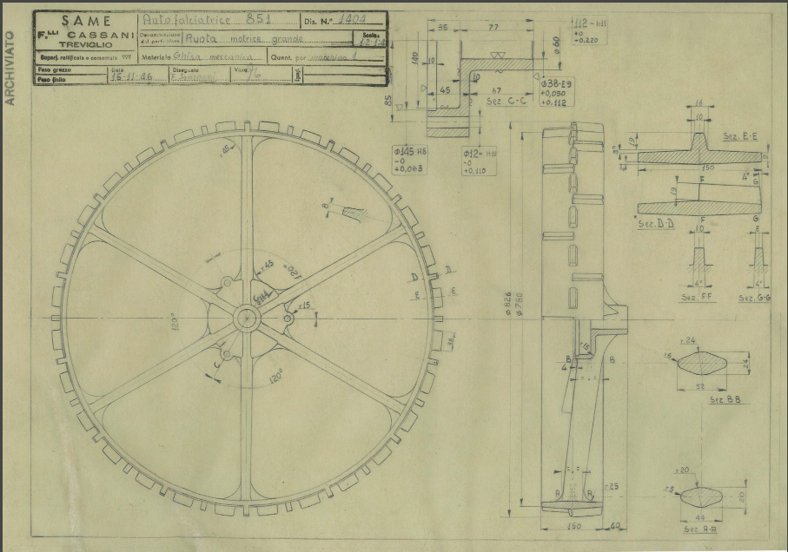
Part Highlight II (Part 1404)
Issues and Assumptions:
The spokes are a very complex shape, starting much wider near the axle and narrow towards the outer wheel.
Circular patterns make the tread much easier to create.
The spokes also slant outward away from the inside on each wheel. Creating a spine for the multi-sectioned solid was essential to making this realistic.

Slide 9
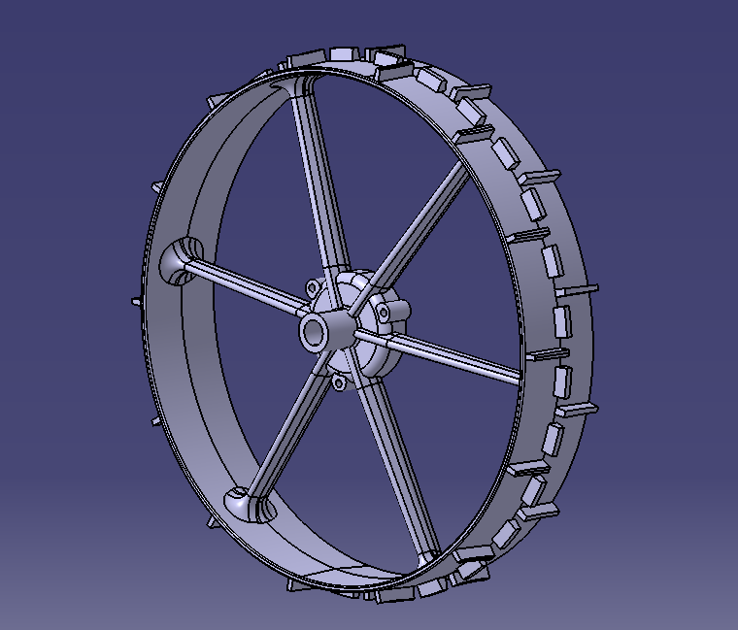
Part Highlight II (Part 1404)
Issues and Assumptions:
Start by creating a revolve of the center
Use Multi-section solid to create the complex geometry of the first spoke, then use a circular patter to make the rest of them
Circular patter the tread on the wheel.
Make sure to correctly define the spine of the spoke. It is a

Slide 10
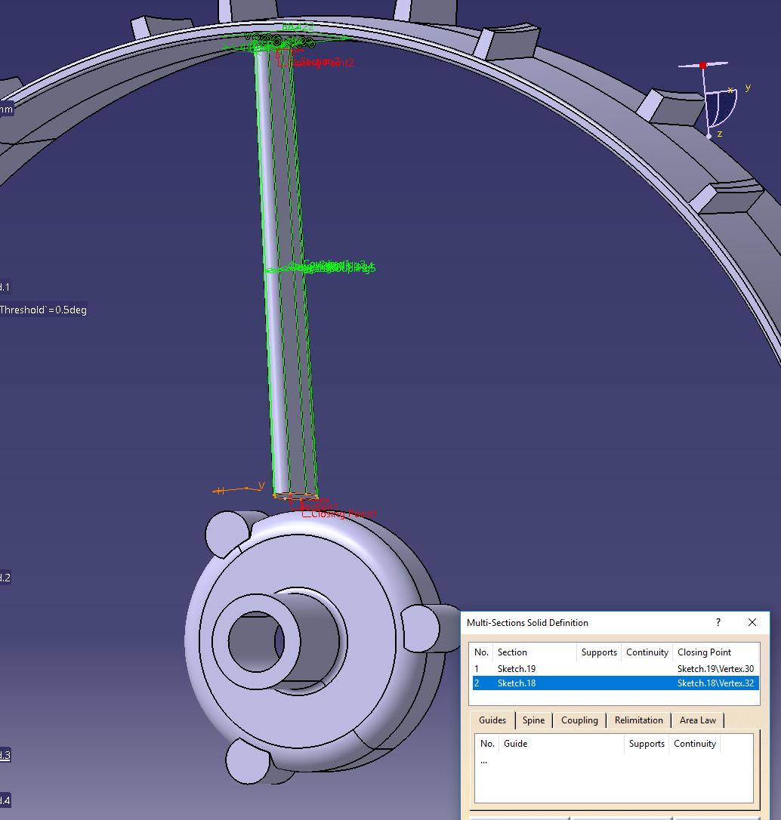

Slide 11
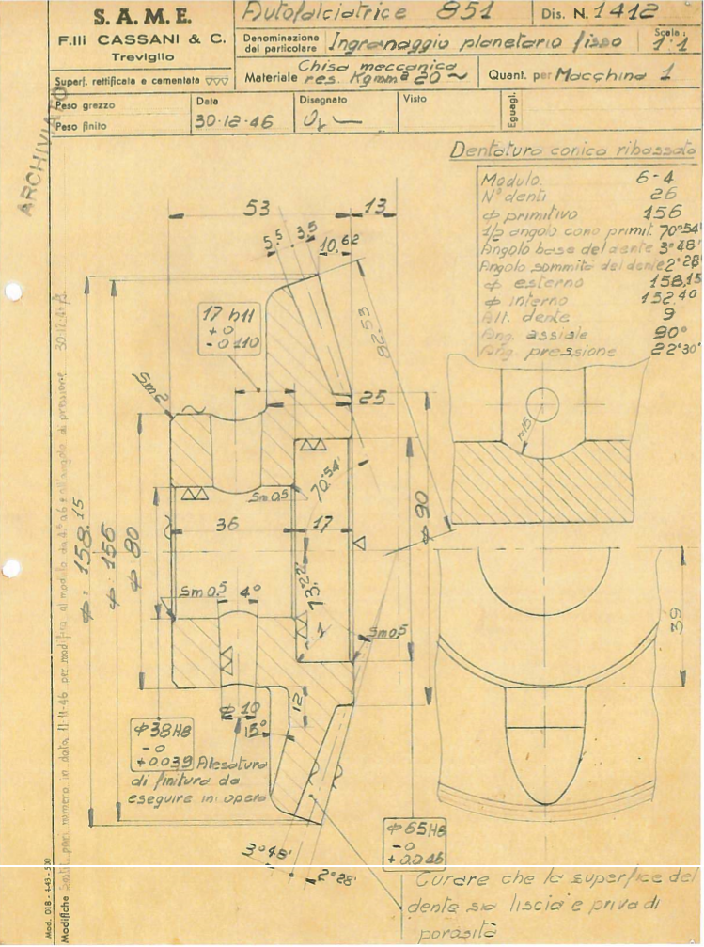
Part Highlight III (Part 1412)
Issues and Assumptions:
This Drawing (like most of the others) is dark and fairly hard to read. This makes a complex figure even more difficult to understand.
This part works as a gear in conjunction with part 1413
Made by using a revolve and then a circular pattern
Impossible to tell from drawings how many of the little cut-outs there are. Shown in the right bottom of the drawing.

Slide 12
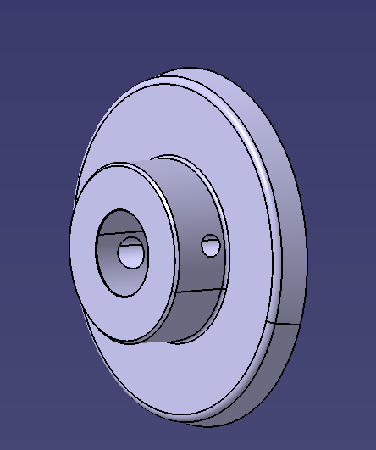
Part Highlight III (Part 1412)
Issues and Assumptions:
We ended up leaving out the cut-outs on the front of this partially because we didn’t know how many there were. Also, because we figured it would be easier to put it together first and then decide how it might fit together best.

Slide 13
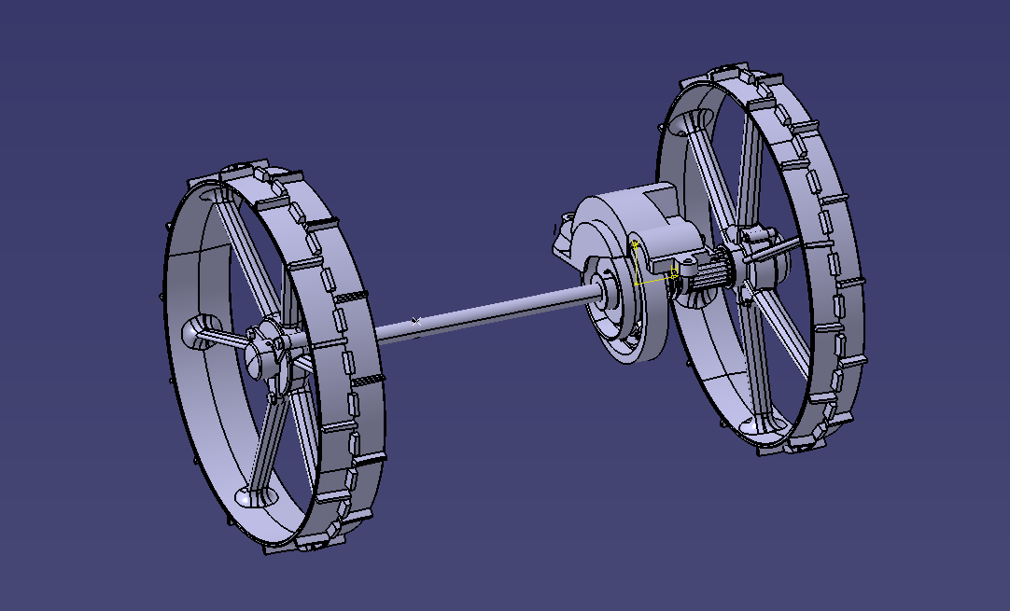
Full Assembly
Issues and Assumptions:
The spokes are a very complex shape, starting much wider near the axle and narrow towards the outer wheel.
Circular patterns make the tread much easier to create.
The spokes also slant outward away from the inside on each wheel. Creating a spine for the multi-sectioned solid was essential to making this realistic.
In the drawing package, there is actually 3 different assemblies. We didn’t end up figuring out what they all went to and just decided to focus on the main transition assembly instead. It would be important to inform students of this before a project as it can be very confusing.

Slide 14
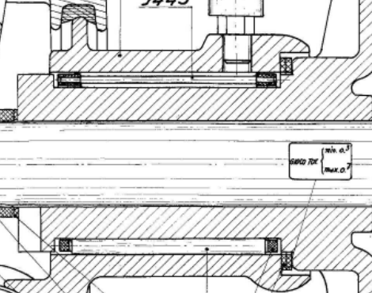
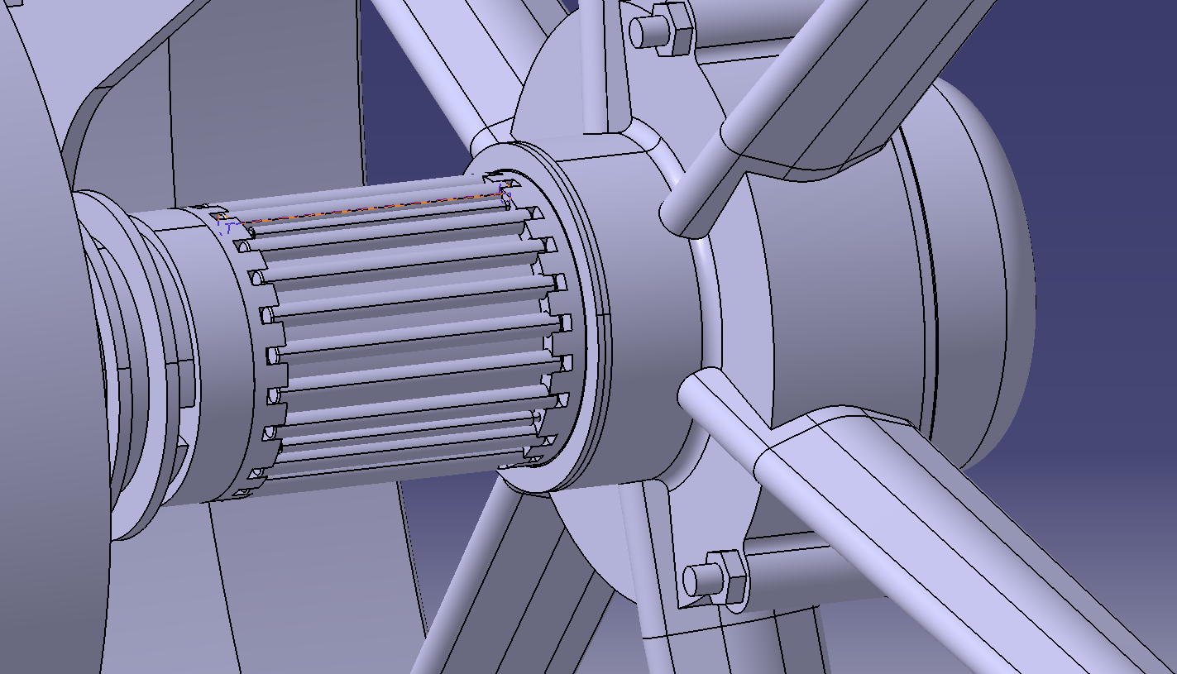
Full Assembly
Part 1443
Issues and Assumptions:
Since there was only one assembly drawing that only had a few views, it was difficult for us to figure out what was really meant to be going on in this system.
A good example of this is shown. In the drawing package, this is how it shows the assembly of part 1443.
Since there is only two of these shown, an assumption how many of them there are and how they will fit together had to be made.
There were multiple instances like this one where we basically had to just make something work because of a lack of informantion.

Slide 15
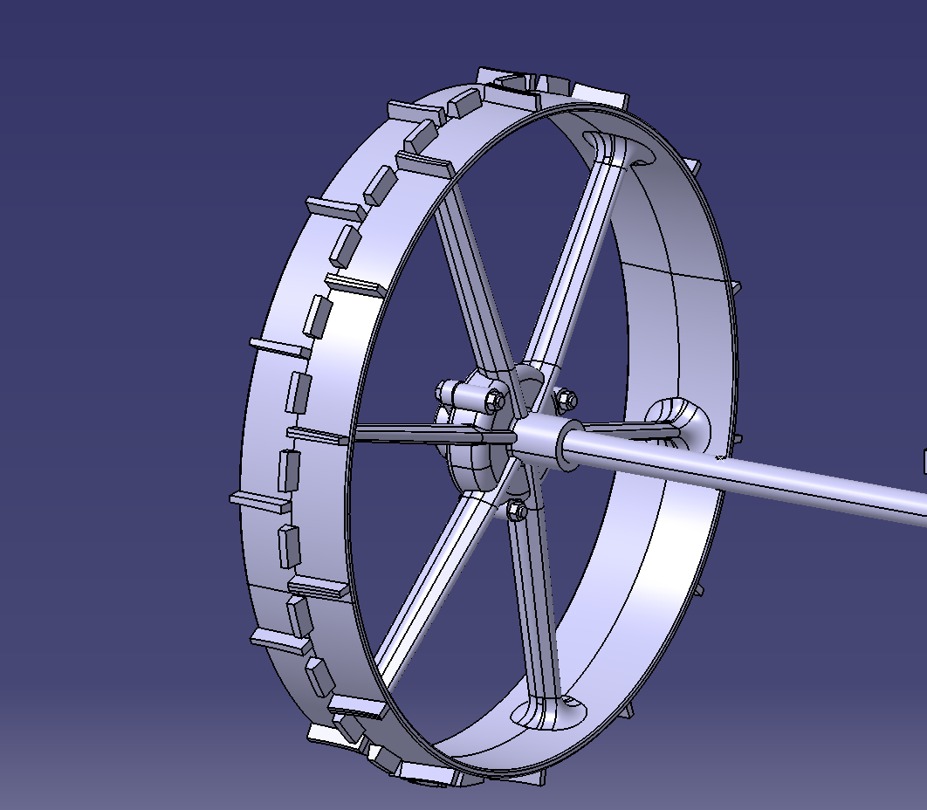
Full Assembly

