Slide 1
Surfacing Projects (Shelby GT500 - 1967)
By:
Faisal AlGudairi
Mshari AlDossary
Fawaz AlHarbi

Slide 2
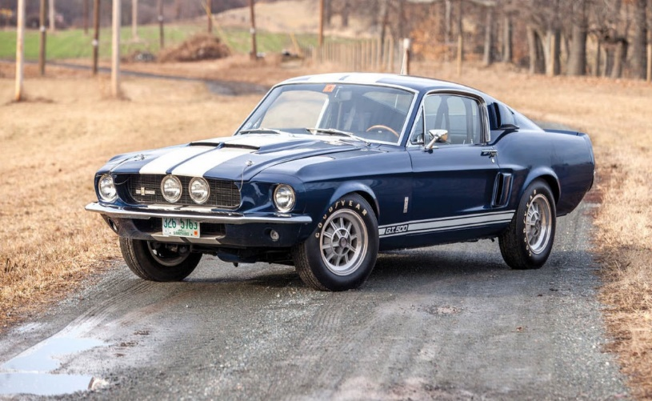
Shelby GT500 - 1967

Slide 3
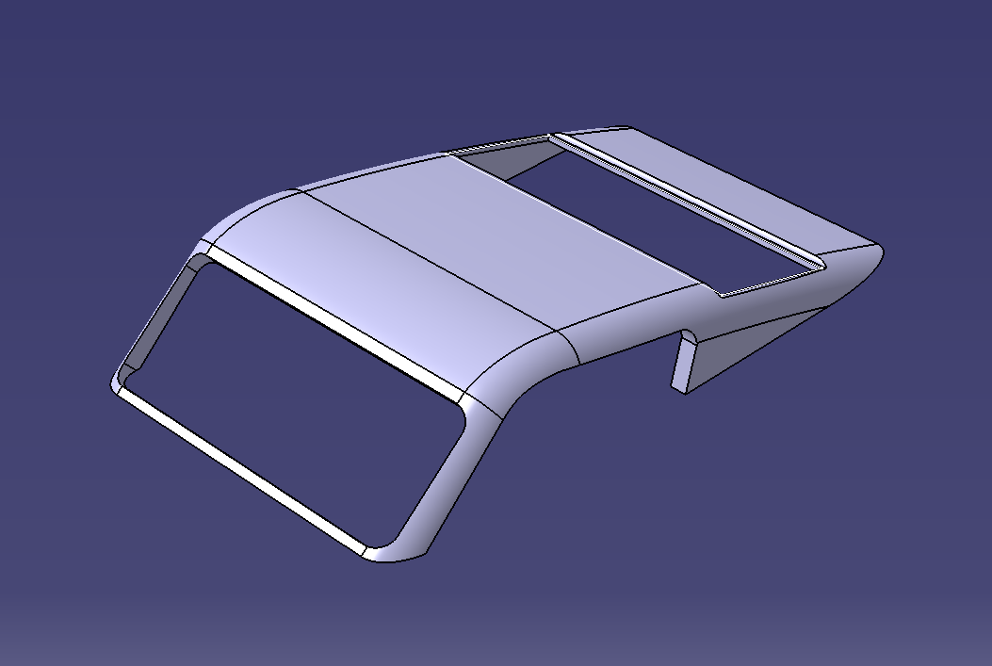
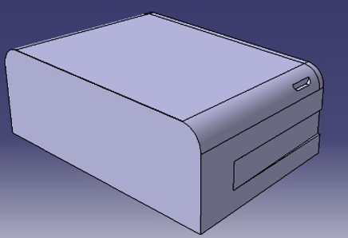
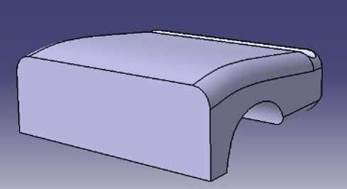
Car body
By designing the front part I learned how to remove material from the body and of the edges.
The roof of the car created using shell function and fillet function to smooth the edges.
The back side of the car. Hole function was used to create the space for wheels

Slide 4
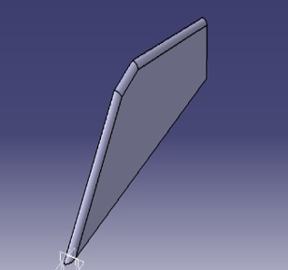
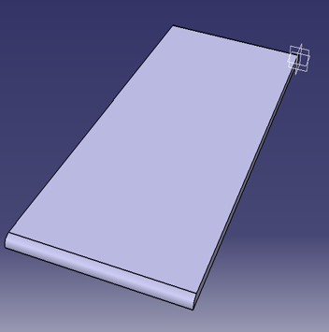
Hood, Front & side Glasses
The Hood part was a tricky one. By using angular sketching tools we achieved the slides on the hood.
It was easy to create the glasses by using simple sketch and pad function.

Slide 5
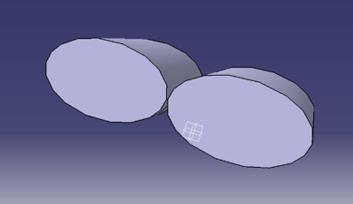
Rim & Exhaust
Rim was a difficult part to create. Especially the holes and then the curves.
By using the pad function and the sketch we created the Exhaust.

Slide 6
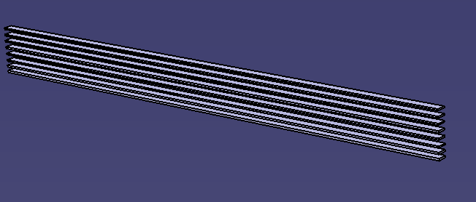
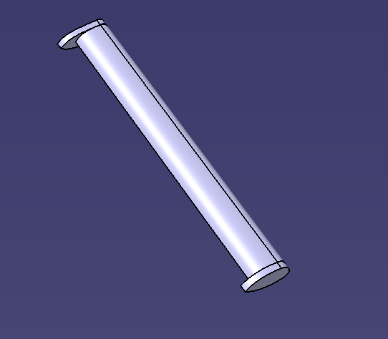
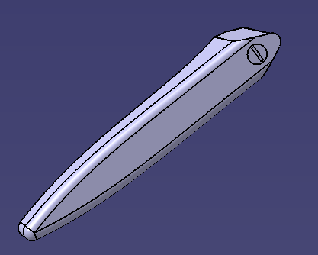
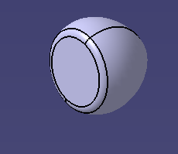
Some other parts
By designing the Grid it helped me to learn how to mirror same model multiple times.
The frame designed to cover the lights. This part was an easy task to do.
This is the side stripe of the model created using number models
The wing designed for the back side of the car. It was an easy part to design. I learned the extrusion of the specific model.
This is the car’s door knob
Lights designed using pad function based on specific dimensions. I learned how to create 3D model part.

Slide 7
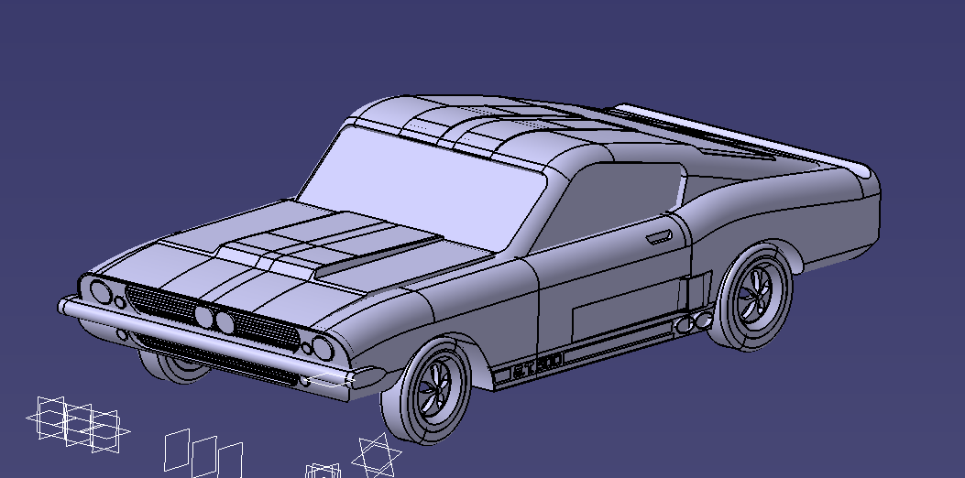
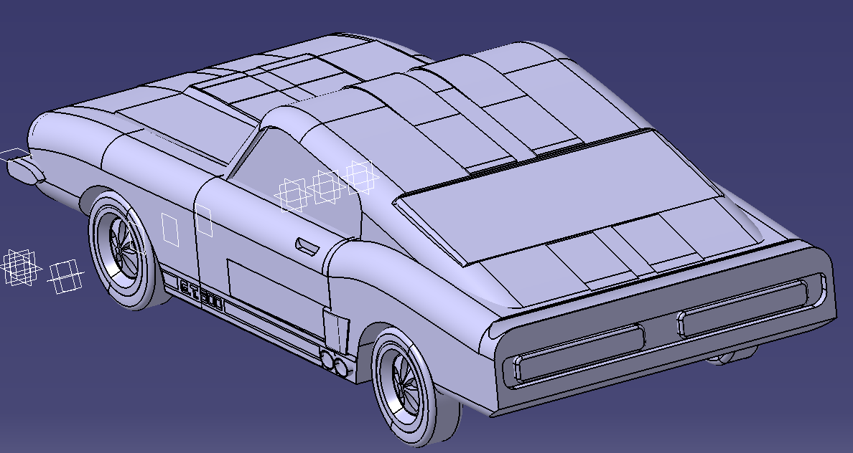
Final Surface

