Slide 1
2017 Ski-Doo MX-Z Surface Modeling
Jared Kellerer, Levi Vogel

Slide 2
Project Definition
Create accurate surface models of the CSC Snowmobile’s front body panels
Allow future CFD simulations
Enable team to create decals
Process development for creating surface models from 3D scans

Slide 3
Process
Import STL scan file into CATIA Product and enter the Generative Shape Design Workbench
Define points and reference geometry from mesh
CATIA recognizes connections between the triangular facets of the 3D scan as points in space
Use line, spline etc. tools to define the surface boundaries
Use applicable surfacing tools, Fill Surface is especially useful

Slide 4
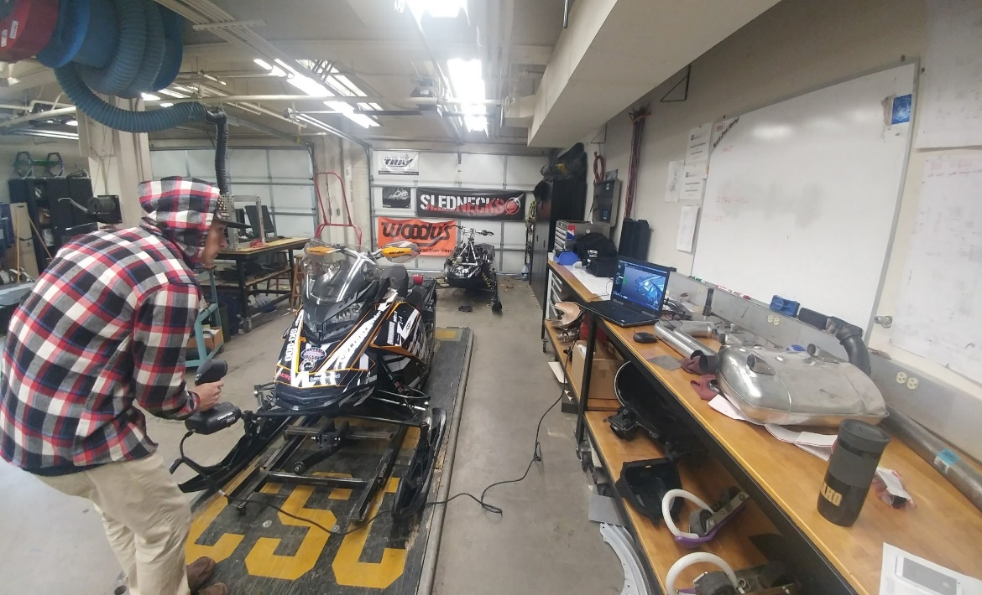
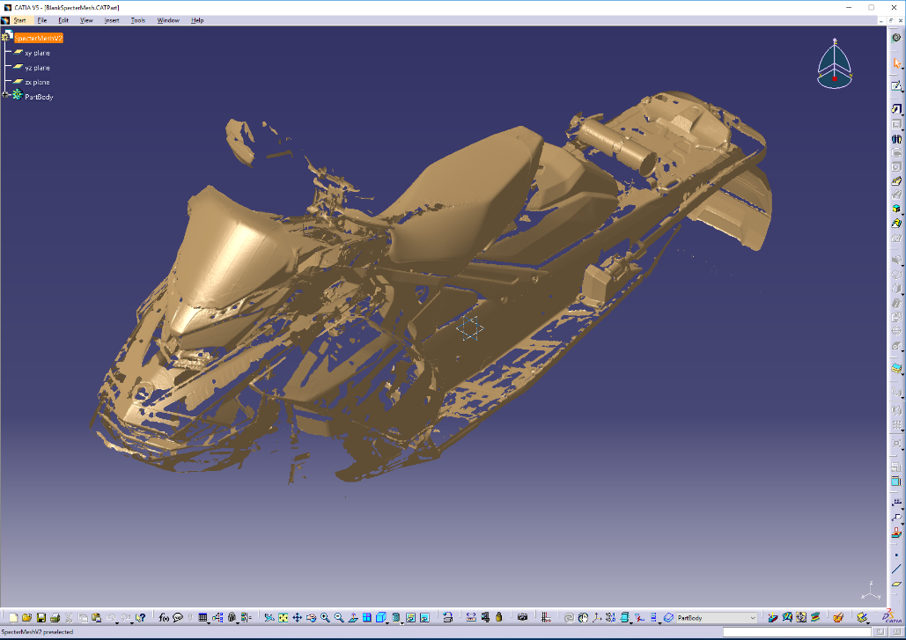
3D Scanning
Capturing 3 dimensional reference geometry using a Creaform handheld scanner
Imported into CATIA as an STL mesh file

Slide 5
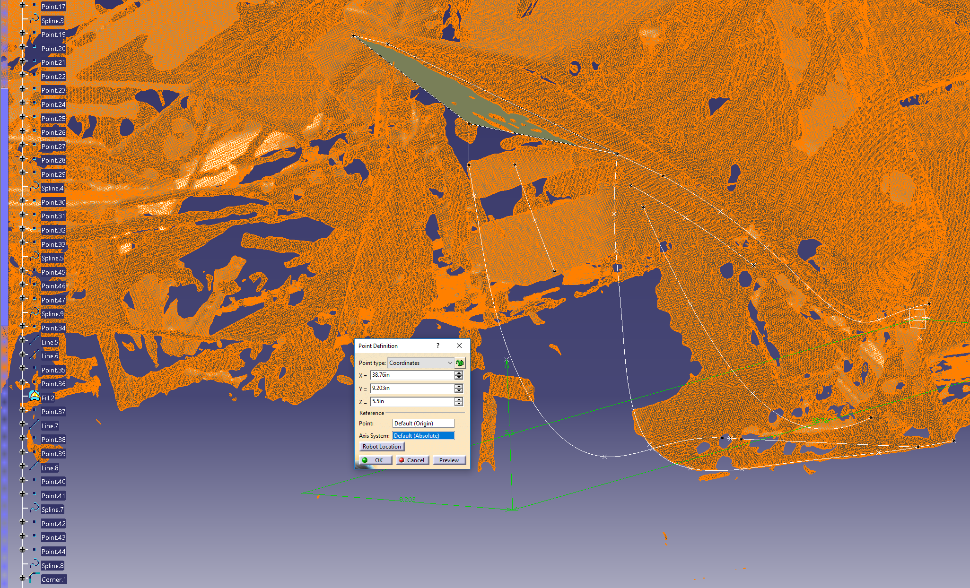
Point Definition
Defining reference points to create surface models.
Applying points to the 3D mesh as well as utilizing 3D coordinate definition

Slide 6
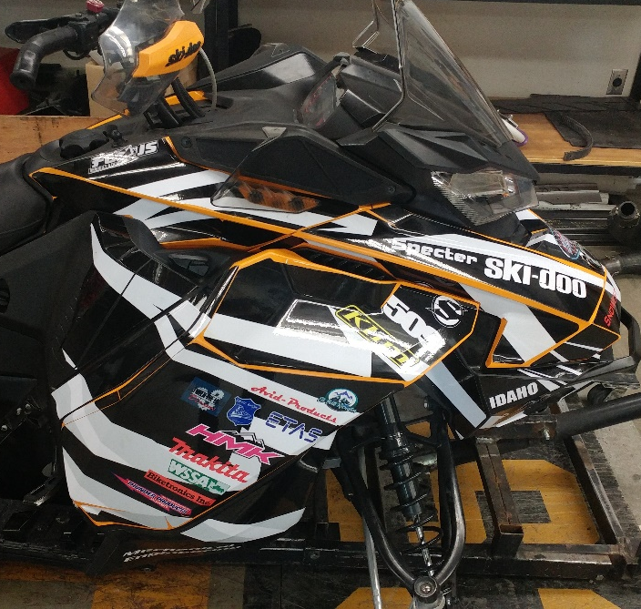
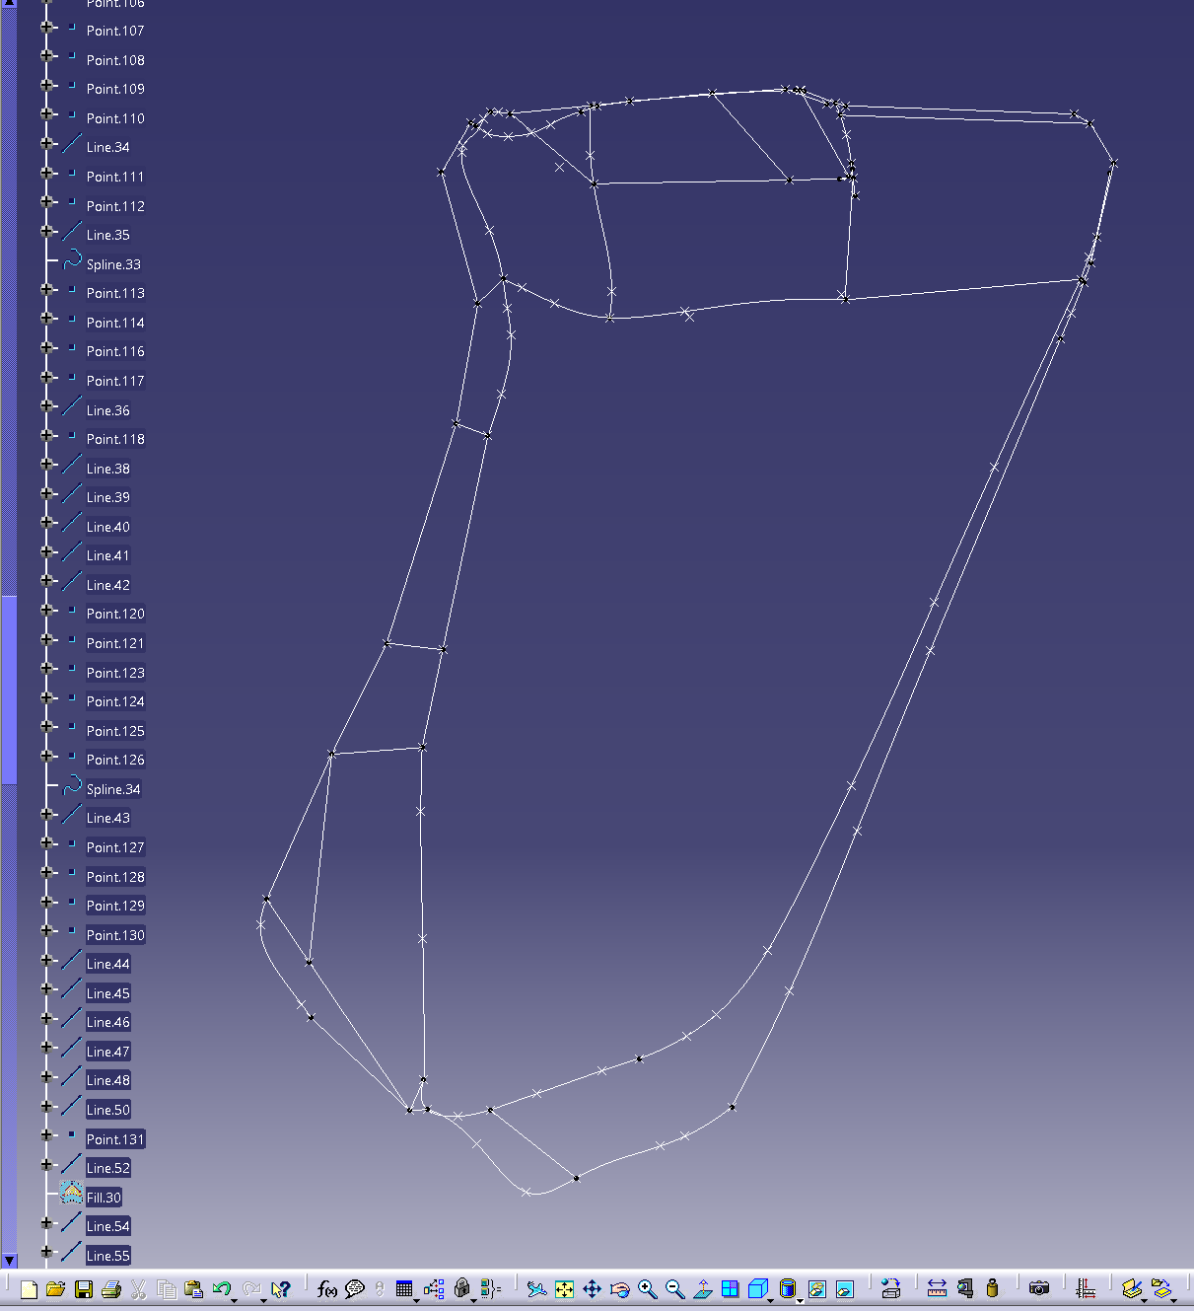
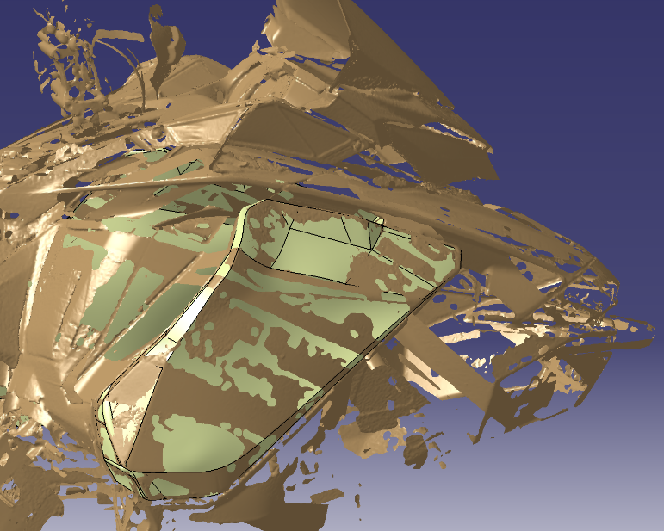
Geometry Extrapolation
Using Scanned Geometry
A 3D sketch can be created to outline the surfaces to be modeled

Slide 7
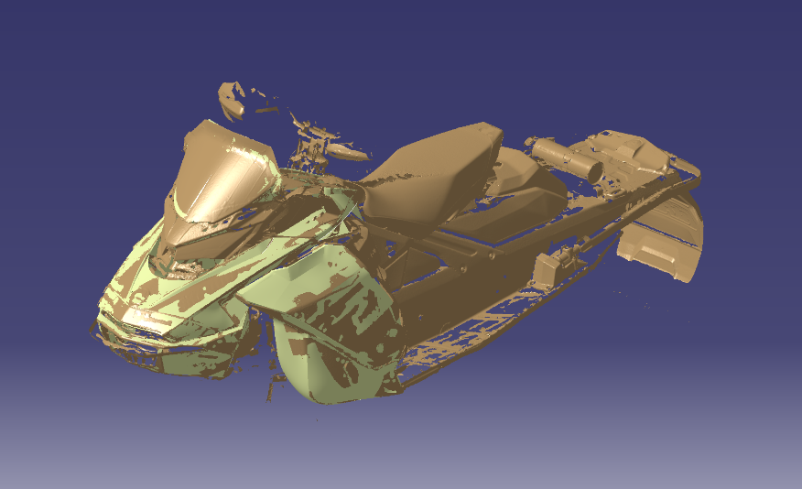
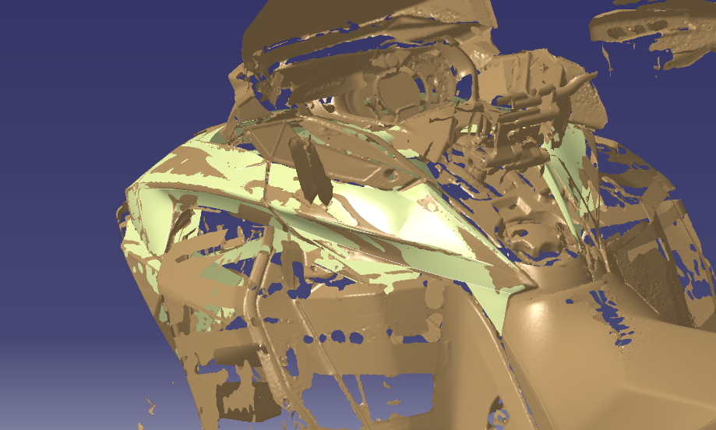
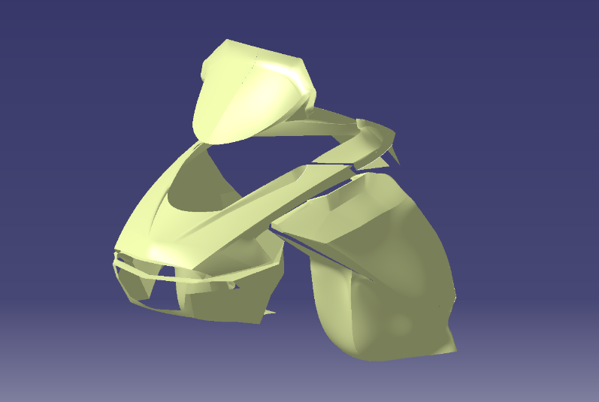
Pictures

