Slide 1
Testing the effects of support selection and mesh size on analysis.
Analysis of FEA Supports and Mesh
Geoffrey Wood
Atticus Zborowski

Slide 2
Choosing the wrong support can significantly change the analysis results

Slide 3
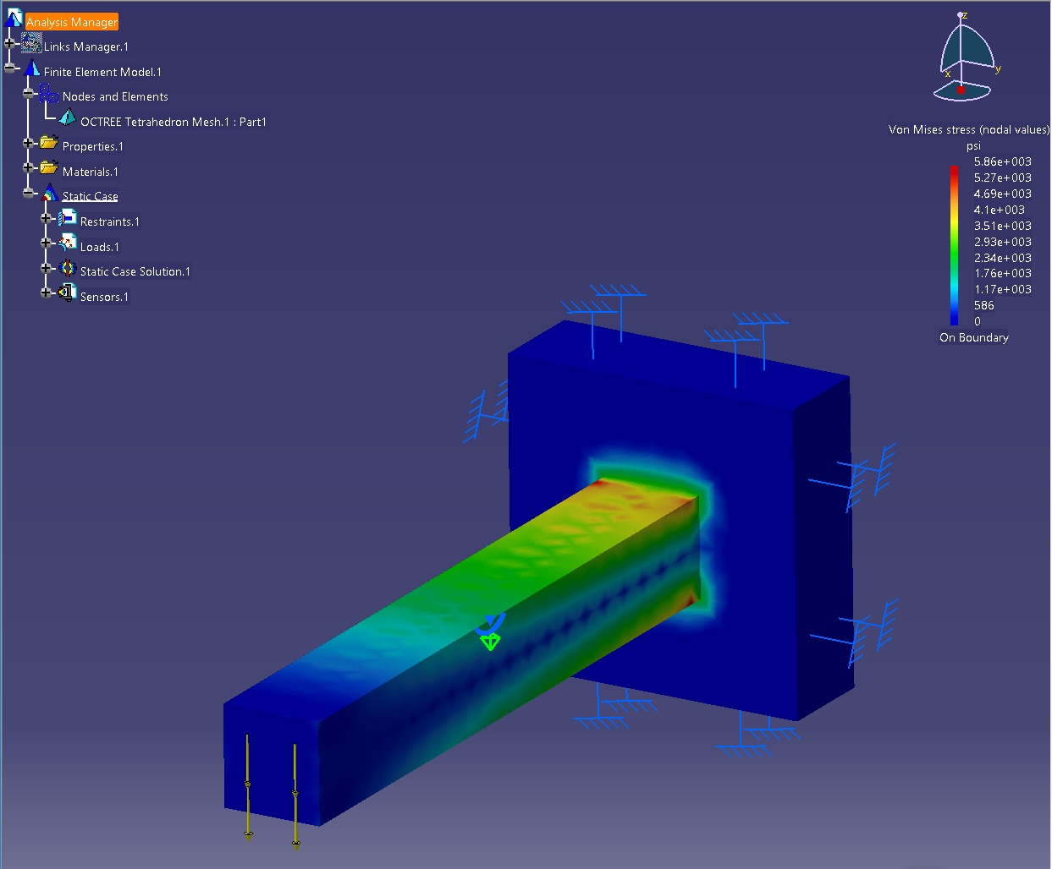
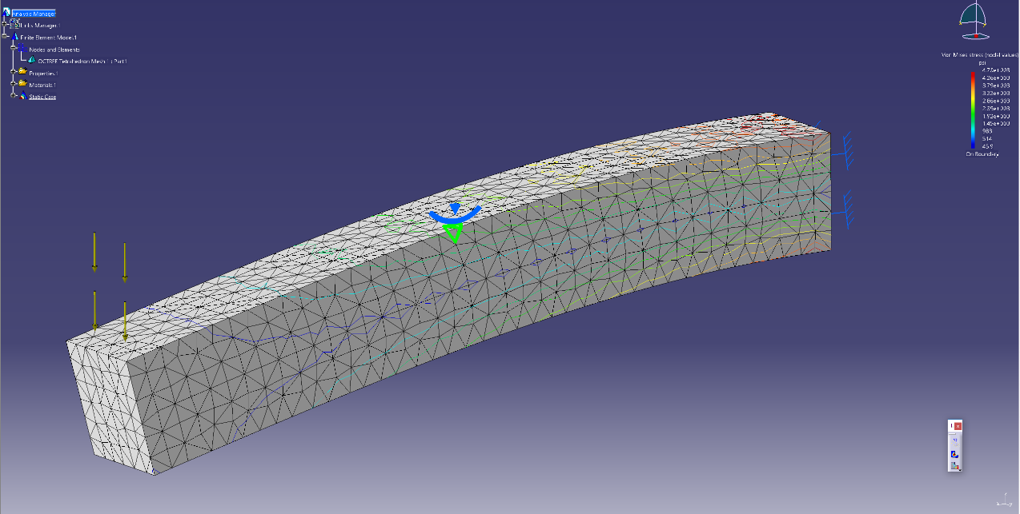
We created a test case to explore methods of constraining a beam
TEST CASE:
3x3x20-in bar
0.5-in mesh size
0.2-in sag
-1,200 lb_{f} in the ‘Z’ direction

Slide 4
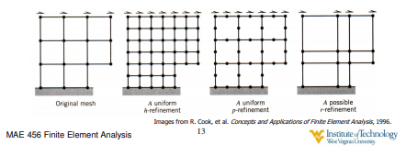
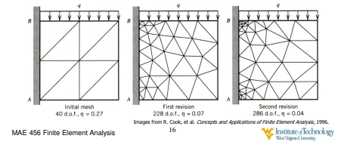
Smaller mesh sizes are better. Or are they…?
Smaller mesh size generally fits to the part geometry better, unless the part is not easily divisible by the mesh size.
We will investigate the effects of changing mesh size of a cantilever beam, measuring error from a hand calculation, and hoping to discover a converging solution.

Slide 5
DISCOVERIES:
Choosing incorrect supports can significantly change analysis results
If a part is changed, even in insignificant ways, the analysis will change because the mesh was generated differently
CATIA has an error that varies with the size of the mesh, but precision depends on how closely the mesh geometry matches the actual geometry. Smaller mesh is generally better, but not always.

