Slide 1
FEA Comparisons
Jake & Jake (Jake Elliott & Jake Jermyn)

Slide 2
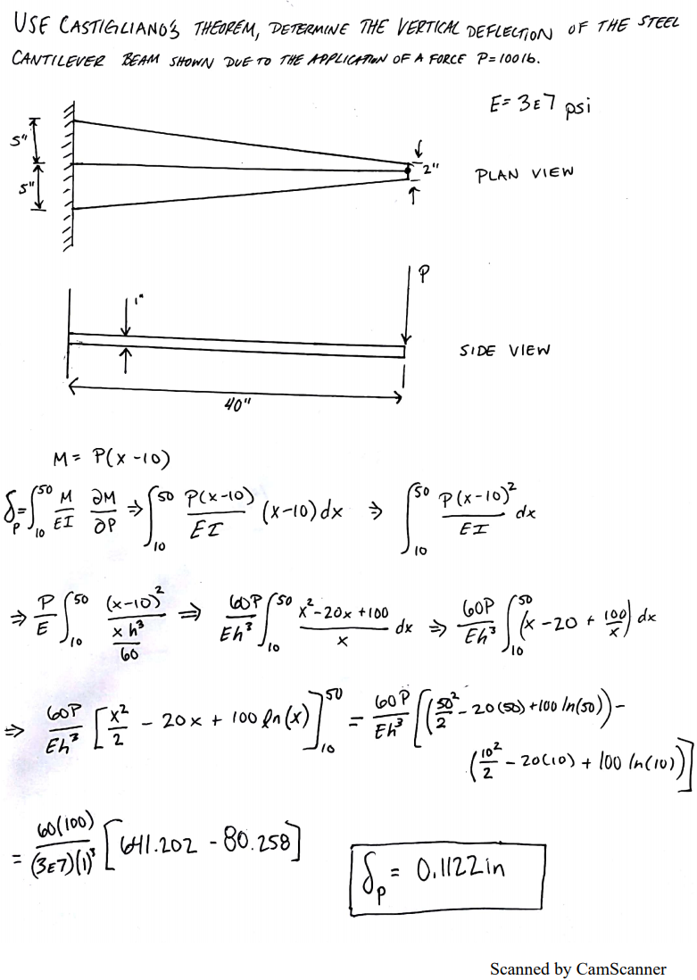
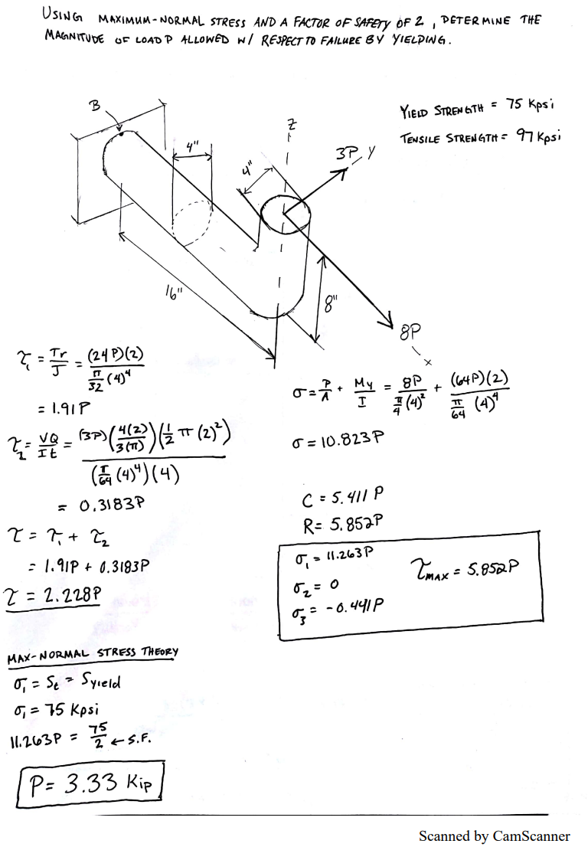
Handwritten Solutions
**2/4 Examples Shown**

Slide 3
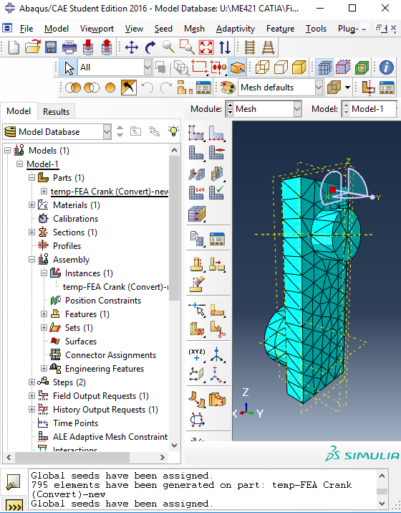
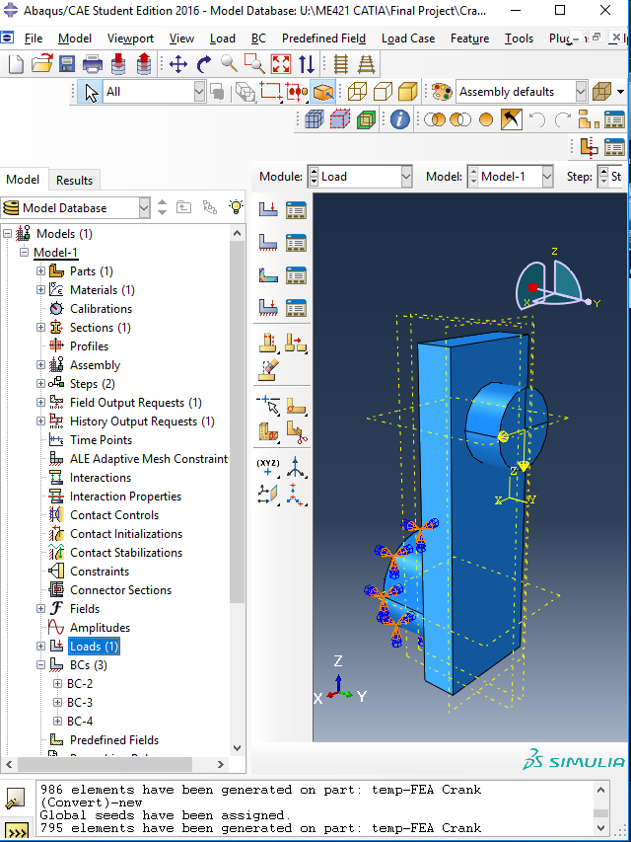
Abaqus Finite Element Analysis
*Abaqus FEA computations are still in progress

Slide 4
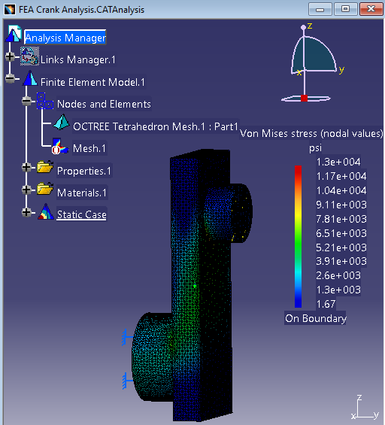
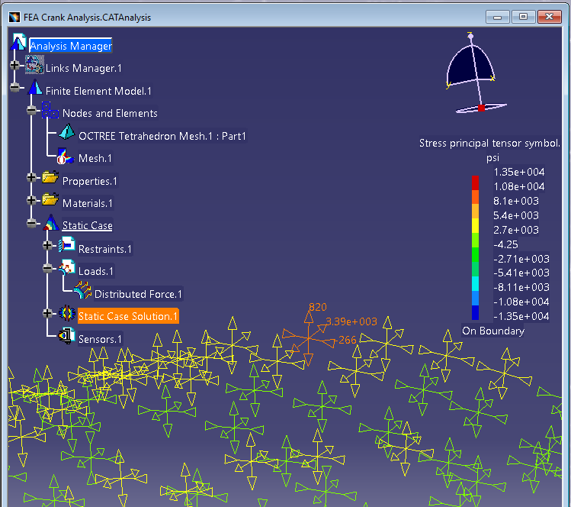
CATIA Finite Element Analysis
*Crank & Bar Examples shown*

Slide 5
Computation Comparison
 | Crank | Bar | L-Shape | Castigliano Beam
Handwritten | 3420 psi | 75000 psi | 306.46 psi | 0.1122 in
Abaqus | 3249 psi | *Did not Work | 336.8 psi | 0.1492 in
% Error | 5% | N/A | 9.9% | 33.0%
CATIA | 3390 psi | 75600 psi | 302.23 psi | 0.102 in
% Error | 0.877% | 0.8% | 1.4% | 9.1%

