Slide 1
Next Generation Lionel Hampton Music Studio
Russell Bennett, Daniel Wilkinson

Slide 2
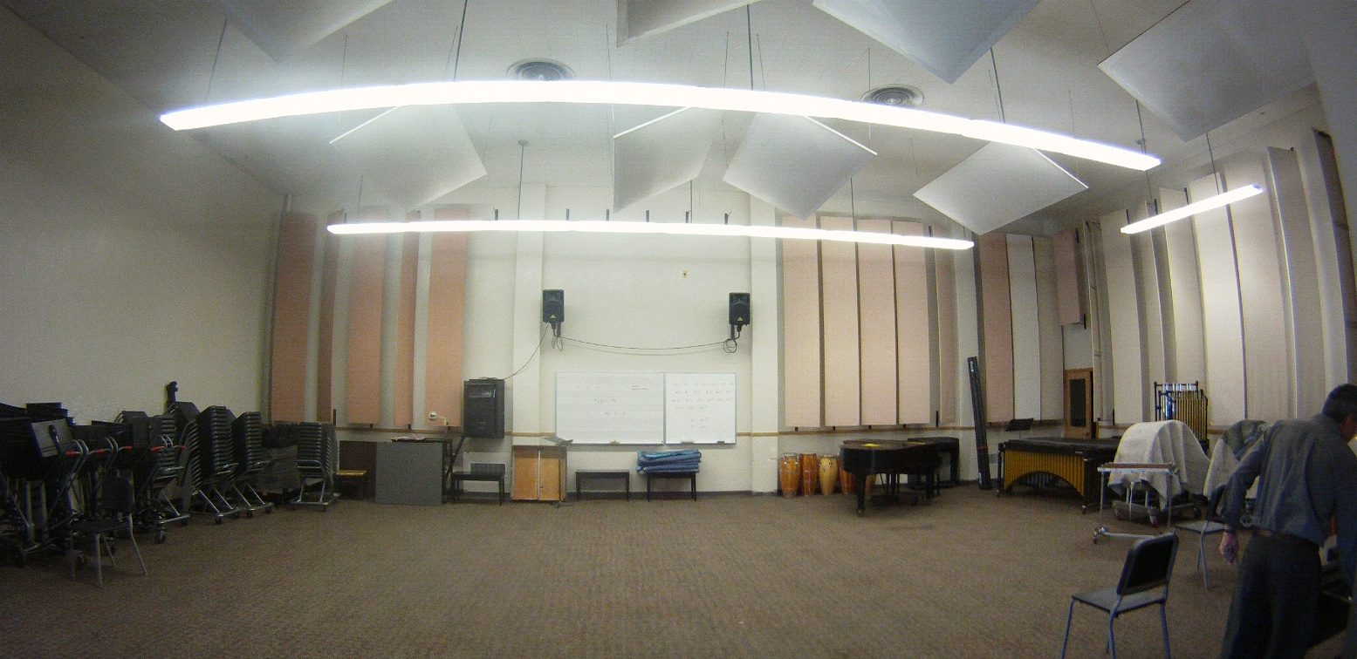
Objective
Redesign the Lionel Hampton Music Studio
Improvements in room usability and functionality
Architectural and aesthetic improvements

Slide 3
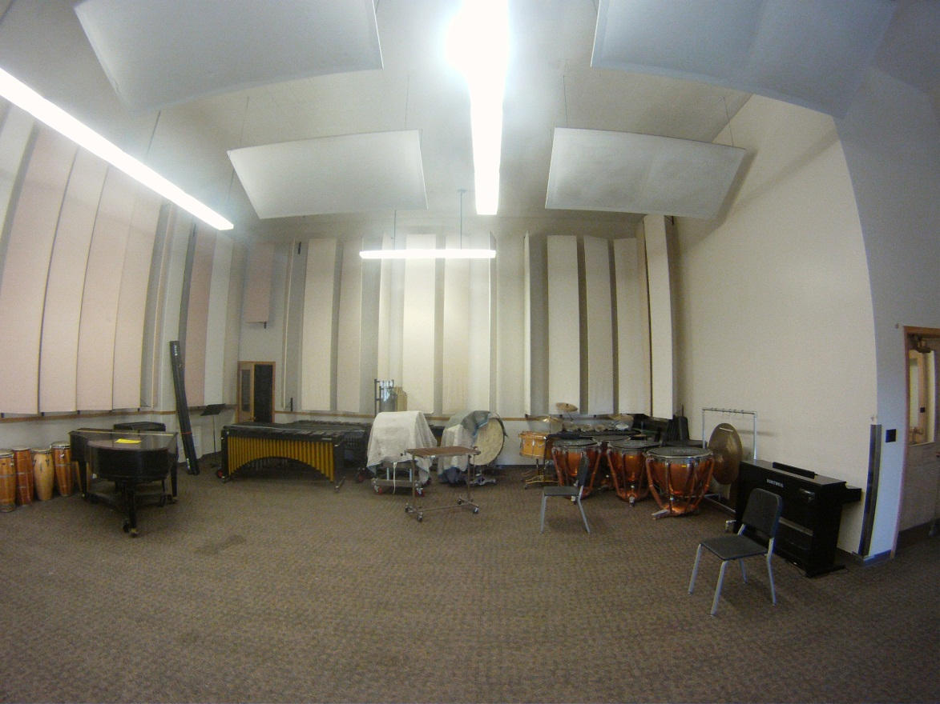
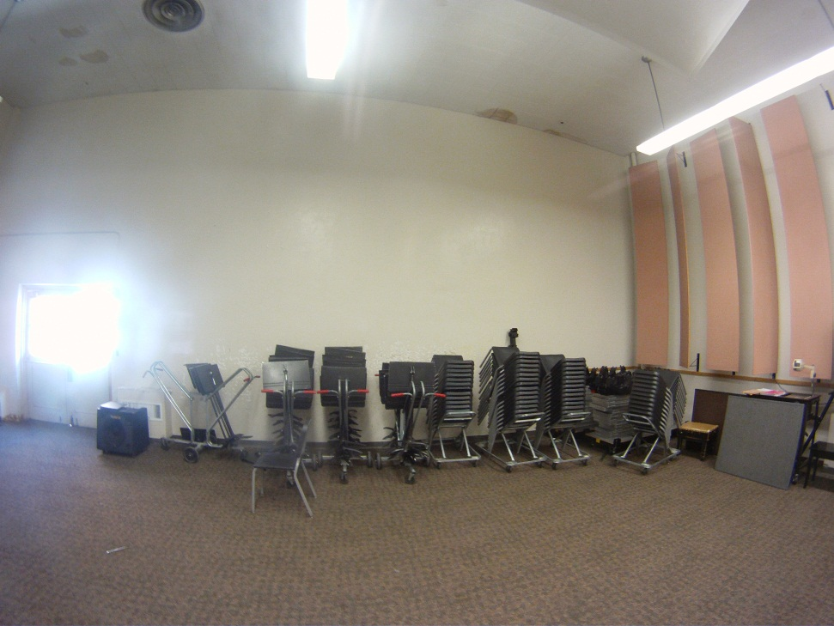
Present State
:’(
Last Remodeling: Late 1960s

Slide 4
What could be…
Glass Walls
Large Window Addition
Vandals Logo
Music Themed Decoration
Revamped Storage System

Slide 5
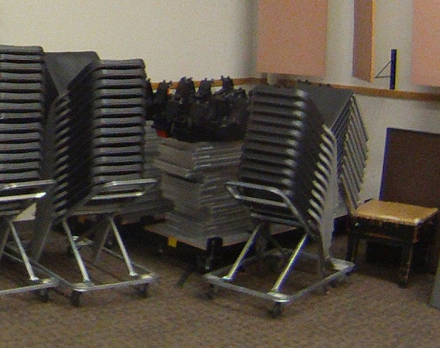
Storage System
Basic Idea: Make the stadium more accessible.
Easier to organize and assemble.
Existing
Redesign

Slide 6
Aesthetic Changes
Existing
Redesign

