Slide 1
Dimpled Frame Tubes Aerodynamic Study w/Fluent
Neal E. Joslyn
Christopher W. Roberson

Slide 2
Objective
Current State: Little is known about the effects of dimples on the aerodynamics of bicycle frame tubes
Research Question: Determine whether a dimpled bicycle frame is more aerodynamic then a smooth one.
Rationale: Traditional round frame tubes have superior ride characteristics to airfoils, but suffer from aerodynamic drag. Our goal is to engineer a design that takes the best of both worlds.

Slide 3
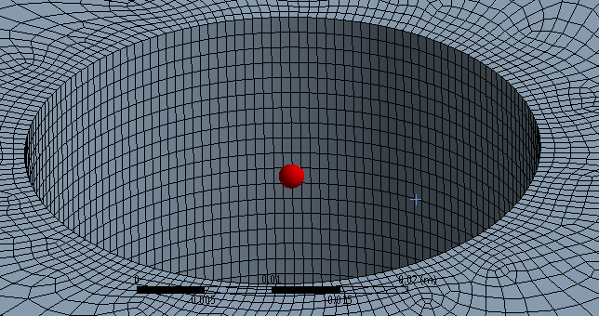
Smooth Tube Solid Model
This is the smooth mesh cylinder that is representing the part of the down tube of a bicycle. This is where racing design for bicycles is today.

Slide 4
Fluent Analysis w/Smooth Tube
This test was conducted at 11 m/s, a typical average speed for bicycle races. This study shows that there is a turbulent region at the back of the tube. This is greatly increases the pressure difference, increasing total drag.

Slide 5
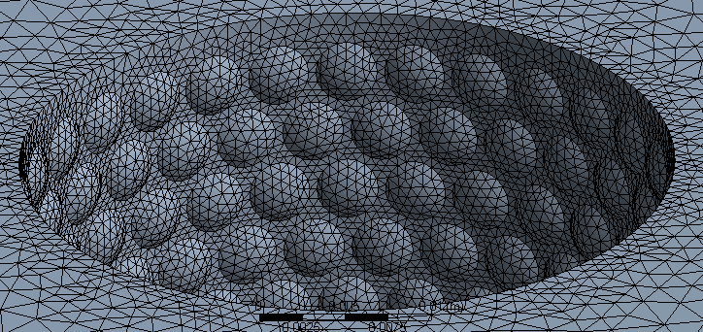
Dimpled Tube Solid Model
This is the dimpled mesh cylinder that is representing the down tube that we propose to be more aerodynamic.

Slide 6
Fluent Analysis w/Dimpled Tube
This test was also conducted at 11 m/s. Compared to the smooth frame analysis, there is a great reduction in turbulence behind the tube, reducing total drag.

Slide 7
Other Shapes Considered
Kamm Tail
This shape is growing in popularity because it feels like an airfoil (aerodynamically), but is a better ride
Airfoil
This shape is the shape of choice by professionals when it comes to time trials. It has the least amount of drag and therefore more aerodynamic than the other shapes.

Slide 8
Fluent Analysis w/ Kamm Tail
The benefit of having a Kamm Tail is most of the aerodynamic capabilities of a Airfoil without the harshness of the ride. The shape allows for flexibility where it is needed and rigidity where it is needed.

Slide 9
Fluent Analysis w/ Airfoil
Without a doubt the airfoil shape outperforms the other shapes when it comes to aerodynamics. There is little to no pressure build-up behind the airfoil when the flow of fluid has a yaw angle of zero degrees.

Slide 10
Closing Comments
Although the airfoil outperformed the other shapes it comes with concerns. In any sort of cross wind the ride becomes much tougher and the bike itself is not a comfortable ride.
The Kamm Tail provides almost as much of a reduction in drag force and it is a much smoother ride providing flexibility where it is needed.
**Important** - The point of this project was to see the affects of dimples. The dimpled tube was more aerodynamic than the smooth tube which proves out hypothesis. Surprisingly the dimpled tube was not far behind the Kamm Tail design as far as aerodynamics is concerned.
Another important point is that the dimpled tube will perform the same on any wind conditions. The airfoil and Kamm Tail will experience harder riding conditions on cross winds.

