Slide 1
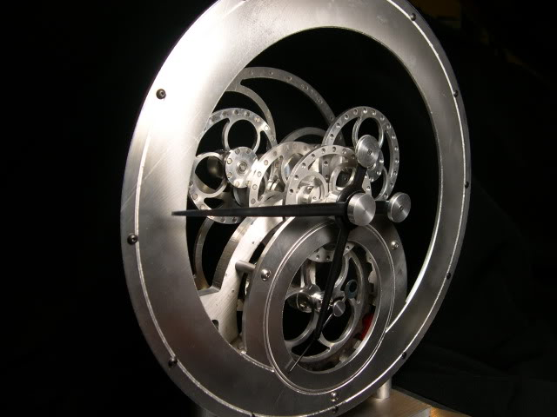
Magnetic Gear Clock
Andring, Chesnut, Miller, White

Slide 2
Objective
Use CATIA to replicate the magnetic gear clock model featured in Digital Machinist
Make preparations to fabricate the finished product in the ME Shop

Slide 3
Modeling Process
Read the article featured in Digital Machinist
Identify vendors for purchased parts
Determine effective file architecture for assemblies and parts
Create virtual parts and assemblies
Create renders and animations of final assemblies.

Slide 4
Magnetic Gear Clock

Slide 5
Magnetic Gear Clock

Slide 6
Magnetic Gear Clock

Slide 7
Clock Animation

Slide 8
Lessons Learned
Assembling
Sometimes it is not quite clear how assemblies go together, even if an assembly diagram is provided. In this case, both solidworks and catia were used to make the full assembly. The solidworks assembly was used to gain knowledge of how everything fit together because solidworks is a more forgiving program to work with. After making an assembly in solidworks, a complete assembly was made in catia using the information we gathered from the first assembly.
Animation
CATIA can be difficult to animate some subassemblies. In our case, we originally had the hour hand and minute hand of the clock in the same assembly so the spun together. In order to solve this problem, we ended up making a separate subassembly for the hour hand so that it could be made to spin at a different speed.

