Slide 1
Skeleton Clock
Joshua Carlson
Alec Wyland
Josh Dalton
Chadd Bergland

Slide 2
Objective
Model an existing Skeleton Clock using native CATIA parts.
Design a more compact weight and pulley set for the Sketleton Clock.
Visualize the modified clock on a wall outside the ME Machine Shop.

Slide 3
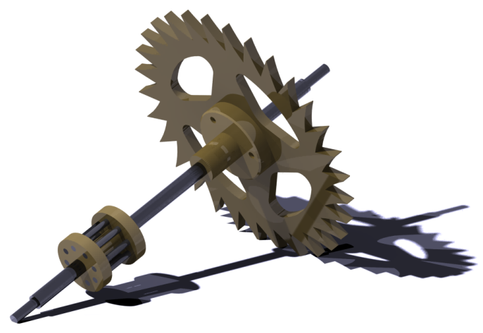
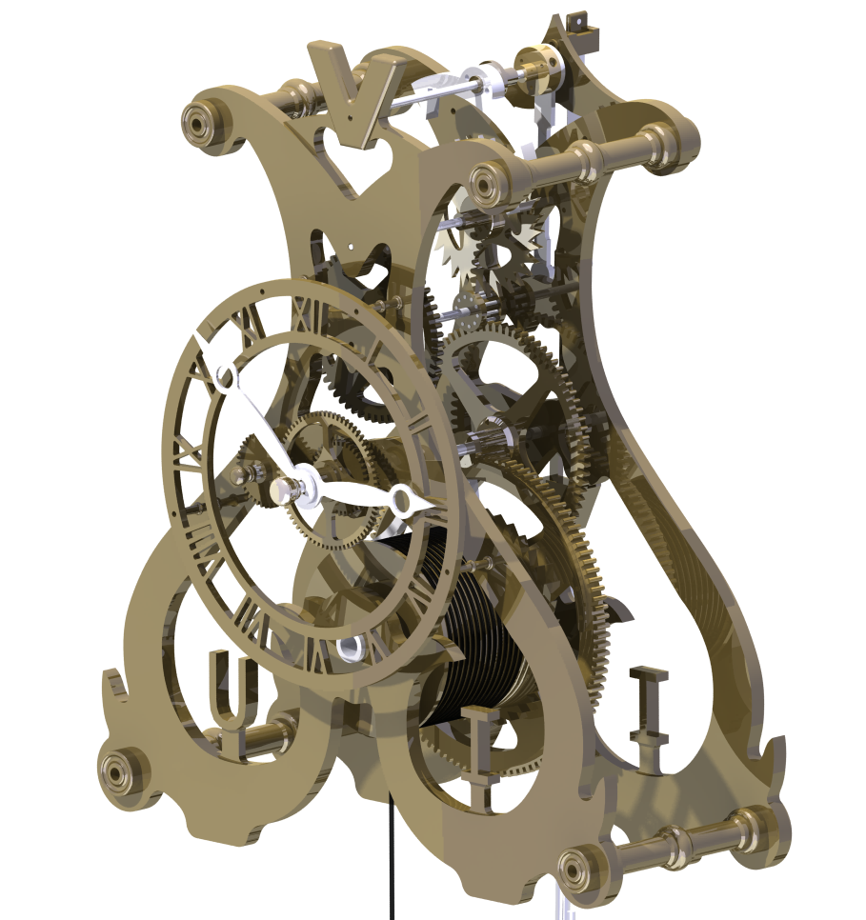
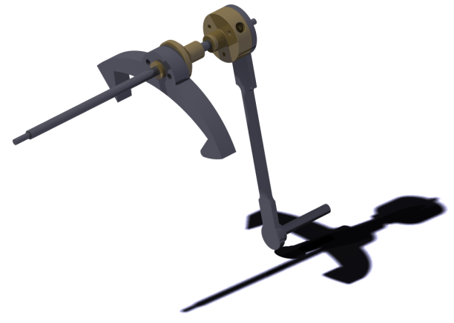
Skeleton Clock Internals
Escape and Arbor Sub-Assembly
Center Wheel Sub-Assembly
Escapement Clutch Sub-Assembly

Slide 4
Compound Pulley/Weight Set

Slide 5
Skeleton Clock Visualization

