Slide 1
Boxer Engine Model
Members:
Faisal Alahmadi
Ashton Bailey
Chris Jerue
Phil Petersen

Slide 2
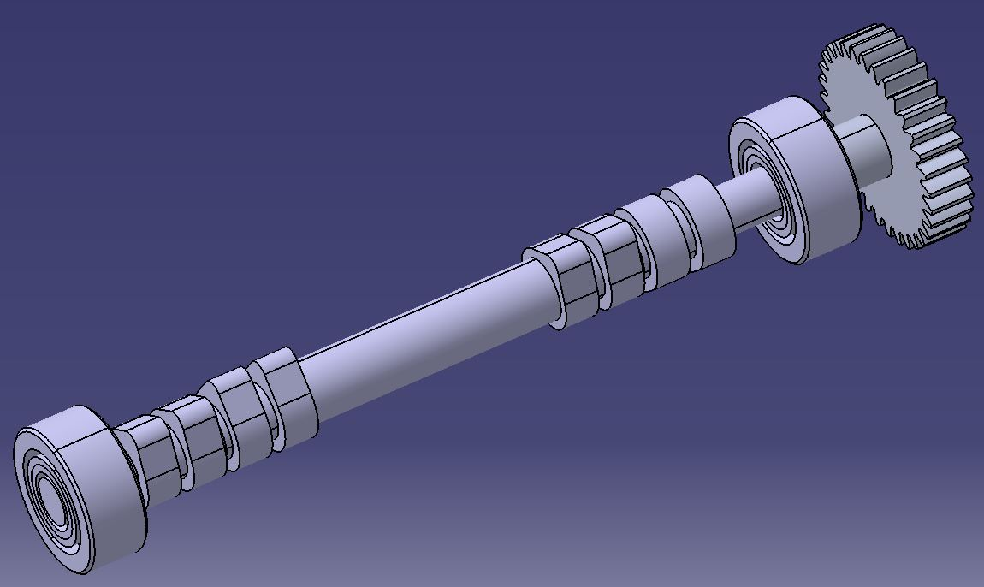
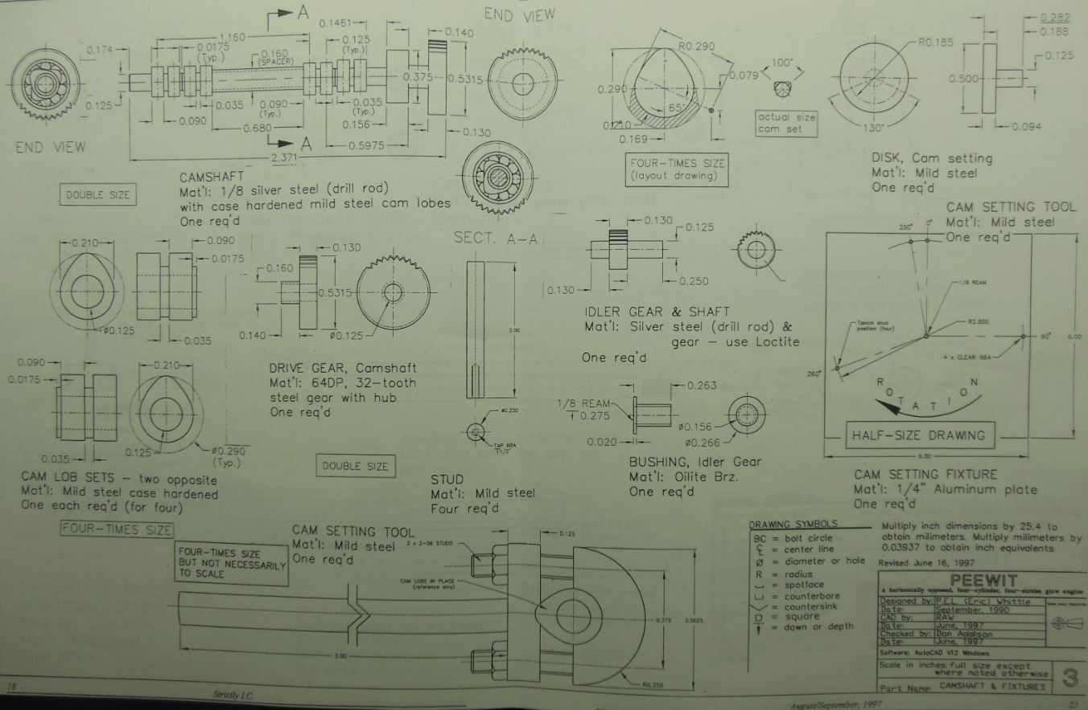
Objective
Scout Possibilities for a ME301 Project
Transcribe Blue Print Plans into a 3-D Model
One of the many pages of plans
This one for the Cam Shaft Assembly
The Modeled Cam Shaft

Slide 3
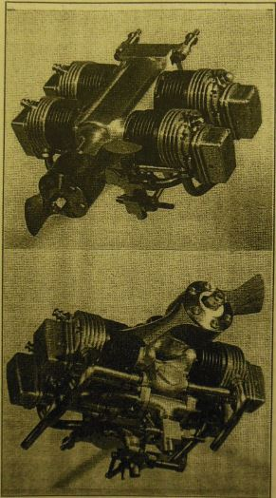
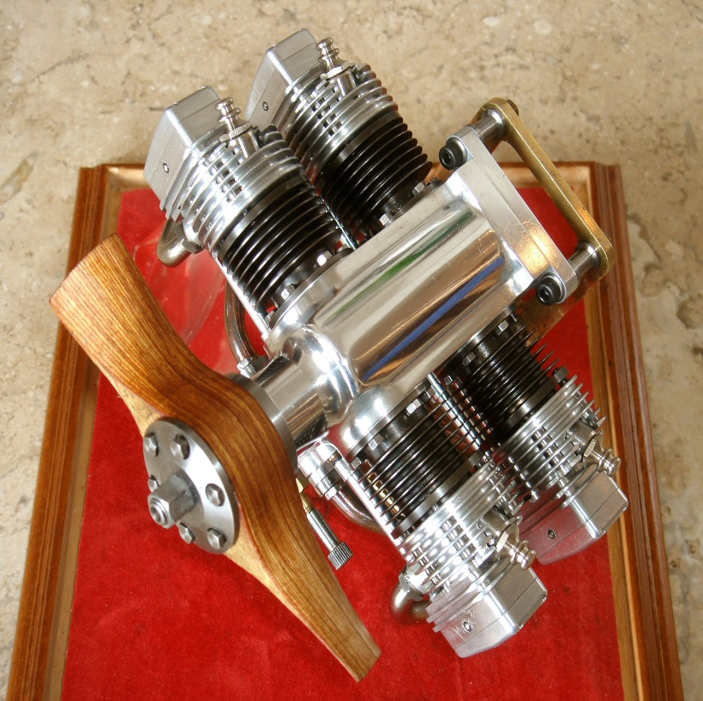
The Model
Original plans intended for model building use.
Left: A completed model built from these plans.
Right: Initial model Plan views.

Slide 4
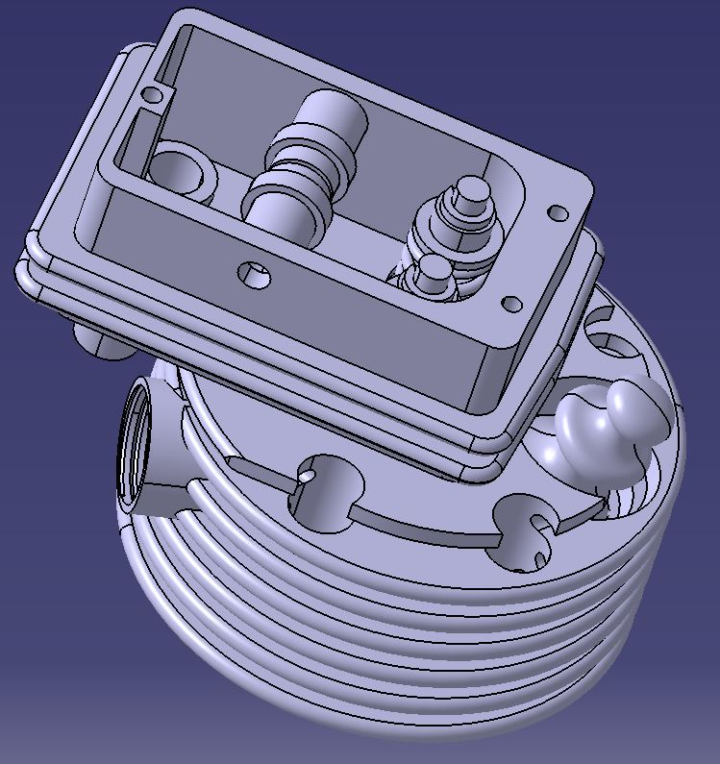
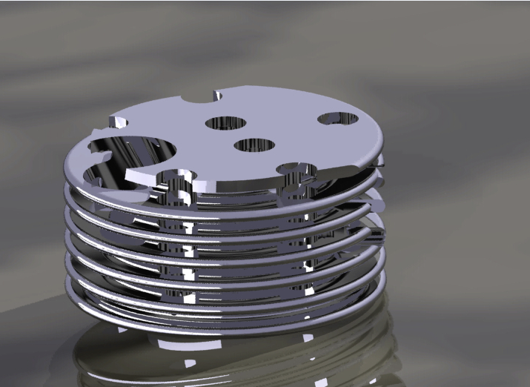
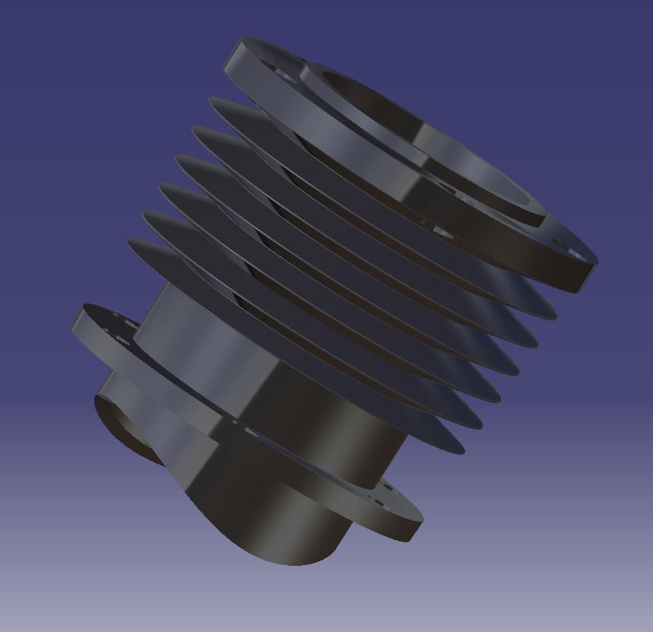
Working with Fin Geometry
Above: Modeled Cylinder
Head & Valve Train
Above: Rendered Cylinder Head
Left: Modeled Cylinder

Slide 5
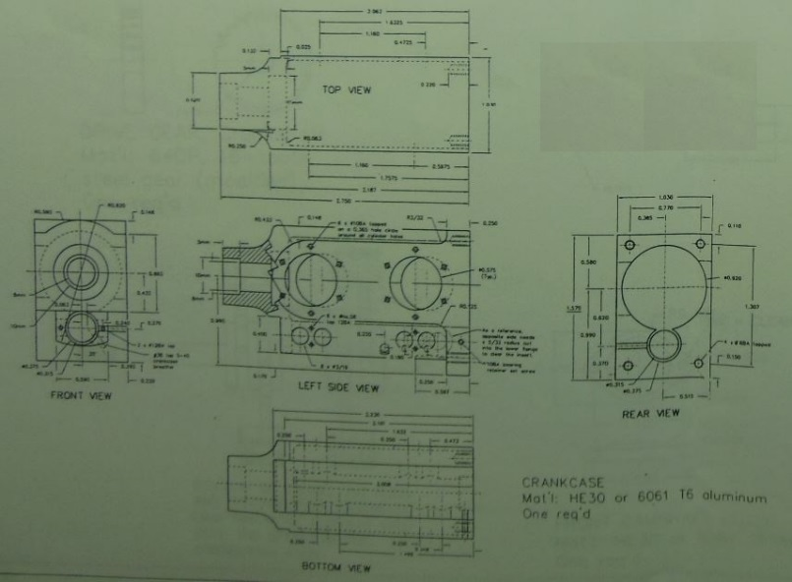
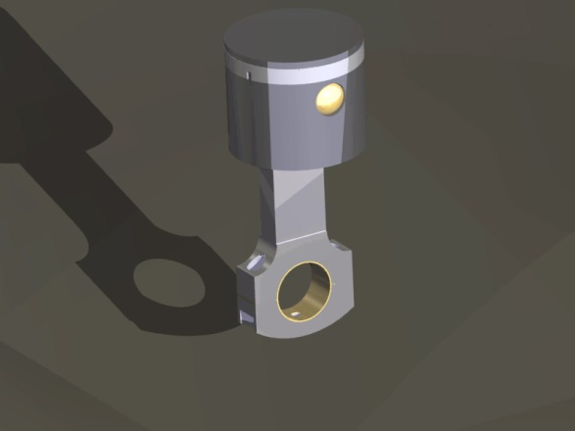
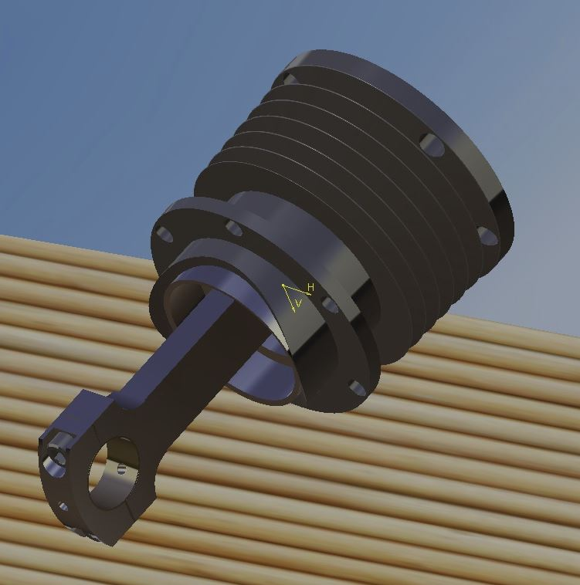
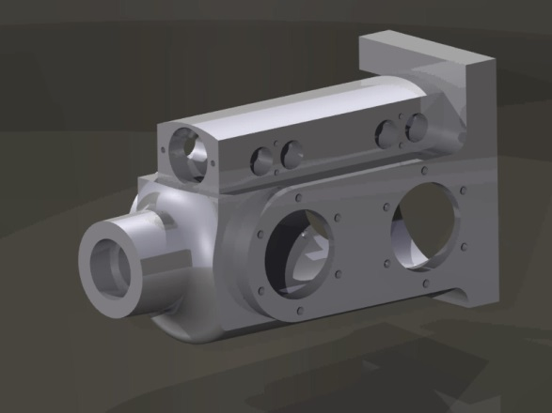
More Parts!
Left: Crankcase
from plans to
model
Right: Piston and
Piston / Cylinder
Assembly

Slide 6
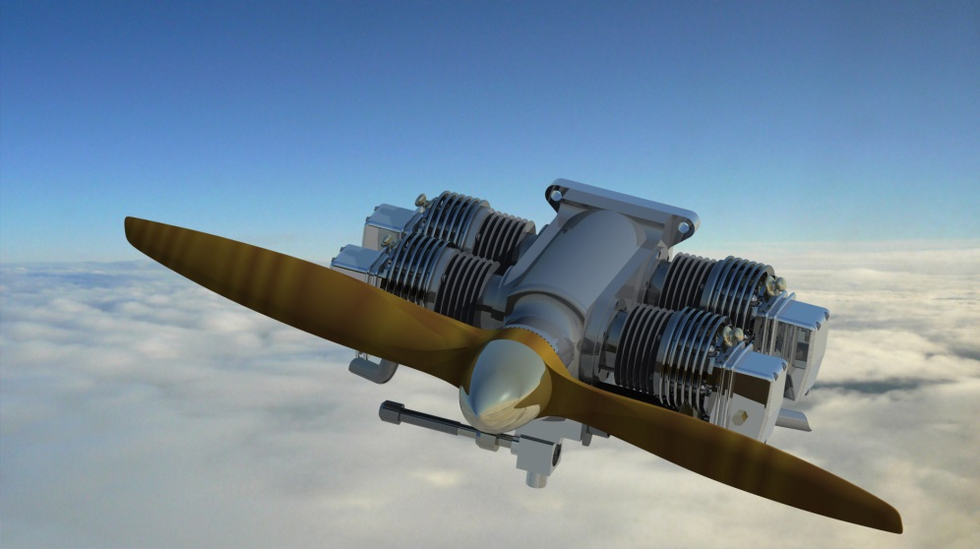
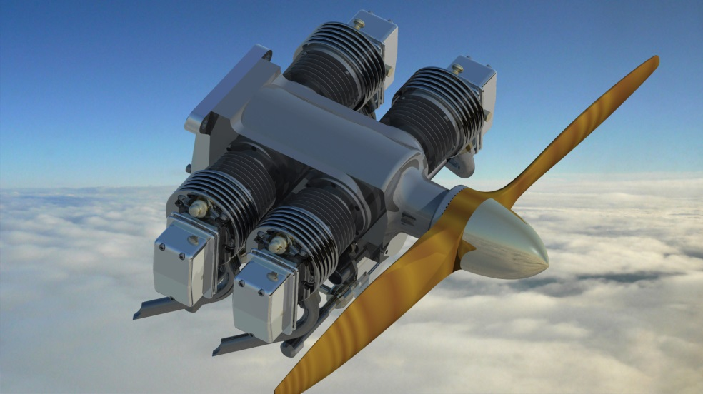
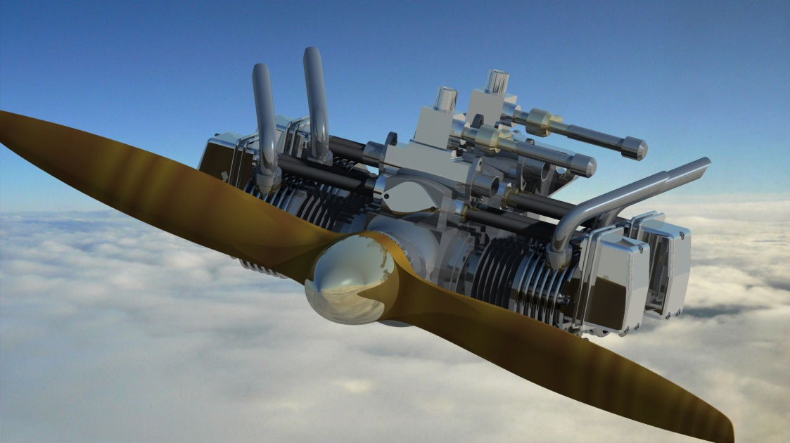
The Final Product

