Slide 1
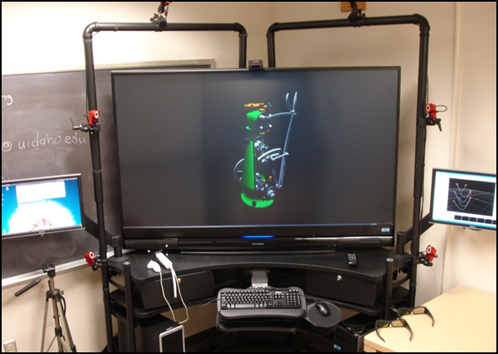
Cave Visualization
Kyle Polito Darren Mabe

Slide 2
Objective
Stream lining IQ station use
Fixing color transfer
Import advanced CATIA models

Slide 3
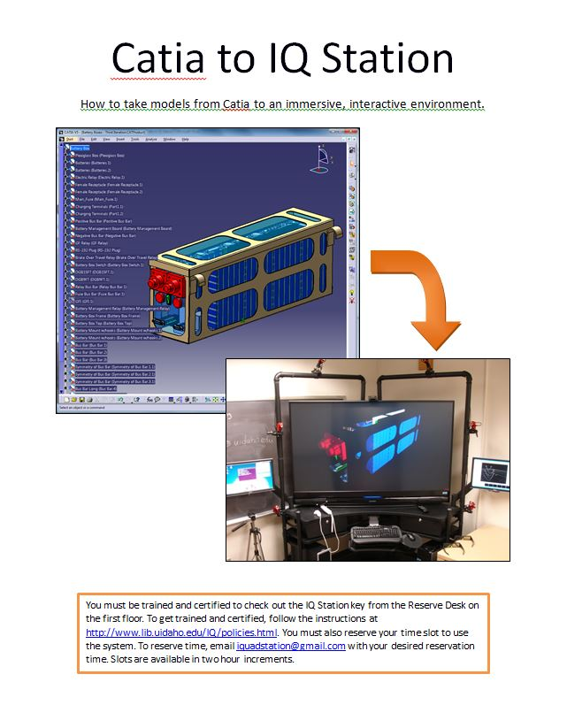
Stream lining IQ station use
Edited both existing tutorials to make procedure for importing 3D geometry to the cave very simple
Using Step file transfer instead of igs simplified process

Slide 4
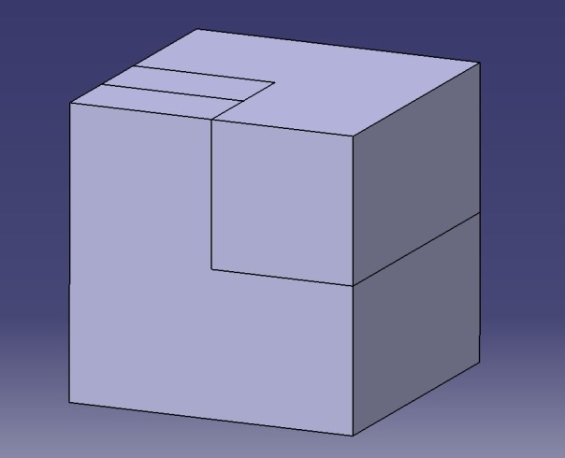
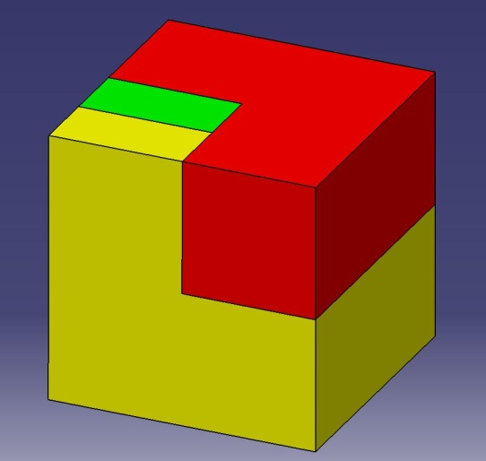
Fixing color transfer
Apply material to each part separately
Change color of the part
Color applied without material
Color applied correctly

Slide 5
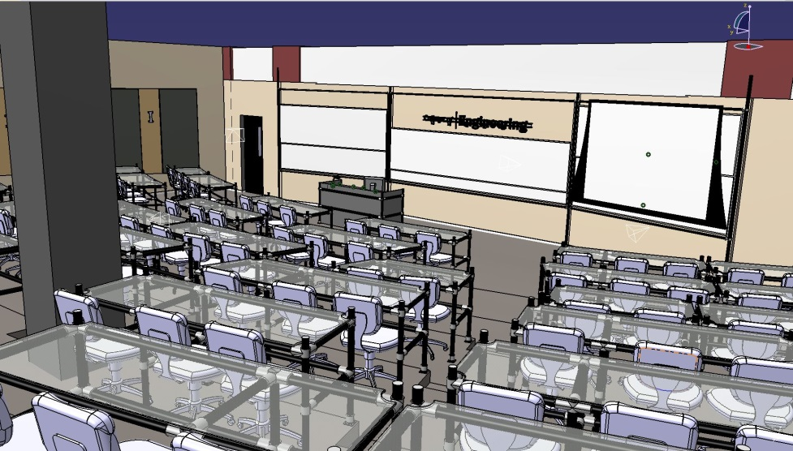
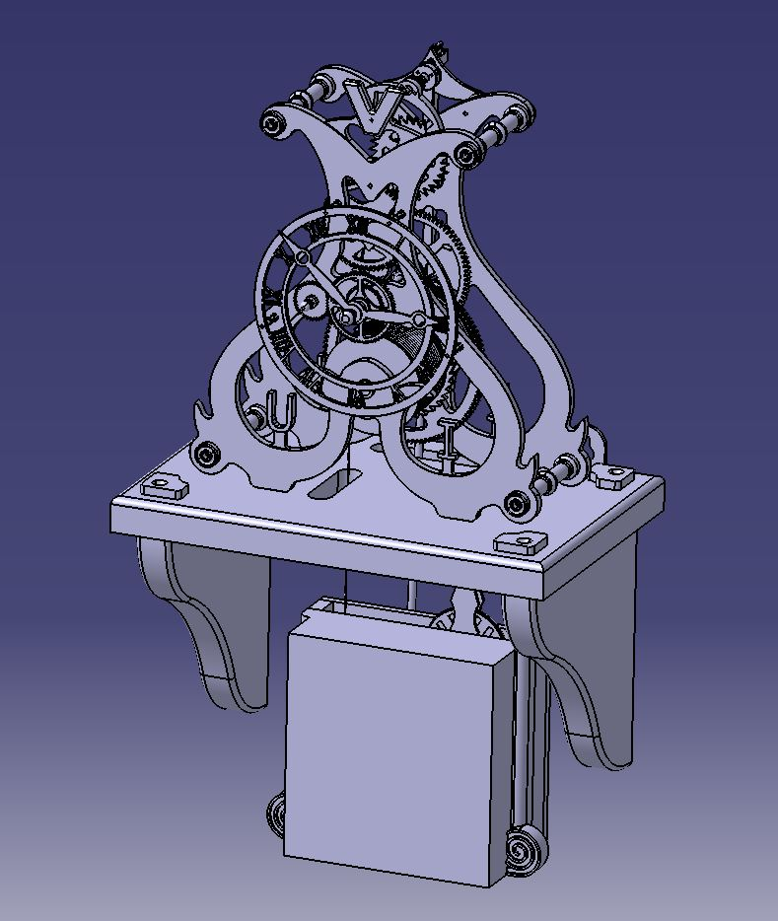
Importing Advanced Catia models
Skeleton Clock
EP 214 and 216 Renovation

