Slide 1
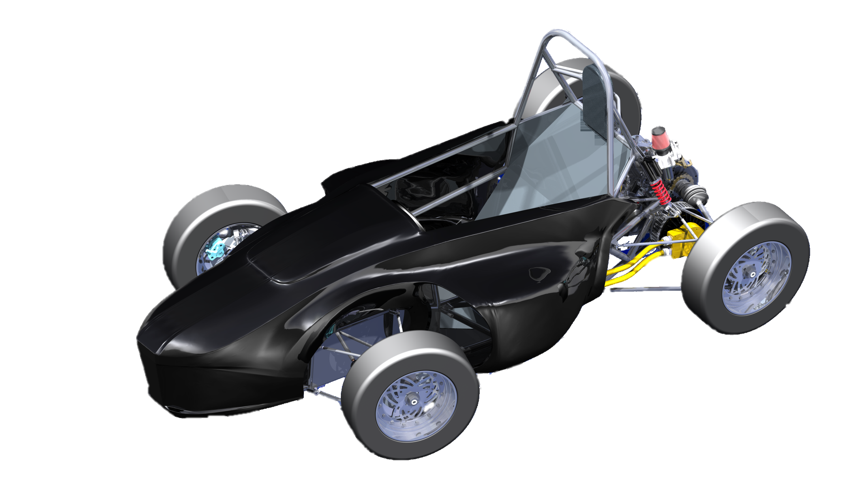
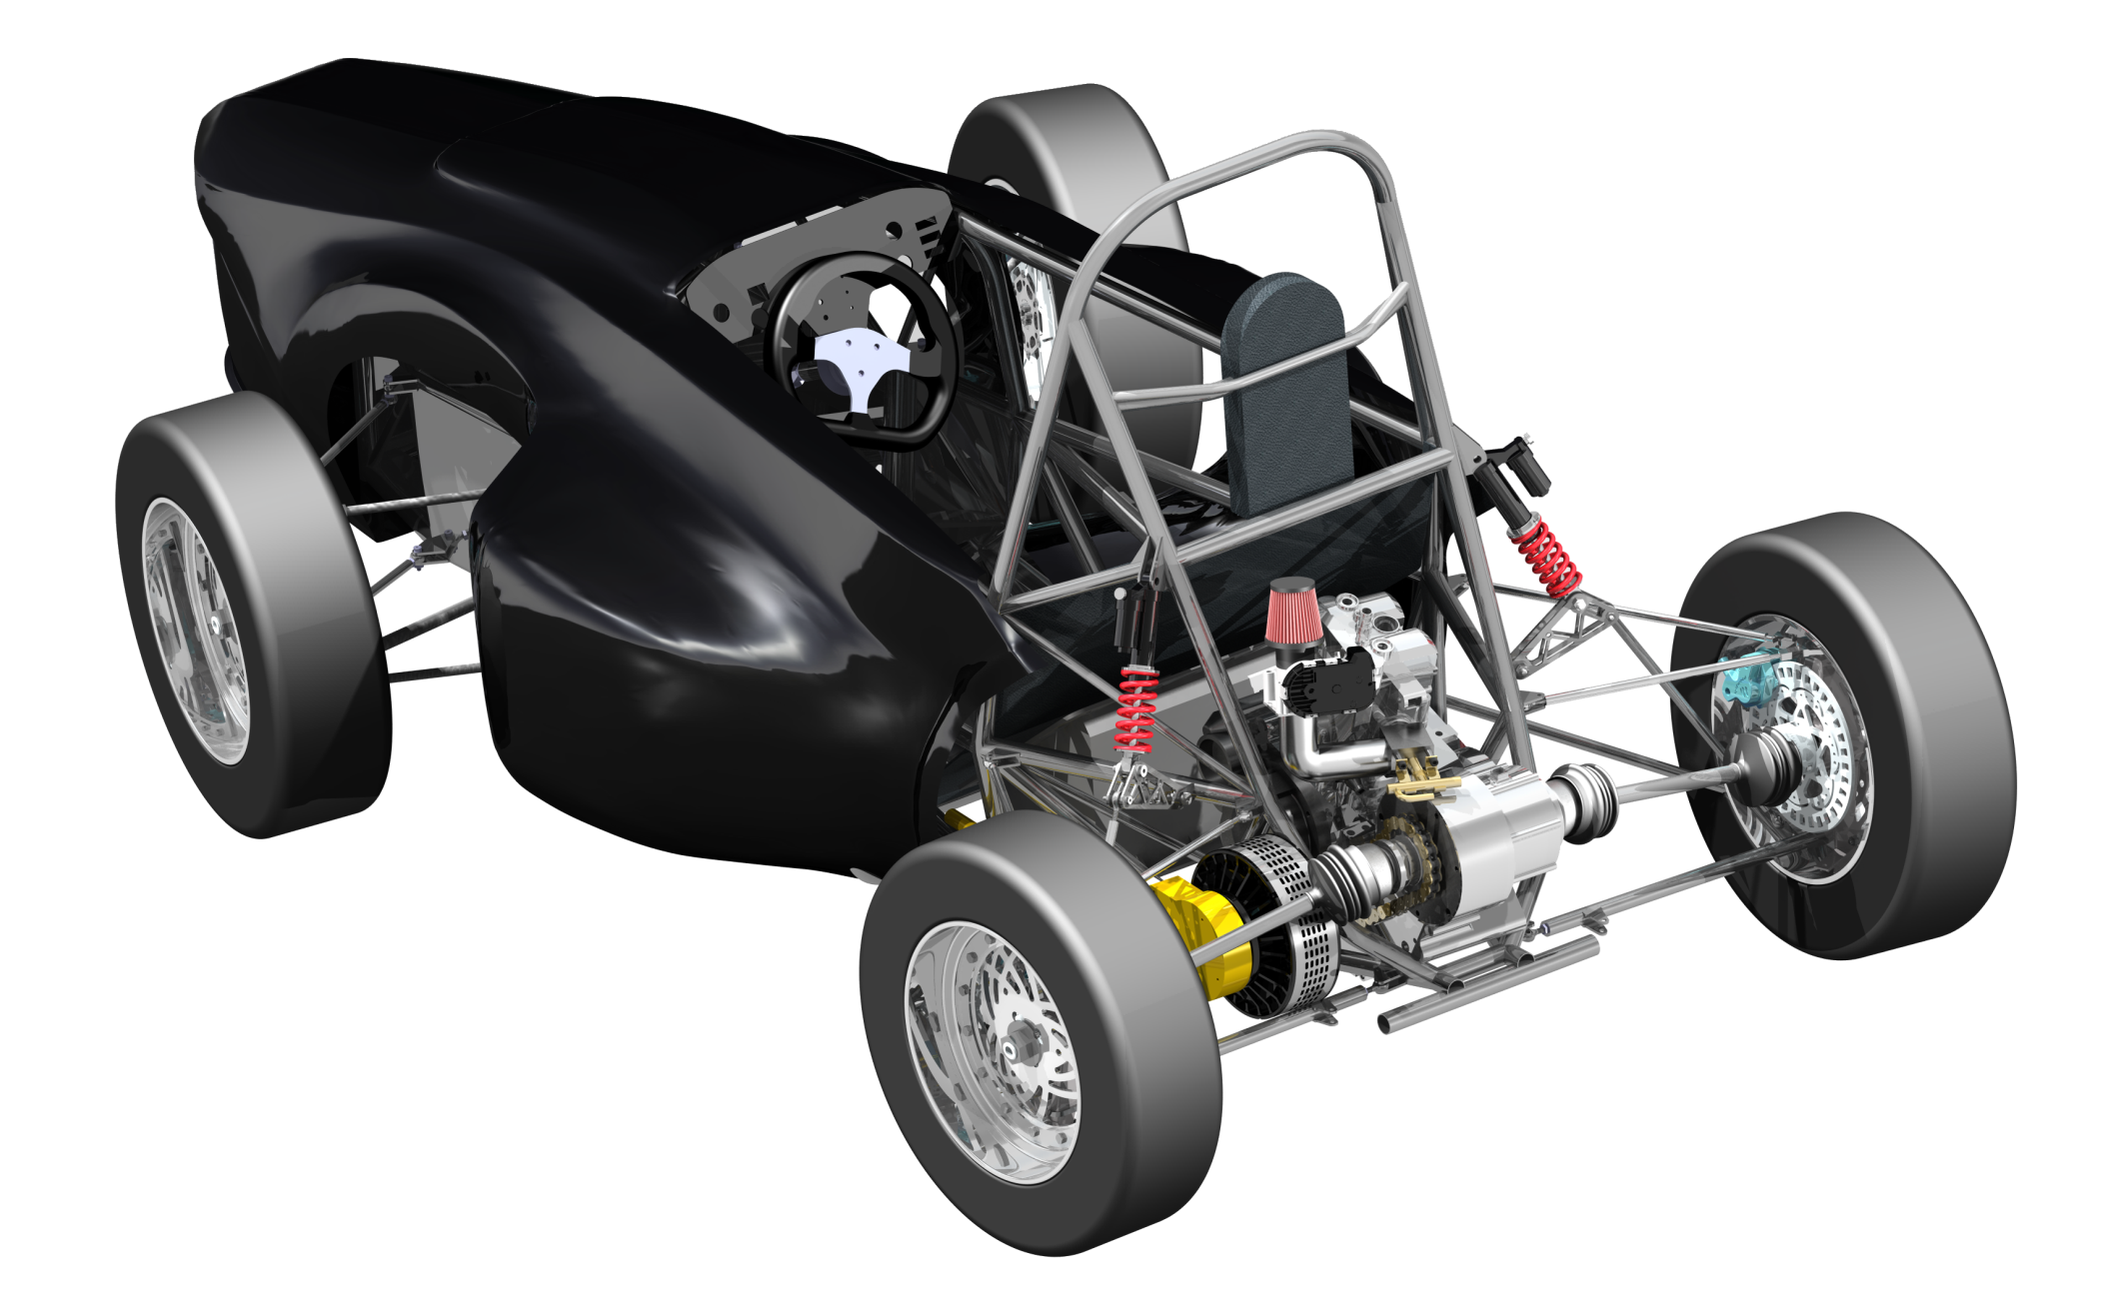
Formula Hybrid SAE Vehicle

Slide 2
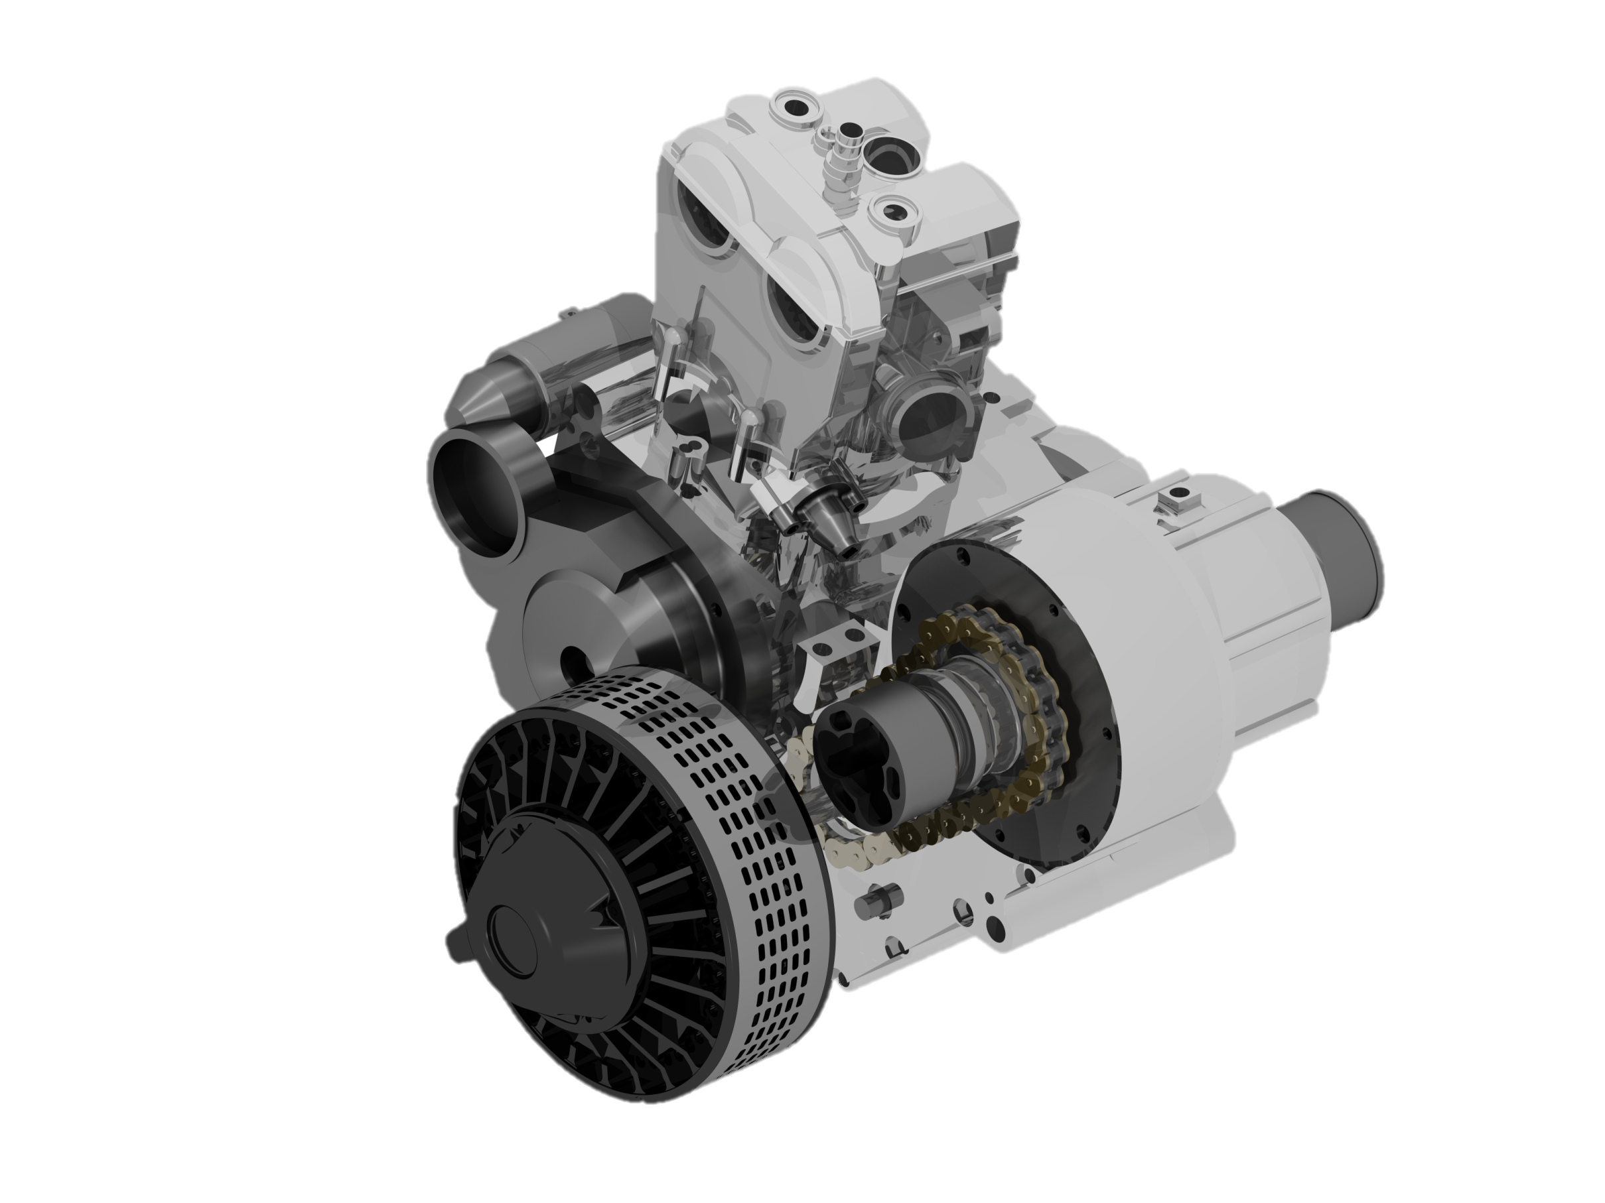
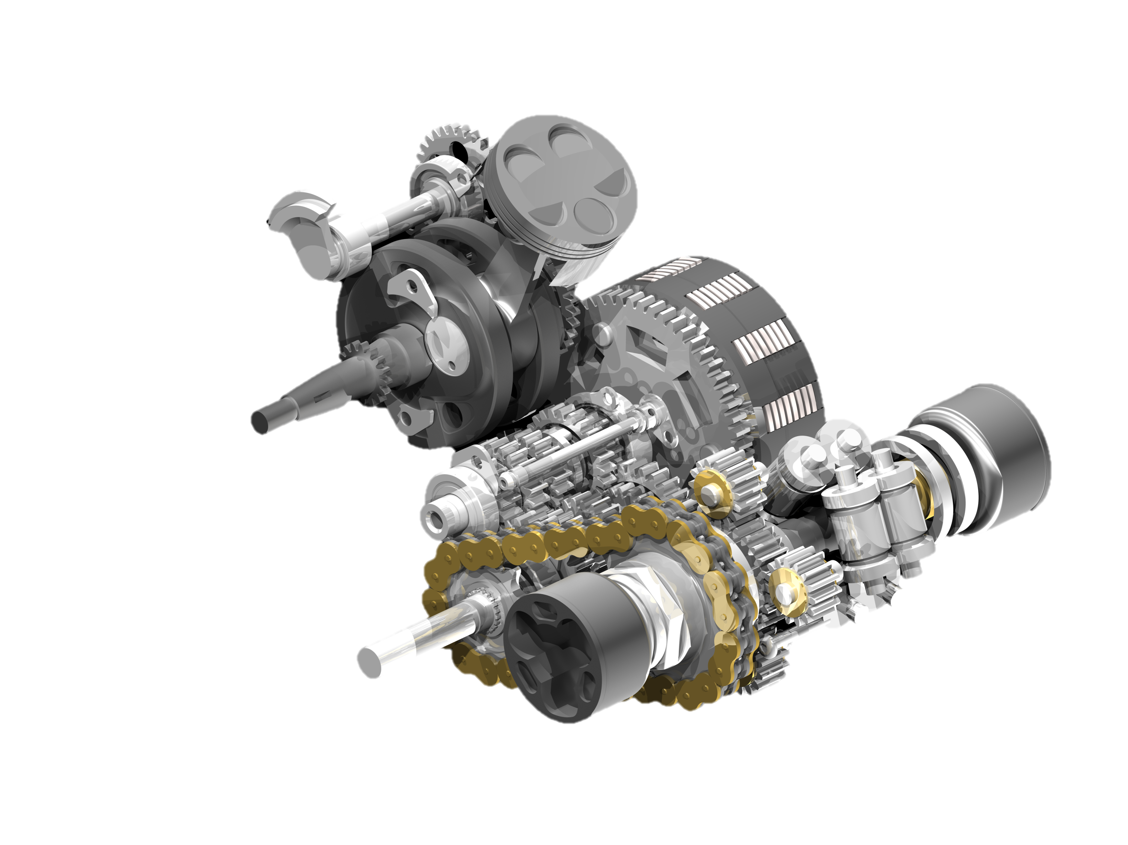
Drivetrain
Features
Case Machined In-House
Custom-Designed Torsen Differential
Directly Coupled Electric Motor
Compact Packaging
Trihubdle CV Joints
Custom Output Shaft
Rekluse Clutch System

Slide 3
Energy Management System
Features
Customizable Energy Split
Energy Management Controls
Redundant Safety Features
Data Acquisition

Slide 4
Pedal Assembly
Throttle
Throttle by Wire Input via Redundant Potentiometers
Failsafe Throttle Stop
Adjustable Pedal Reach to Accommodate Differently Sized Drivers
Brakes
Adjustable Brake Bias
Custom Master Cylinders
Brake Over-Travel Switch
Braided Stainless Steel Brake Lines

Slide 5
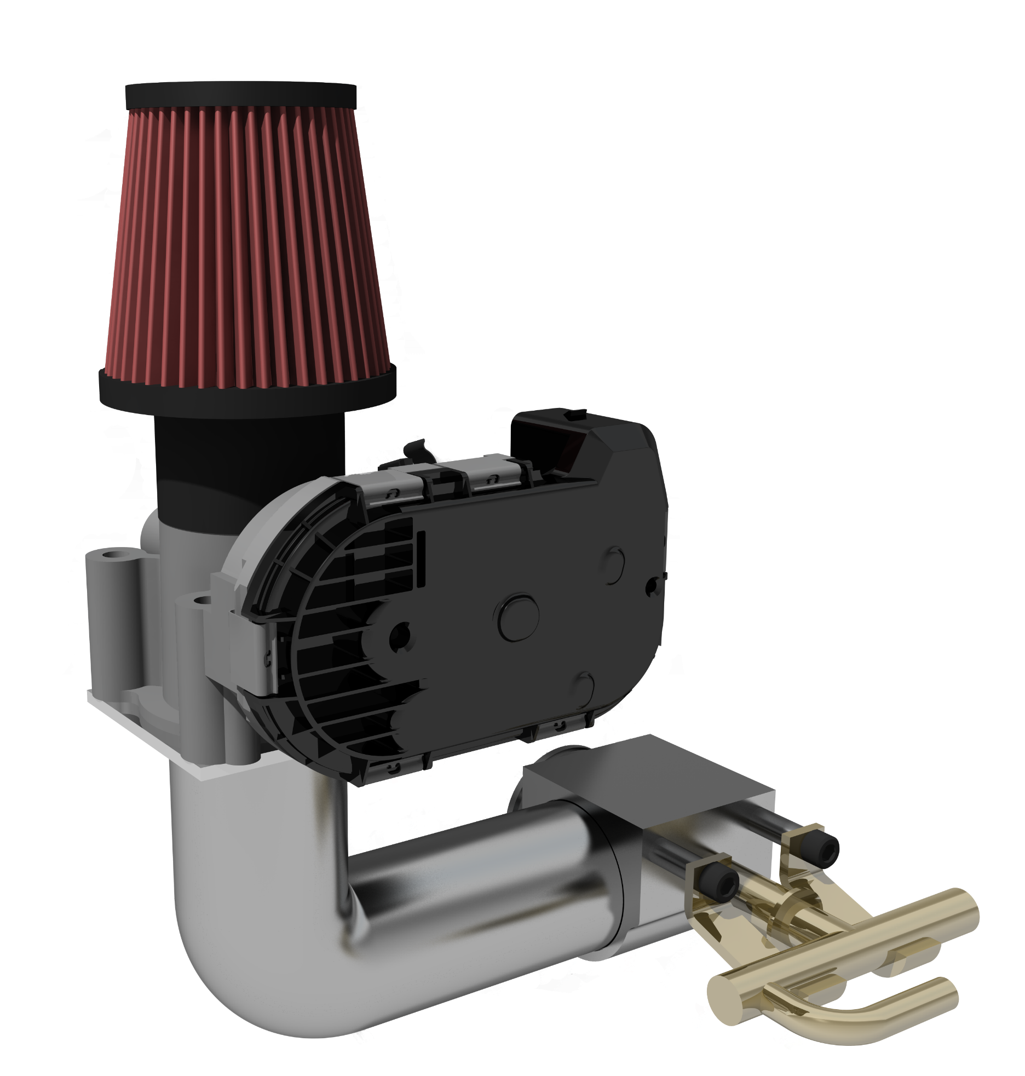
Throttle Body and Intake
Features
Designed for Improved Volumetric Efficiency
Built In-House
Port Injection
Bosch Electronic Throttle Body

Slide 6
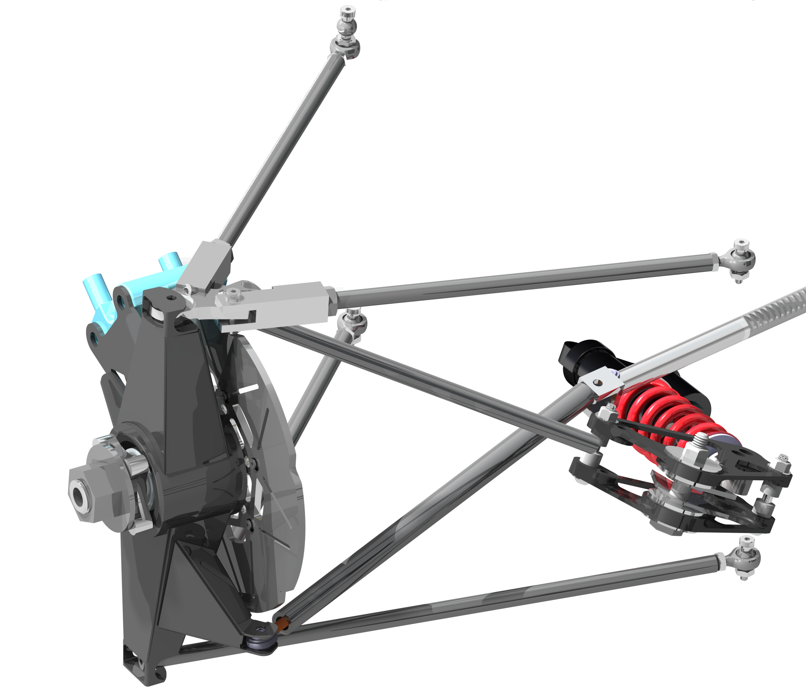
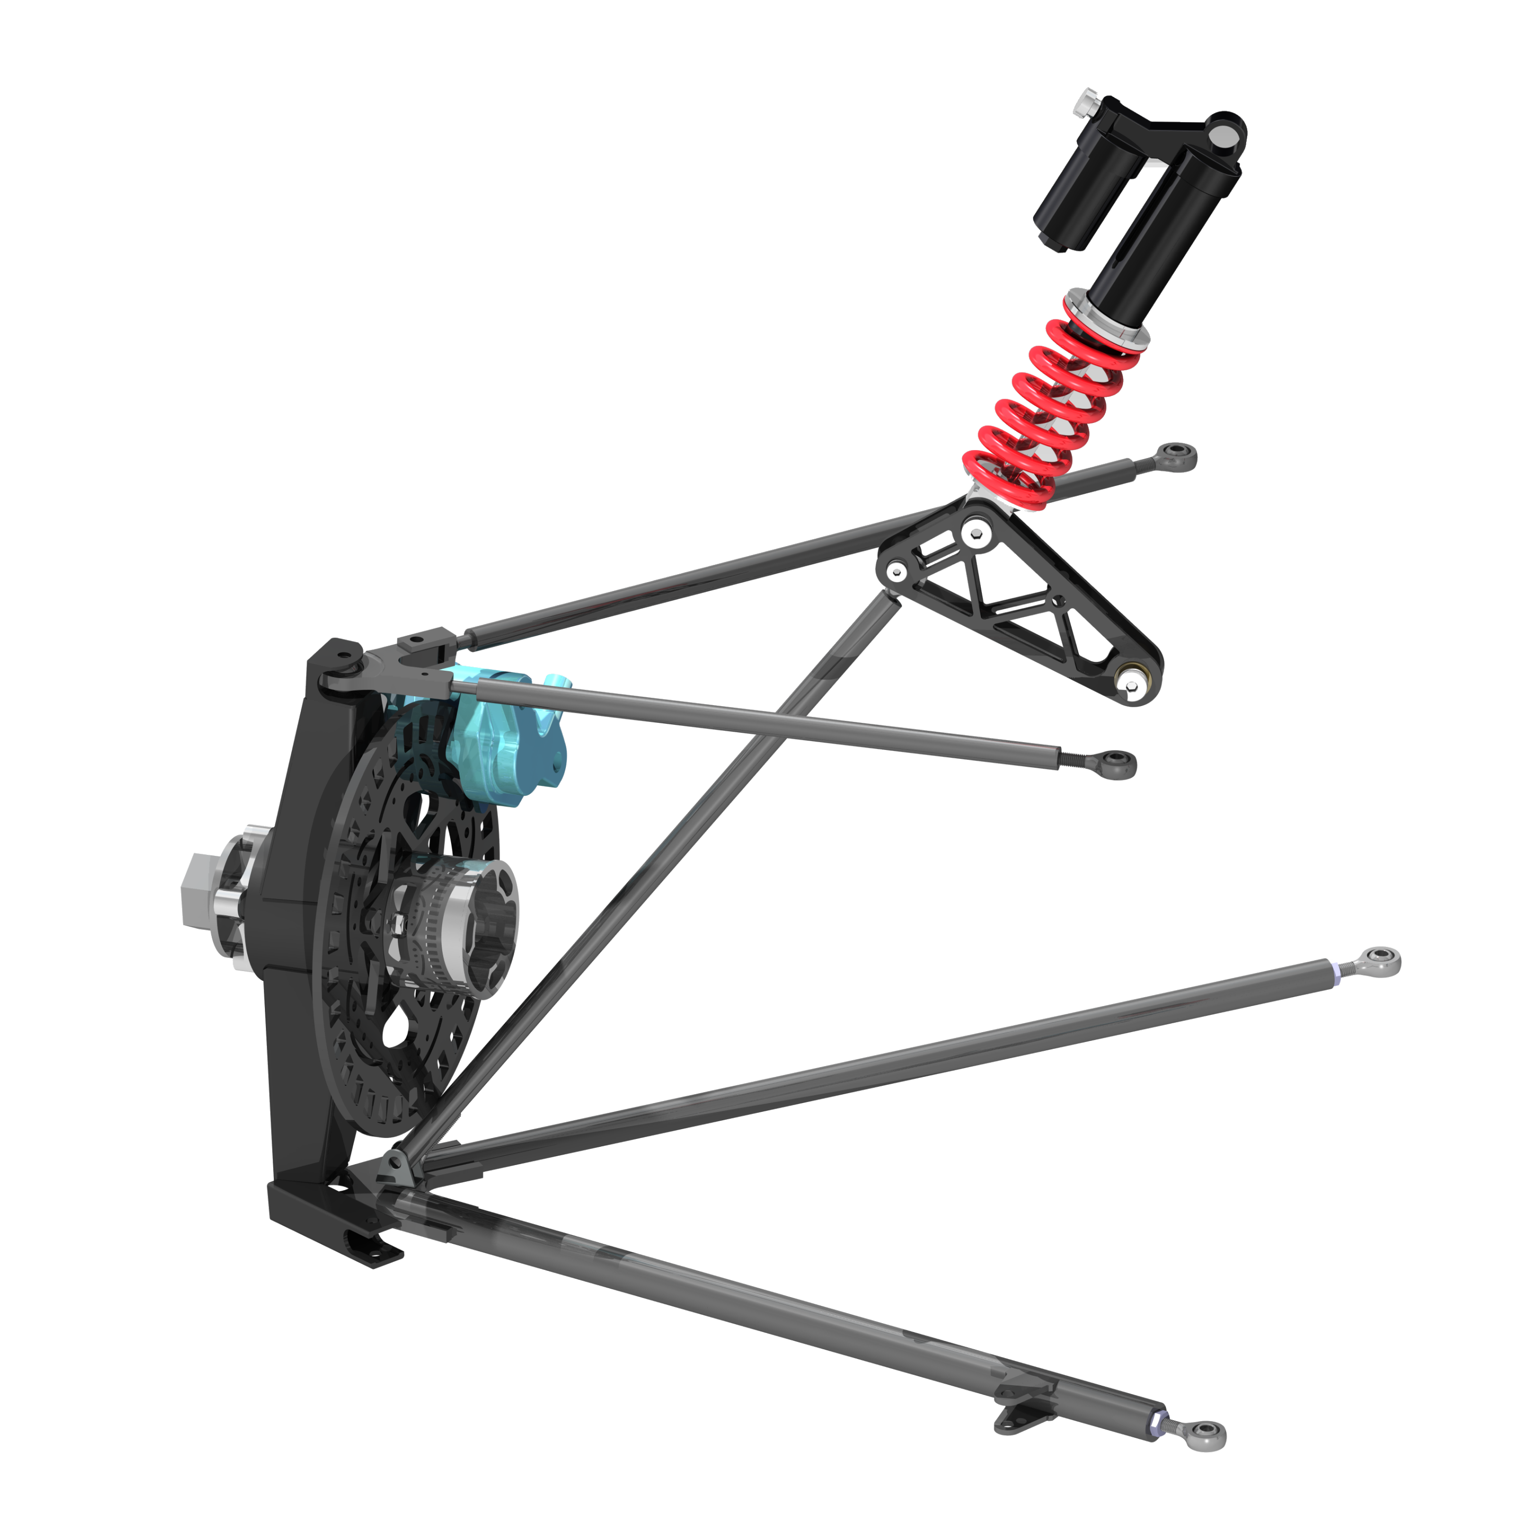
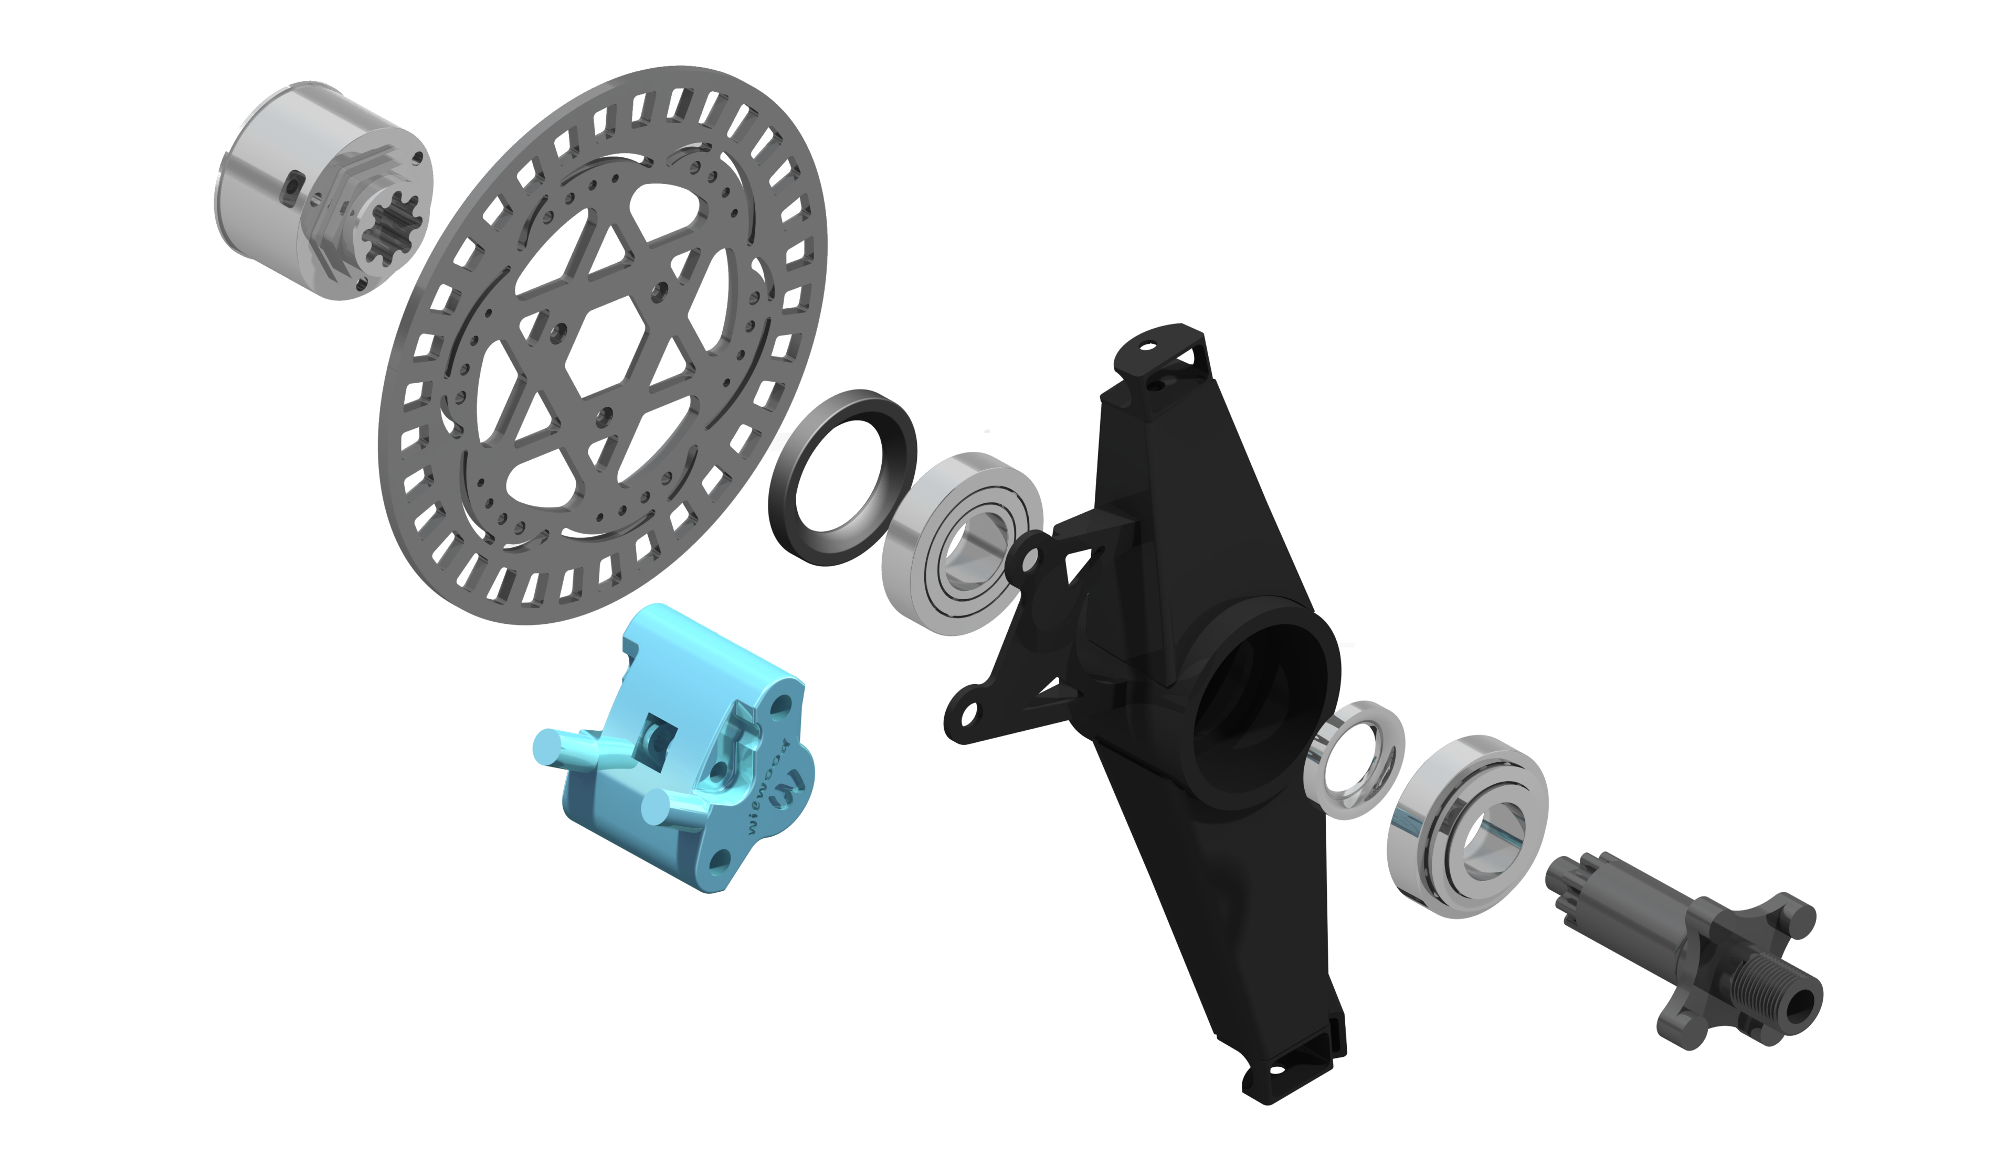
Suspension
Features
Pull Rod Actuated Bell Cranks in Front
Fully Adjustable A-Arms
Fox Racing Shocks
Welded Uprights
Anti-Roll
1:1 Motion Ratio
1.12” Ride Height
1.25” Bump Travel
1” Droop Travel

Slide 7
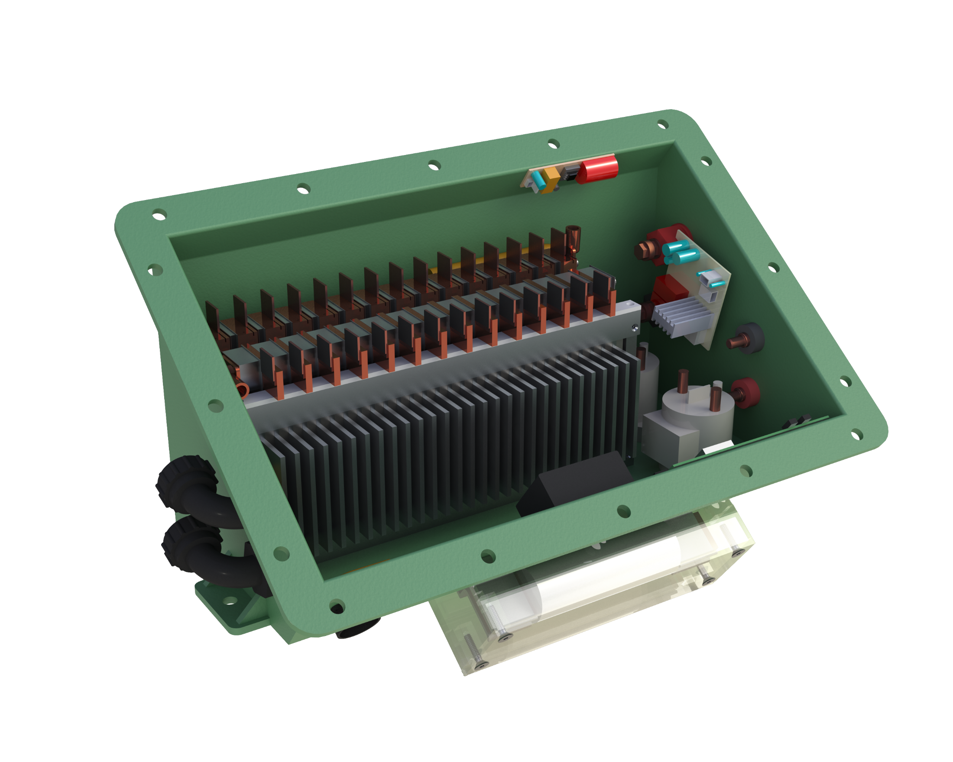
Battery Box
LiPo Cells
Hi-Voltage Relays
Features
Glass/Epoxy Composite
Weight: ~50 lb
29 LiPo Cells
Series Configuration
Capacity: 2.6 MJ
Nominal Voltage: 108 V
Max Nominal Current: 200 A
Aluminum Heat Sink
Battery Management System
Main Fuse

