Slide 1
EP 103 Room Re-design
Kirk Delmas, Scout Ferguson, and Kyle Cleveland

Slide 2
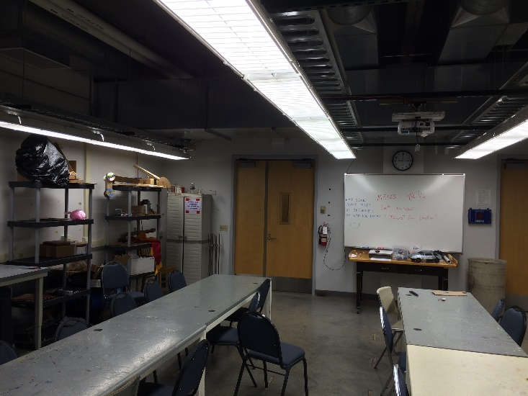
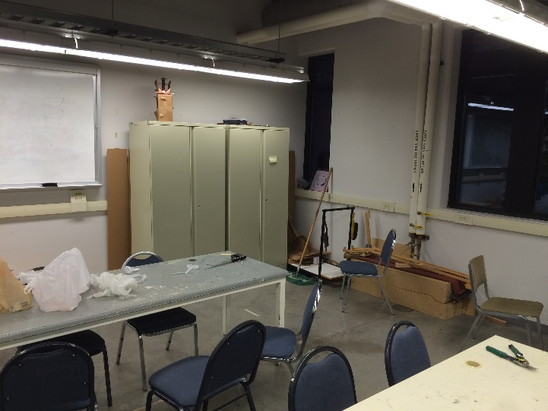
Current Status and Goals
Our room is EP 103 and it is currently used as a classroom and workspace for ME 123 and ME 223.
Goals:
Model the current room and features as accurately as possible
Implement ideas to make the space LEAN
Implement smart improvements to the space (security emphasis)
Make the room aesthetically appealing and tie it to other engineering workspaces
The room quickly becomes cluttered and there have been problems with missing equipment.

Slide 3
EP 103 Re-vitalized!
North Wall
Moving clockwise around the room, we have set up a workflow around the perimeter. West wall:
-project display shelves -projector screen/white boards
North Wall:
-workbenches and tool storage
-cleaning cart
-material storage
East Wall:
-current project storage shelves
West Wall
East Wall

Slide 4
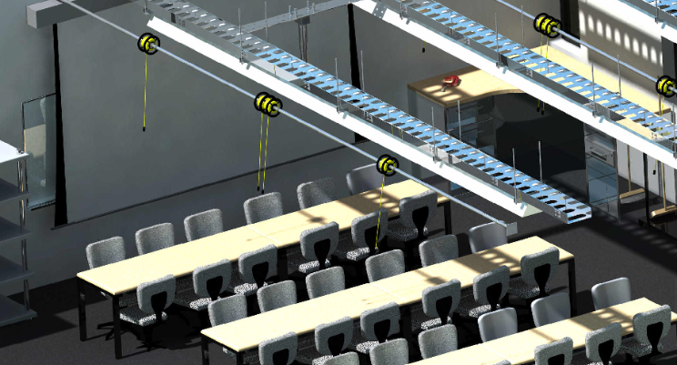
Overhead Fixtures
Overhead Light rotated and raised to open room
Retractable power cords accessible from all parts of room

Slide 5
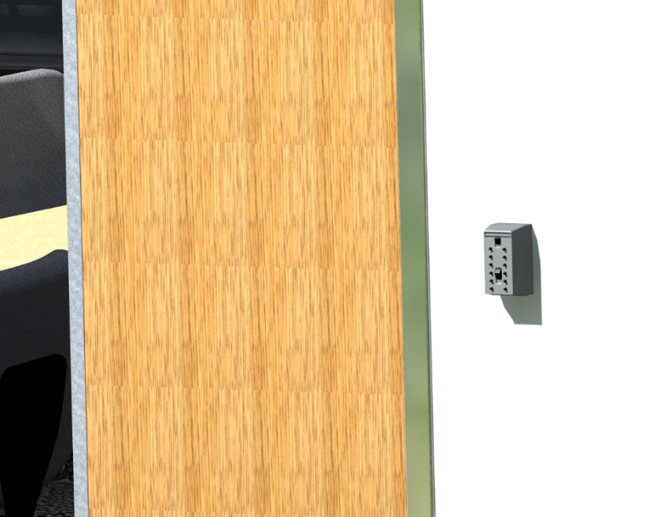
EP 103 Security
4-digit lock box with tethered room key inside
Located outside front door
24/7 accessibility to classroom
Instructors distribute key code to students

Slide 6
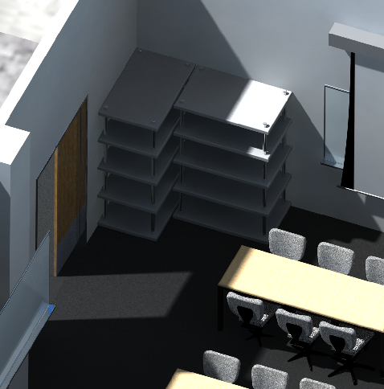
Storage
Larger, heavy-duty storage space
Locking cabinets for more valuable items (professor access only)

Slide 7
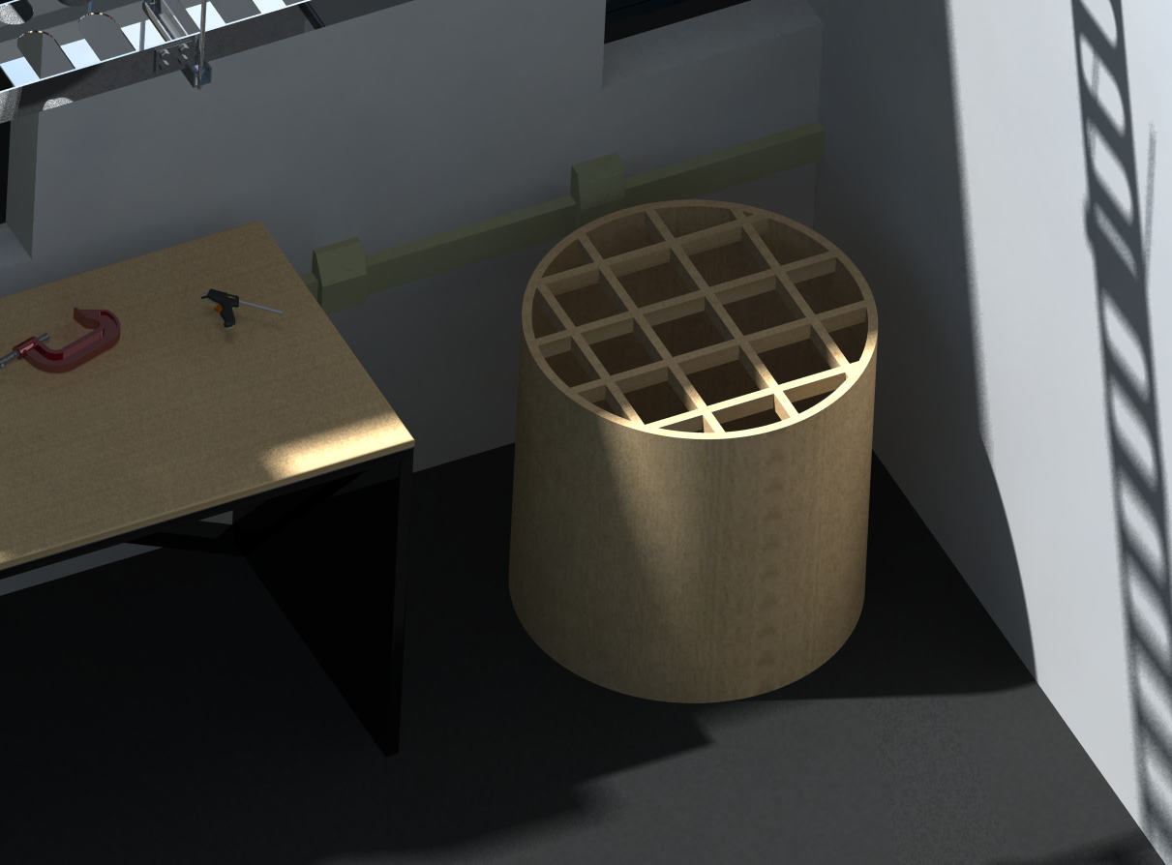
Storage
Material bin stores longer pieces of wood, metal, etc. in an upright and organized fashion

Slide 8
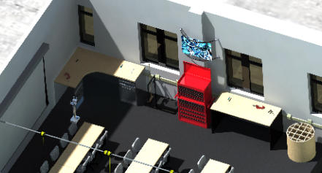
Workbench
Larger, taller tables for working on projects
Easily accessible tool box

Slide 9
EP 103

