Slide 1
Spinal Cavity Computational Fluid Dynamics
Orrin Adams, Marcelino Arteaga, Charles Krueger

Slide 2
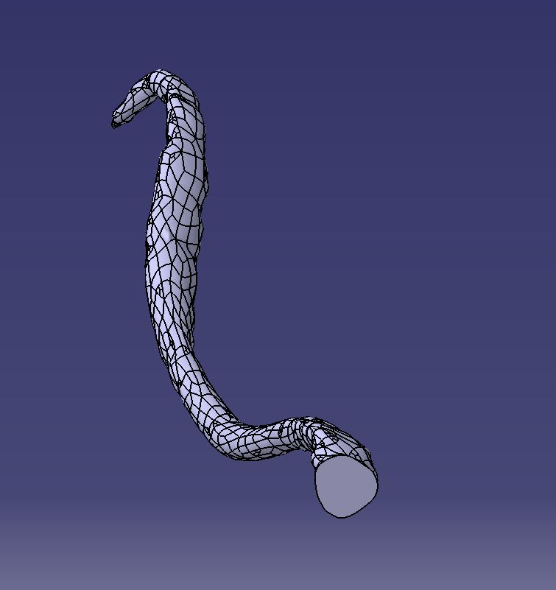
Objective
The purpose of this project was to build a model of the spinal cord cavity in CATIA that could be 3D printed and used for fluid analysis.
We started with STL files of the spinal cord and dura(the sheath around the cord that contains the fluid).
Spinal Cord
Dura

Slide 3
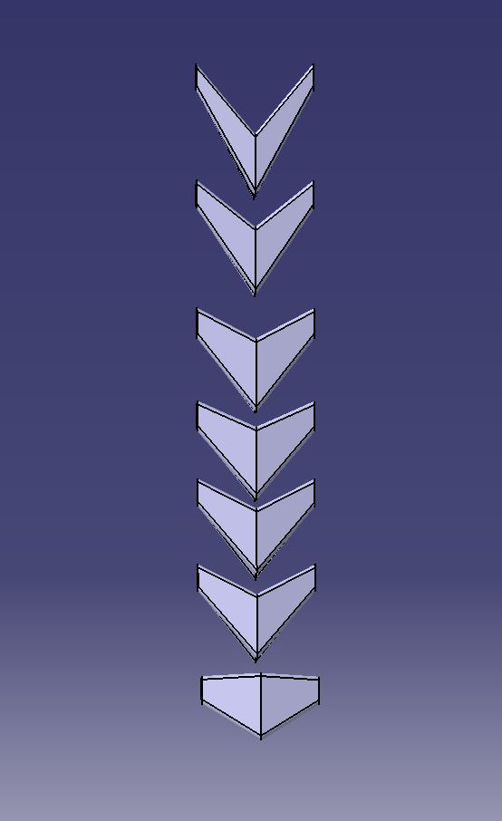
Nerve Rootlets
3D printed idealized nerve groups were used to support the spinal cord.
Due to their size these nerves had to be idealized so they could be printed.
Nerve rootlets form bundles and groups as they exit the dura and dimensions obtained from an MRI scan were used.
Idealized Cervical Nerve Roots

Slide 4
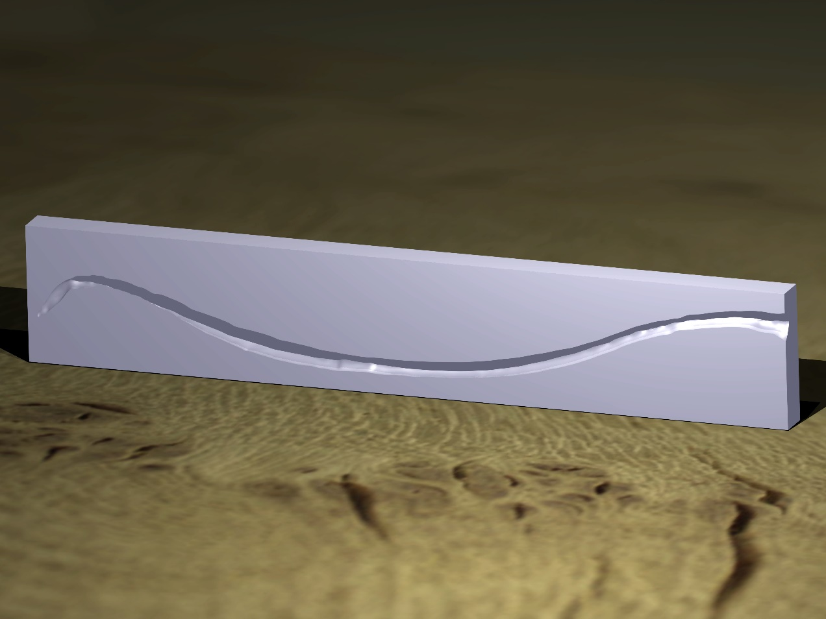
Dura Cavity
Using Boolean subtraction a cavity in the shape of the Dura was created.
Dura Cavity

Slide 5
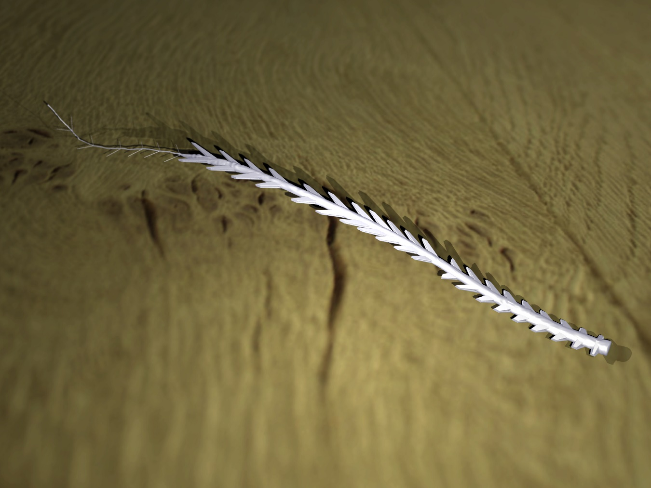
Spinal Cord + Rootlets
Using MRI data, the idealized rootlets were placed along the spine.
At the tail end simplified cylinders were used to provide support while still representing existing nerves.
Spinal Cord + Rootlets

Slide 6
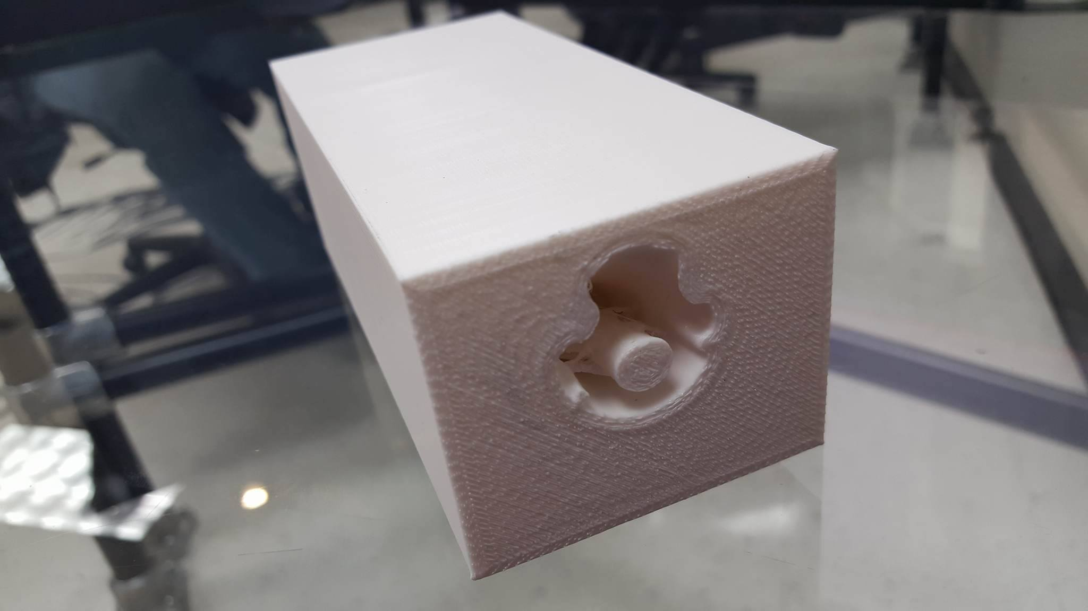
3D Print of Cervical Section

