Slide 1
Strictly I.C. Miniature Engine Design The DUX
Michael Mark
Ken Speers

Slide 2
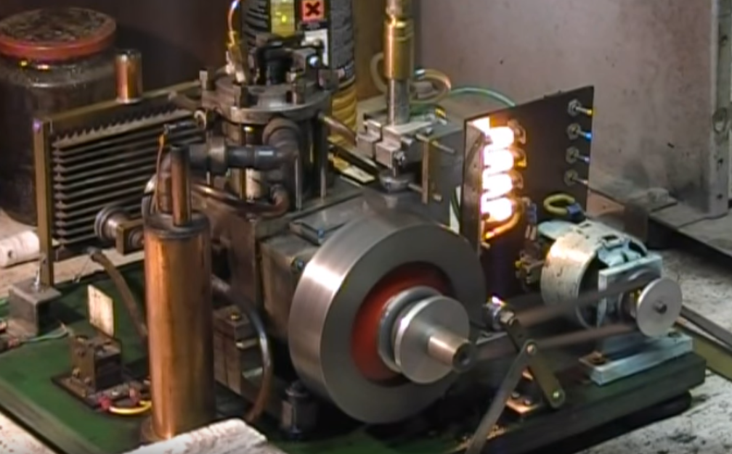
Objective
Given a 17 year old set of drawings, using CATIA 3-D modeling software, create and edit a set of models to accurately display the miniature diesel engine dubbed “The DUX” and its parts.

Slide 3
Water Pump Assembly
The water pump is a simple design of a rotor in a housing that is driven
by a shaft connected to a drive pulley

Slide 4
Fuel Injector Assembly
The fuel injector spray nozzle is created by scribing a
slot along the small insert shown in order to atomize
the fuel

Slide 5
Crankcase Assembly

