Slide 1
U of I Clean Snowmobile Front Suspension Model
Alex Wright, Joe Morris

Slide 2
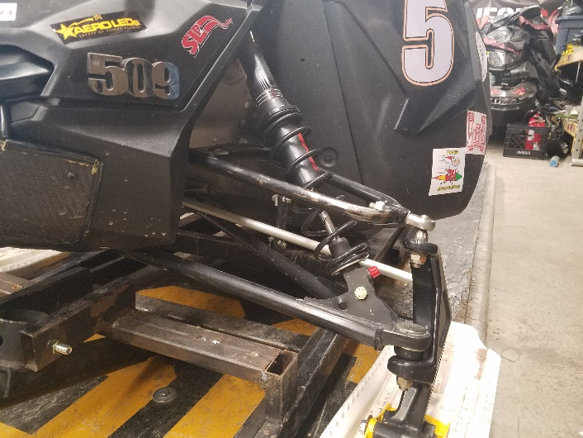
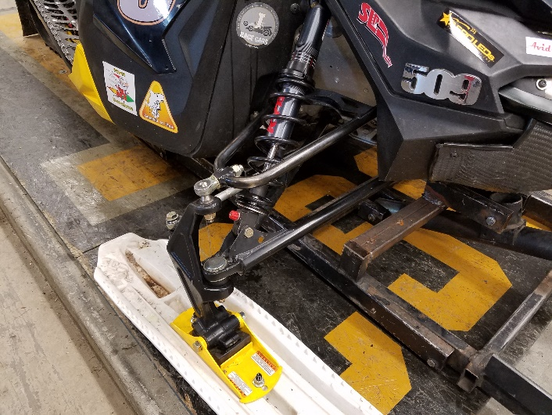
Objective
To create a model of the front suspension components to add to the larger model of the snowmobile
Create parts that can accurately represent themselves in a simulation

Slide 3
Spring and Shock Absorber
An assembly of the spring and shock absorber as it appears on the snowmobile
We modeled the assembly as individual components to allow for simulation

Slide 4
A-Arms and Ski-Leg
Ski-Leg
Upper A-Arm
Each part was modeled to ensure that the mounting points were exact
Lower A-Arm

Slide 5
Full Assembly
The completed model focuses on the geometry of the components and the interaction of the mechanical joints

Slide 6
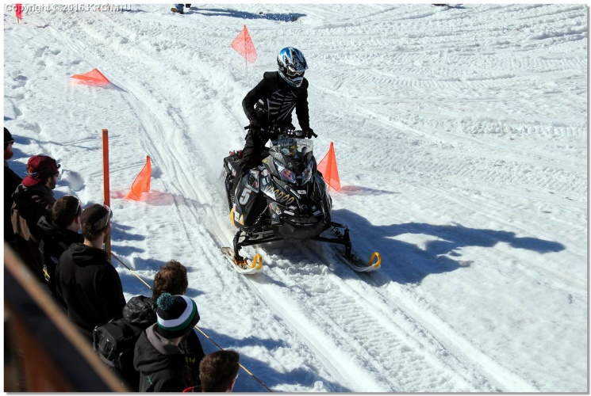
Conclusion
The main focus of this project was accuracy of the parts with the intent of putting these suspension components into a complete snowmobile model in the future

