Slide 1
Thermal Analysis and Simulation Using Abaqus CAE
Jake Miller, Patrick Paulus

Slide 2
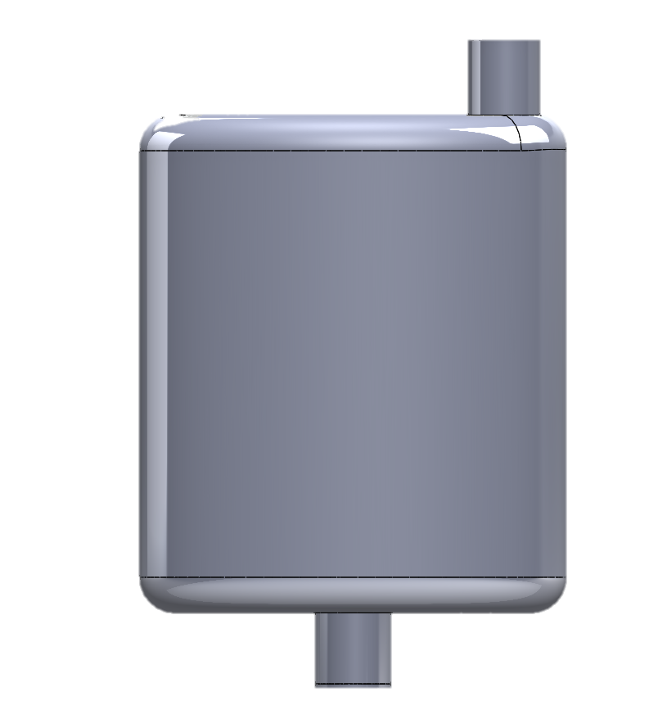
Objective
Identify viability of using Abaqus with CATIA
Conduct thermal and flow analysis of the CSC muffler
Document methods used for importing to Abaqus

Slide 3
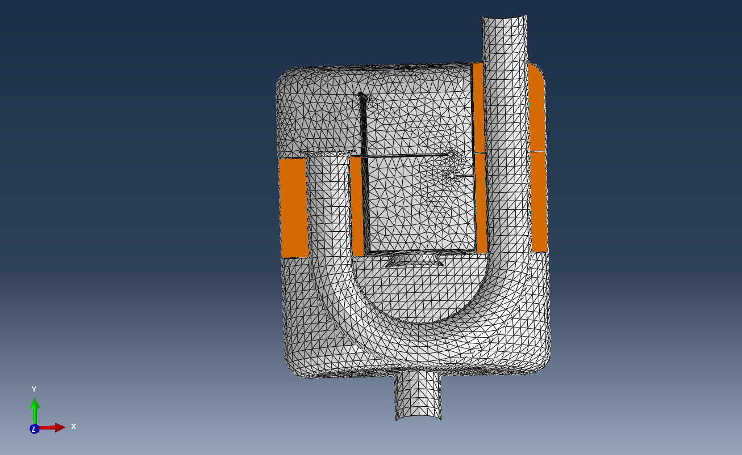
Importing the Muffler
Able to import as .IGS file and mesh using tetrahedral mesh shaping
Able to generate mesh and boundary conditions
Student License limited to 1000 structural nodes (used ~12000)

Slide 4
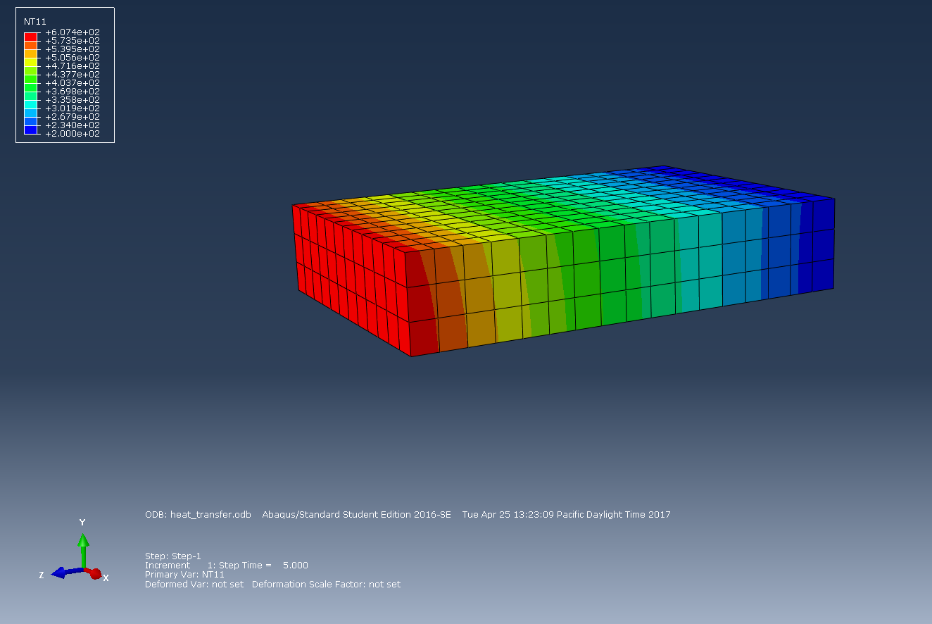
Simple Plate Thermal Analysis
Modelled constant heat flux and convection coefficient heat transfer
Simple geometry allowed for larger mesh size and quicker solver time

Slide 5
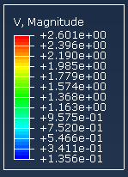
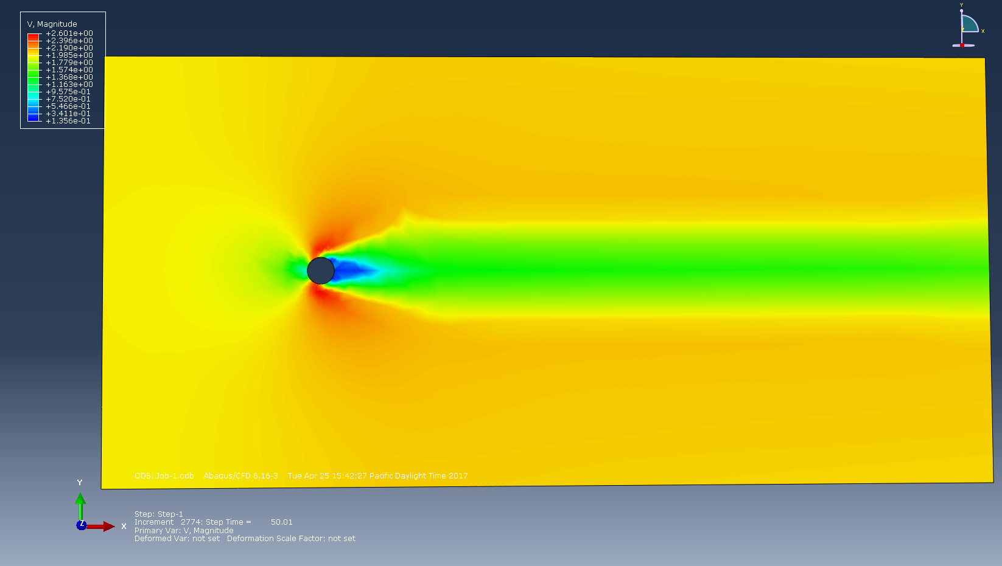
Simple Plate Flow Analysis
Modelled flow across a plate with a hole
Color graph represents velocity

Slide 6
Flow Time Step Video

Slide 7
Project Conclusions
Abaqus CAE is a powerful program but the academic version is severely limited by mesh size
Can be used for thermal, deformation, flow, and Multiphysics simulations
Model importation between CATIA and Abaqus is simple and fast

