Slide 1
Realistic CPU Block Visualization
Justin Hinrichs

Slide 2
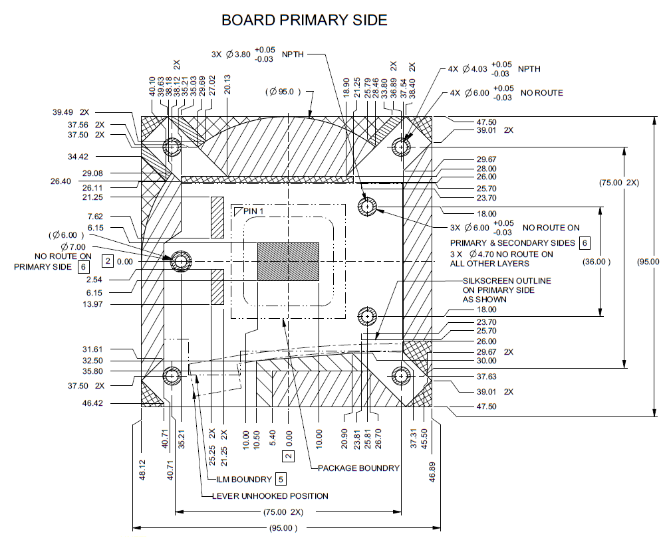
Item Modeling
Started by modeling the part based on estimated size, I had no other drawings to replicate other then how far the mounting holes are
Acrylic top was modeled with Intel’s Broadwell CPU line in mind.
Mounting holes are larger then needed to fit other mounting systems.
My motivation for doing this project was my love for building PCs and I wanted to find a unique block to model

Slide 3
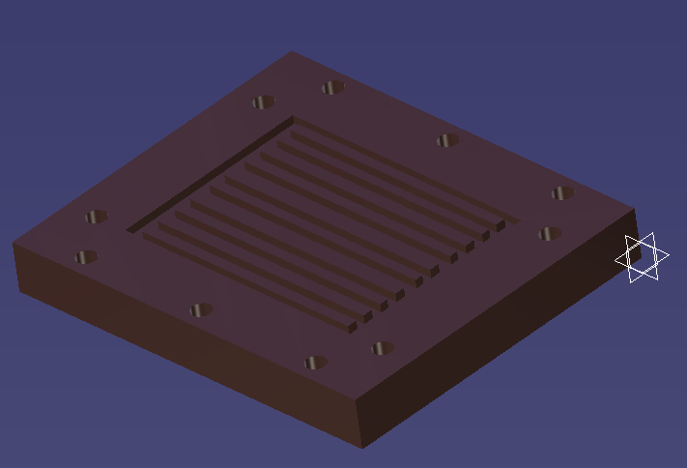
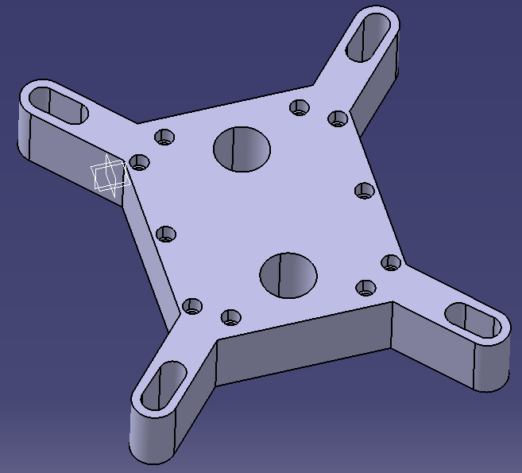
Modeling Process
A lot of time was spent modeling the copper block to size and finding the right size screw holes for the Acrylic piece.
The copper block has 10 channels milled out for water to flow through once assembled.
Most of the work done on these was with the pad and pocket tools.

Slide 4
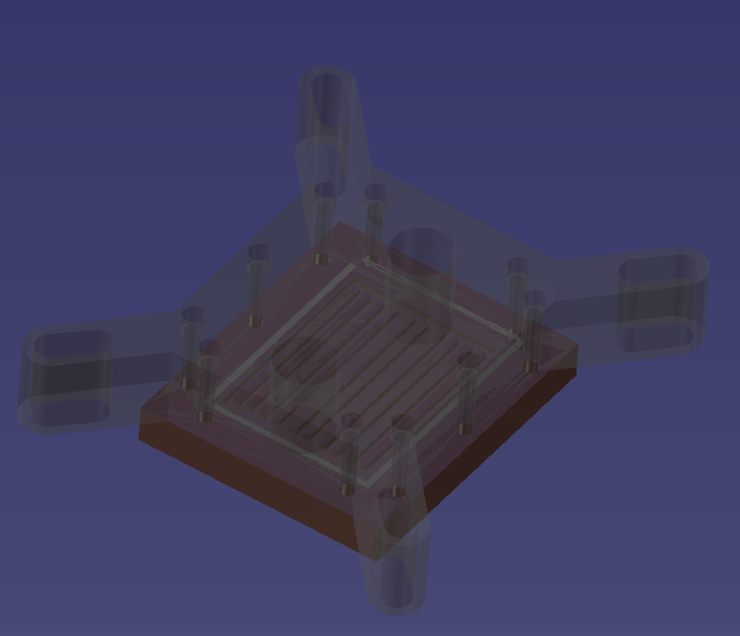
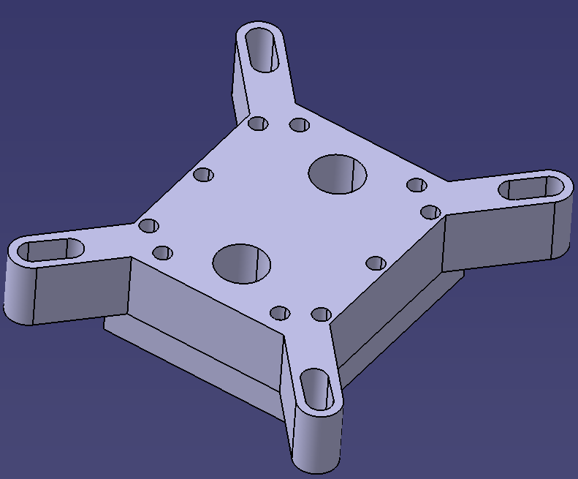
Final Assembly
This is the completed block put together in both material shading and in CATIA grey.
Assembly went smooth as there were only three parts and I cut grooves for the gasket and the acrylic lined up with the sides of the block.

Slide 5
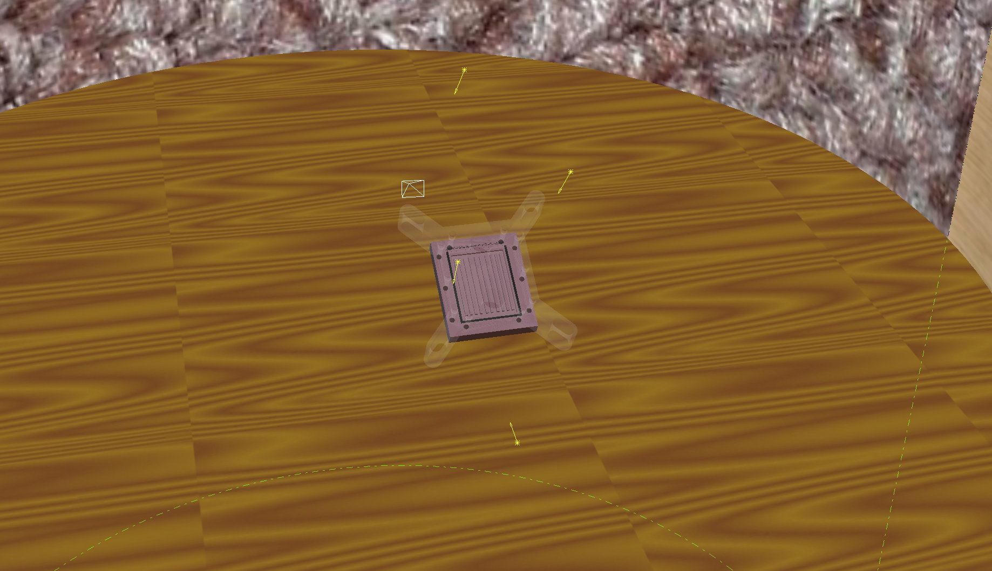
Rendering
Setting the scene was a big part of rendering and if the floor was too reflective or dark the renders would not look quite right.
Positioning the lights was also a difficult task to try and get them to be non reflective and not very intense as to block out some projected shadows.
Adding a slight angle to the part allowed me to get a decent viewing angle to be able to see the depth of the acrylic top.

Slide 6
Comparison
Final Render
Real Thing

Slide 7
Lessons Learned
Low Refraction on see-through objects is very helpful to be able to see through it and yet give it some depth.
Positioning lights and making them less intense to highlight the object they are showing allows a cleaner render.
The ambient of the environment shouldn’t be too bright or dark and be secondary to the object it is centered around.
You can add color blank to a material to give it more depth and realistic look. For example I added a color blank of some scuffed up copper to the block to add to its realism.

