Slide 1
Sustainability in
Capstone Design

Slide 2
COE’s Sustainability Definition
Developed by the COE Sustainability Task Force
Resiliency
To thrive, even under extreme conditions, to overcome disruptions and to create a better future for all.
Economic Vitality
Lean manufacturing, sustainable economic growth, sustainable development and the reduction of poverty and inequality.
The mission of the COE’s Sustainability Initiative is to empower students, faculty, and staff to bring academic expertise to help solve real world challenges through study, research, practice, and advocacy to improve the quality of life for generations to come.
Our Sustainability Initiative encompasses:
Resiliency
Economic Vitality
Environmental Impact
Social Development
Environmental Impact
Use and preservation of resources including energy, water, air, land, biodiversity, and food. The reduction of waste and emissions as well as focusing on increasing reuse and recycling.
Social Development
To promote peace, security, justice, diversity, inclusiveness, health and wellbeing, global education, honesty, transparency, and integrity.
Key Emphasis Sustainability efforts need to be sustainable!

Slide 3
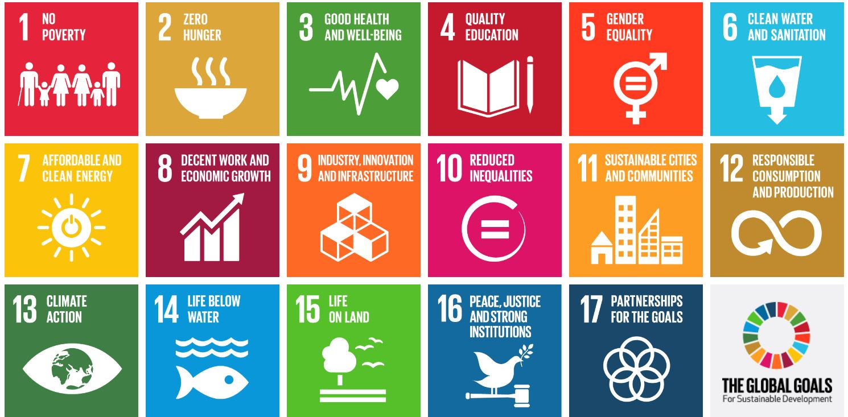
Sustainability – The Global Goals
Homepage - The Global Goals

Slide 4
Industry support
Goal Company What _
1. NO POVERTY Visa financial services to the underserved
2. ZERO HUNGER General Mills meals to local food banks
3. GOOD HEALTH AND WELL-BEING Kaiser Permanente invests in healthy communities
4. QUALITY EDUCATION LEGO funds children’s play, learning, and creativity
5. GENDER EQUALITY Participant Media teaches students worldwide about Malala
6. CLEAN WATER AND SANITATION Kimberly-Clark recognizes that toilets change lives
7. AFFORDABLE AND CLEAN ENERGY Cummins investing in solar power
8. DECENT WORK AND ECONOMIC GROWTH Microsoft helps young people develop computer skills
9. INDUSTRY, INNOVATION, AND INFRASTRUCTURE Qualcomm wireless technology to underserved communities
10. REDUCED INEQUALITIES Citi diversity as a source of strength
11. SUSTAINABLE CITIES AND COMMUNITIES Siemens communities green and sustainable economic solutions
12. RESPONSIBLE CONSUMPTION AND PRODUCTION Nike recycled materials in most of its gear
13. CLIMATE ACTION JetBlue teaches customers and crew about climate change
14. LIFE BELOW WATER Discovery Channel supports clean oceans
15. LIFE ON LAND The North Face protects outdoor areas
16. PEACE, JUSTICE, AND STRONG INSTITUTIONS AirBnB helps refugee relief workers with places to stay
17. PARTNERSHIPS FOR THE GOALS TripAdvisor partners with GlobalGiving to support locally-driven nonprofits
Source: How 17 Companies Are Tackling Sustainable Development Goals (and Your Company Can, Too) - SDGfunders

Slide 5
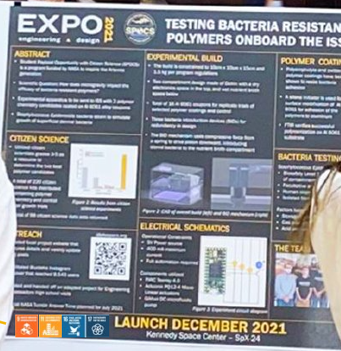
Making Claims . . .
Capstone DESIGN
Assignment:
Identify which of the 17 Global Goals you think your project will positively impact (no > 5).
Add your top impacted Global Goal icons (below) on all subsequent Storyboard and Poster Presentations (on Snapshot Days)
Be ready to talk about why you selected the impacted goals for your project. Example: “Our project will save money (or improve the environment, or benefit society) by…”
Stretch Goal:
Try to estimate how much your project will impact one of the Global Goals. Example: “Our project will save $XX (or improve the environment by reducing xxxxxxxx by XX%) via…”

