Slide 1
Introduction to 3D Printing

Slide 2
Basic diagram (Fused Filament Fabrication)
Movement in 3-axis
Raw material (filament)
Raw material control (extruder)
Surface for manufacturing (bed)
Control system

Slide 3
3D printing process

Slide 4
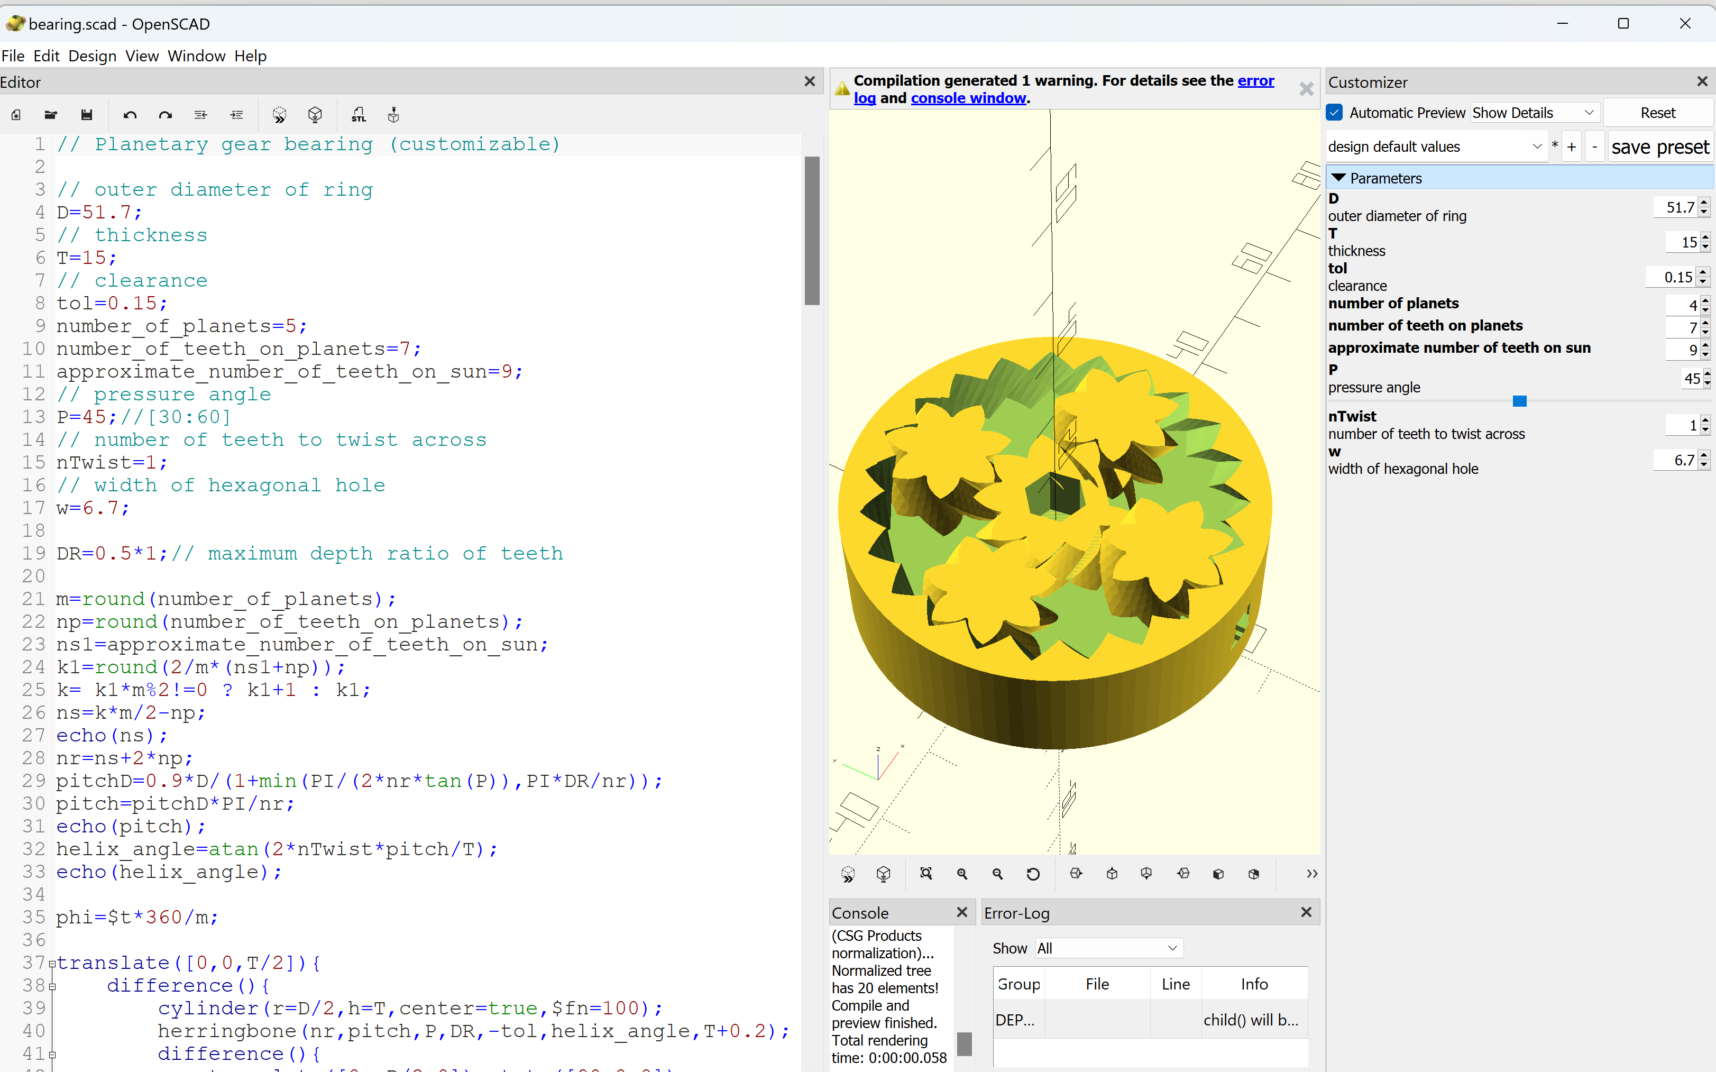
3D CAD model
Create 3D models
Solidworks
FreeCAD
Sketchup
OpenSCAD

Slide 5
3D CAD model
Use existing models
Thingiverse
Grabcad
Other sources
Check license

Slide 6
Slicing software
https://3dprinter.sindoh.com/en/support/downloads

Slide 7
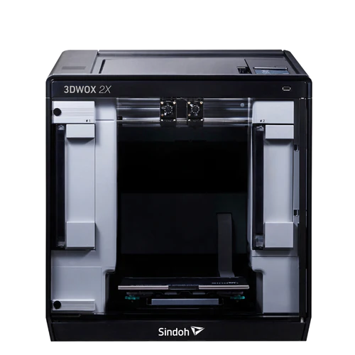
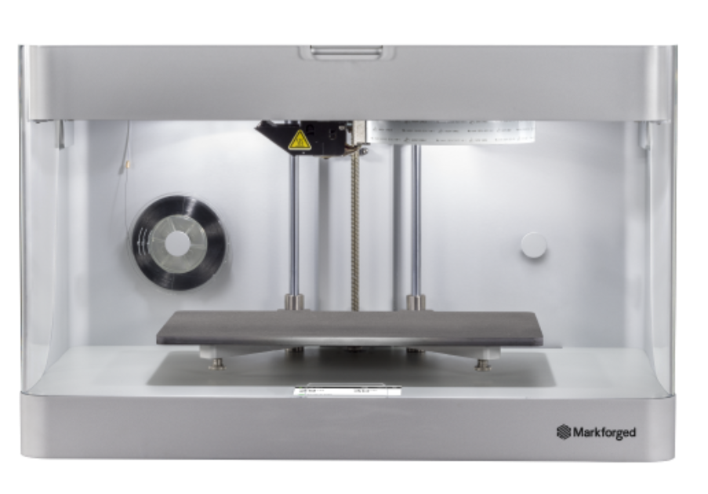
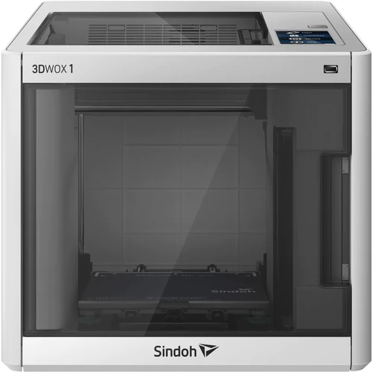
Design considerations
Print volume (aka "build volume")
Bed adhesion
Layer adhesion
Support material
Print directionality
Feature size
Sindoh 3DWOX1
Sindoh 2X
MarkForged Onyx Pro
MarkForged MarkTwo

Slide 8
Build Volume
 | 3DWOX1 234F | 2X | OnyxPro / MarkTwo
Build Volume | 210 x 200 x 195 mm | 228 x 200 x300 mm | 320 x 132 x 154 mm
Layer Height | 0.050 - 0.2 mm | 0.050 - 0.2 mm | 0.1 - 0.2 mm
Materials | PLA/ABS (other non-sindoh) | PLA/ABS/TPU/PVA (other non-sindoh) | Onyx/Nylon MarkTwo only: Cont. fiber reinforcement (Carbon Fiber, Fiber Glass, HSHT Fiber Glass, Kevlar)

Slide 9
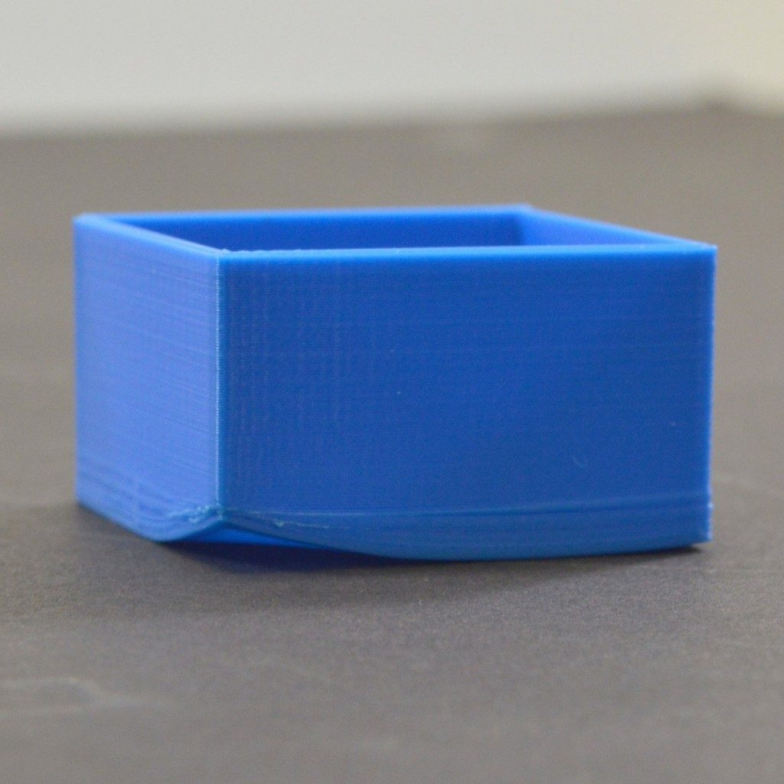
Bed Adhesion
Prevent inadvertent separation
Reduce warping
3 types
Raft – stabilize models with small footprint
Brim – add stability that's easy to remove
Skirt – prime nozzle for steady flow

Slide 10
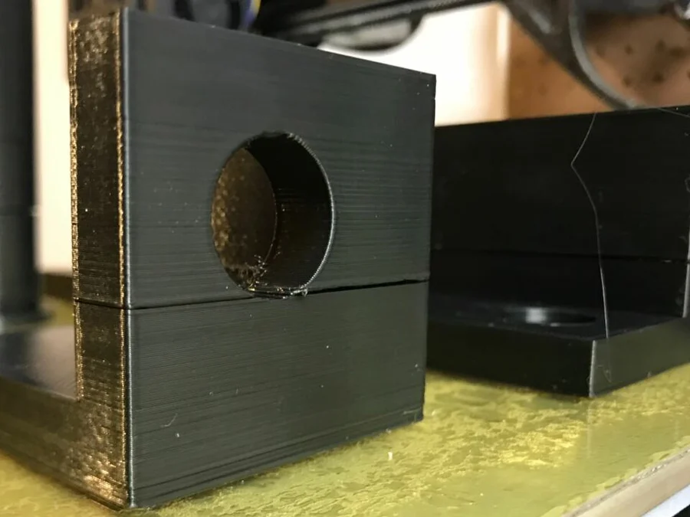
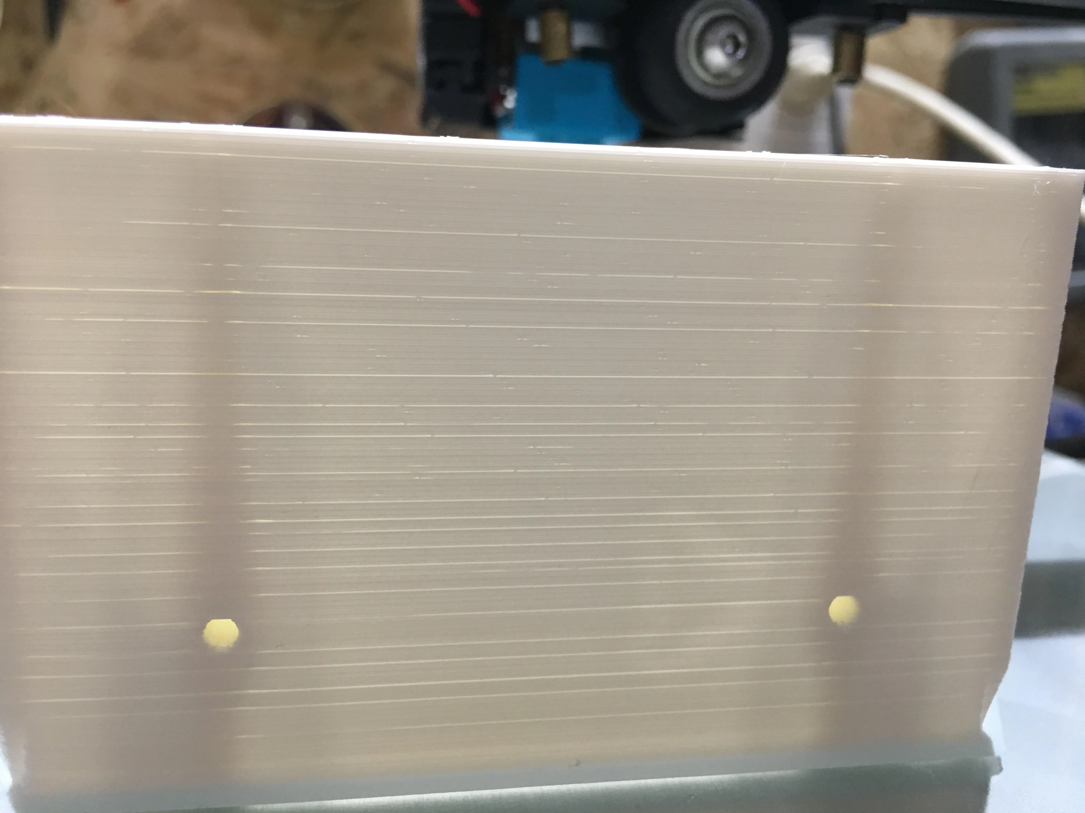
Layer Adhesion
Affected by:
Hot end clogs
Print speed
Hot end temp
Filament feed rate
Part cooling
Layer height
Moisture in filament
Nozzle width

Slide 11
Effects of Print Directionality
X/Y plane
High resolution
High strength
Z/X and Z/Y planes
Weaker along layer lines

Slide 12
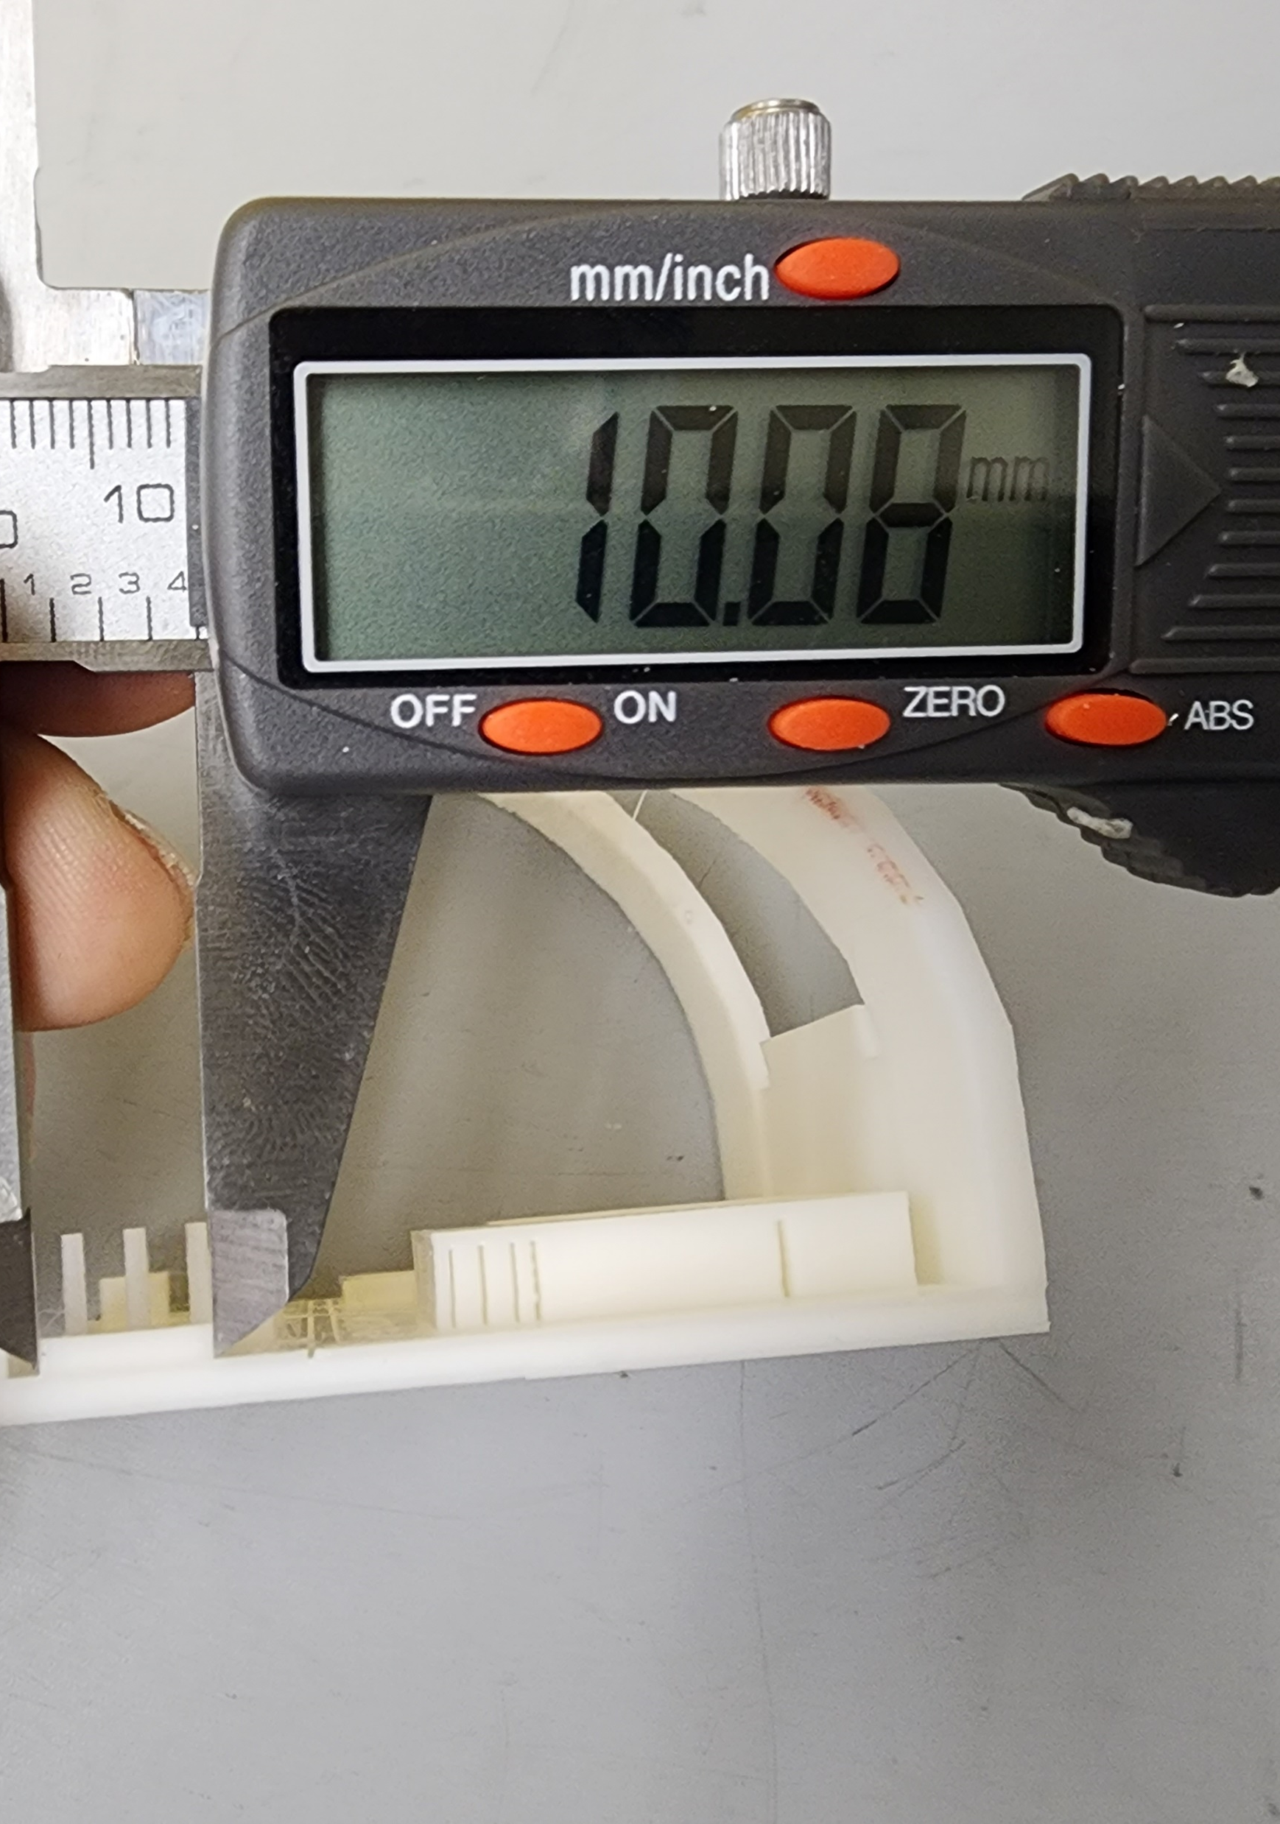
Support material and Feature Size
Nozzle is 0.4 mm
Can’t reliably make smaller features
Can make smaller features such as holes with trial and error
Preferable at least 2 x nozzle width (~ > 1 mm)

Slide 13
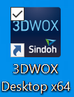
How do you print a part?
Make a part in Solidworks
Export part as an STL (using "save-as")
Import (or drag and drop) STL into slicer
Select printer and print material
Adjust print settings or use default ("Normal" from Easy Mode)
Build layers ("Layer Viewer" in 3DWOX Desktop)
File-->Save G-Code to flash drive
Put flash drive into printer usb port
Select "Print", Select your file, and follow on-screen instructions

