Slide 1
sensors
created by:
Zach lipple
Porter dallenbach

Slide 2
overview
Signal Types
Sensor Types
Magnetic
Potentiometers
Mass Air Flow
Thermocouples
Thermistors
Stator (Magneto)
MAP
Injectors
O2 sensor
Communication Protocols
CAN

Slide 3
Signal Types
Analog vs. Digital
Blue: Digital (1’s and 0’s)
Red: Analog (continuous signal)

Slide 4
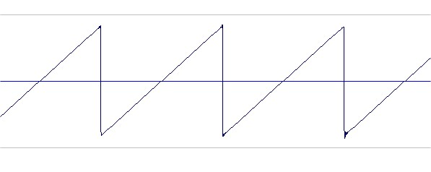
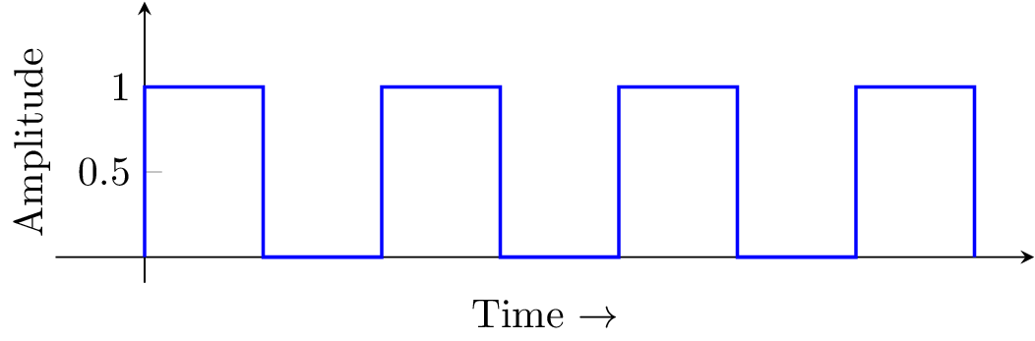
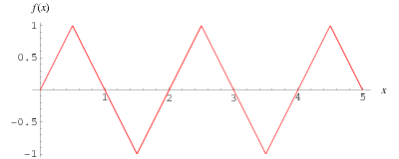
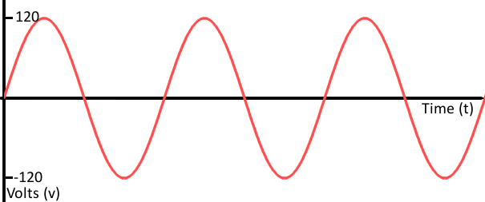
Signal types
Wave types
Square
Sawtooth
Hall Effect Sensor
Encoder
Triangular
Analog/sine
Magnetic Sensor
Most sensors

Slide 5
Magnetic Sensor
Inductive
Where do we use it?
2 Wires
Produces triangular wave
Used for rotational position
Must be moving to generate signal
uses voltagecreated by electromagnet to determine proximity
No friction involved (no wear)
CPS (Crankshaft Position Sensor)

Slide 6
Magnetic Sensor
Hall effect
3 Wires
Produces square wave
Either on or off based on proximity of a magnet
Typically used to count rotations
Where do we use it?
Track Speed

Slide 7
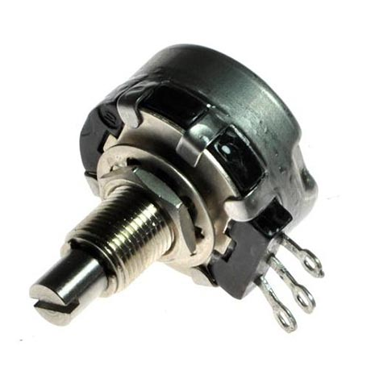
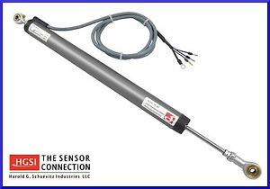
Potentiometer
Rotational & linear
3 Wires
0-5V analog voltage
Potentiometer: “variable resistor”
Where do we use it?
Used for TPS (Throttle Position Sensor)

Slide 8
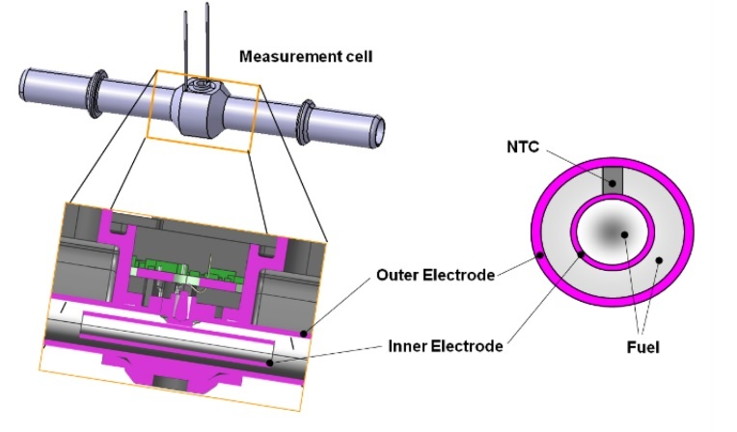
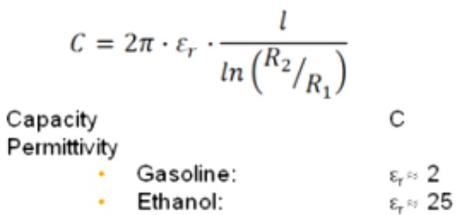
Capacitance meter
Part of flex fuel sensor
Sends an AC Voltage
Measures Capacitance of Fuel (related to change in voltage)
Outputs a oscillatory voltage response (sine wave) at signal wire
Frequency of output is proportional to ethanol %
Sine wave converted to steady voltage via the Flex Fuel module, then sent to EMM

Slide 9
Mass Air Flow (MAF) Sensor
5/6 Wires
Typically outputs a 0-5V analog signal, some output PWM
Hot wire, cold wire, or mechanical
Where do we use it?
Can be used on Dyno
Not currently used

Slide 10
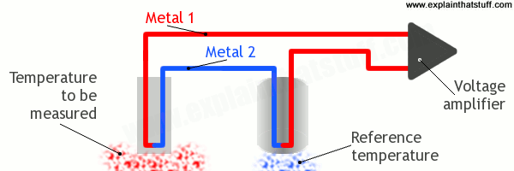
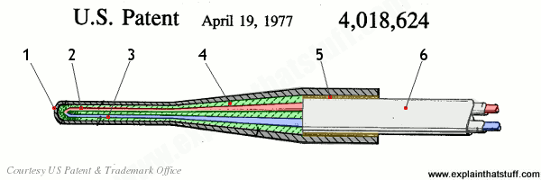
Thermocouple
2 Wires
Generate a voltage based off of the temperature differential between hot and cold end with different metals
Needs reference from cold side
Seebeck Coefficient
Types J, K, T, N, E, B, R, S
All of ours are type K
Chromium-Alumel
Cheap, wide temperature range
Up to 1100ºC
Where do we use it?
Head temp
Exhaust on chassis
Intake

Slide 11
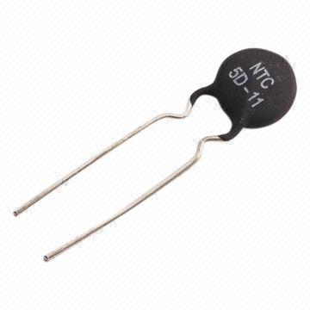
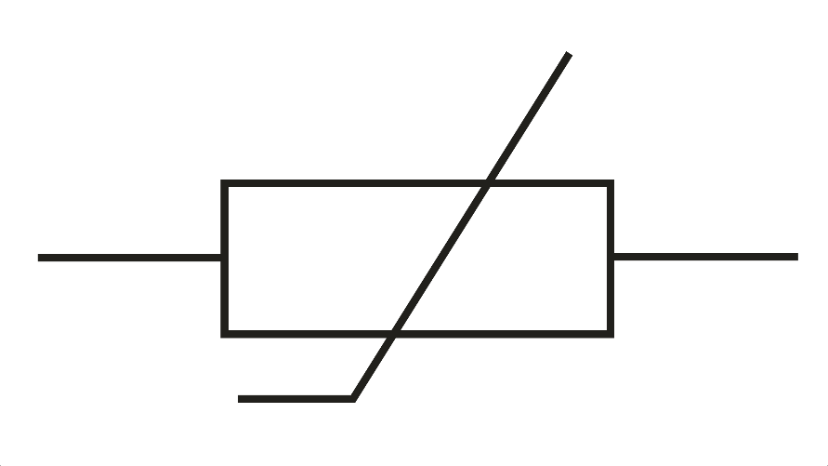
Thermistor
“Thermal Resistor”
2 types: NTC and PTC
Change resistance based off of their temperature
Temperature sensing applications typically use NTC, so the higher the temperature, the higher the voltage
Where do we use it?
Not currently being used

Slide 12
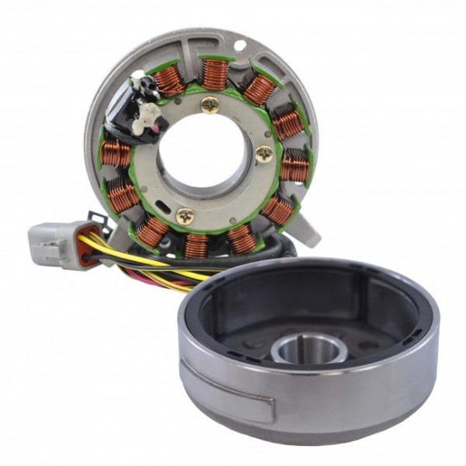
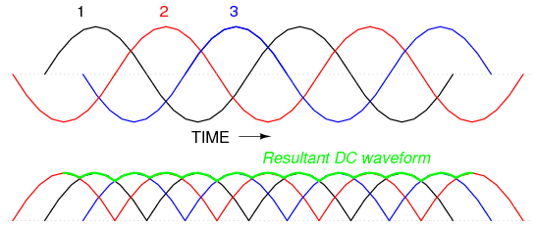
Stator & Magneto
3 or 6 Wires
Stator is the stationary winding
Magneto is the permanent magnet that spins to generate power
20V AC/Phase
Magneto provides the initial current to start the engine (pull start) and charges the battery
Rectifier converts to 12V
Where do we use it?
Generating electricity
V

Slide 13
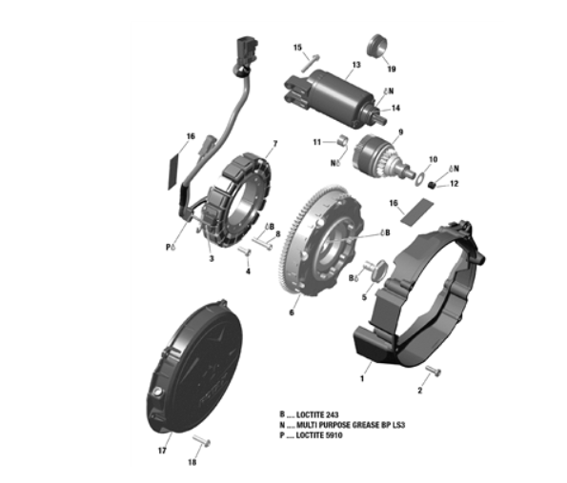
Magneto and starter
Starter
Stator
Magneto
Credit: Skidoo

Slide 14
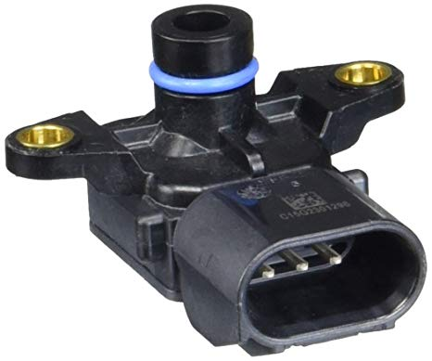
Manifold absolute Pressure (MAP) Sensor
3 Wires
0-5V analog
Reads the vacuum of the intake manifold to determine engine load
Where do we use it?
We currently don’t

Slide 15
Injectors
2 Wires
Pulse driven, 55V DC, electromegnet
Voice Coil (on our sled)
Injection quantity/ duration dependent on voltage
Where do we use it?
ETEC direct injectors

Slide 16
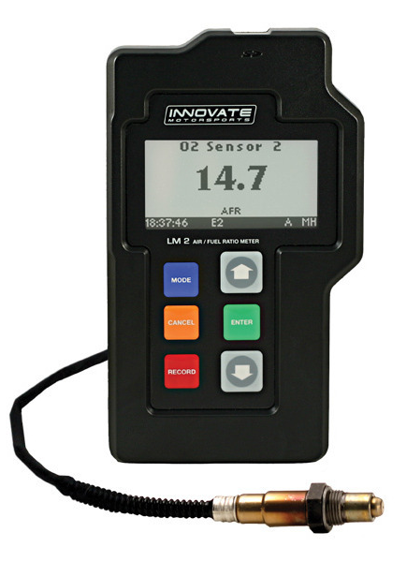
02 sensor
Typically voltage between 0-1V
Placed in exhaust stream
Tells quantity of O₂ present in exhaust gases (lambda not phi)
We use an Innovate LM-2 AFR meter
Where do we use it?
In the exhaust stream on dyno
Would make closed-loop emissions if on chassis

Slide 17
CAN Bus
general
2 Wires
Developed at Bosch
“Controller Area Network”
Differential Signal – High and Low signal state determined from the voltage difference between two signal lines
Message-based rather than address-based
Each message starts with a message ID, and devices on the network can choose whether or not to pay attention
Also for BUDS diagnostics/ reads
Where do we use it?
All CAN signals from ECU
Hopefully on dyno someday

Slide 18
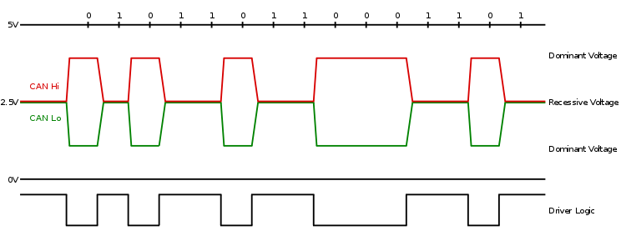
Can bus
Signal example

