Slide 1
Two stroke engines
Presented By:
Porter dallenbach
Garrett potts

Slide 2
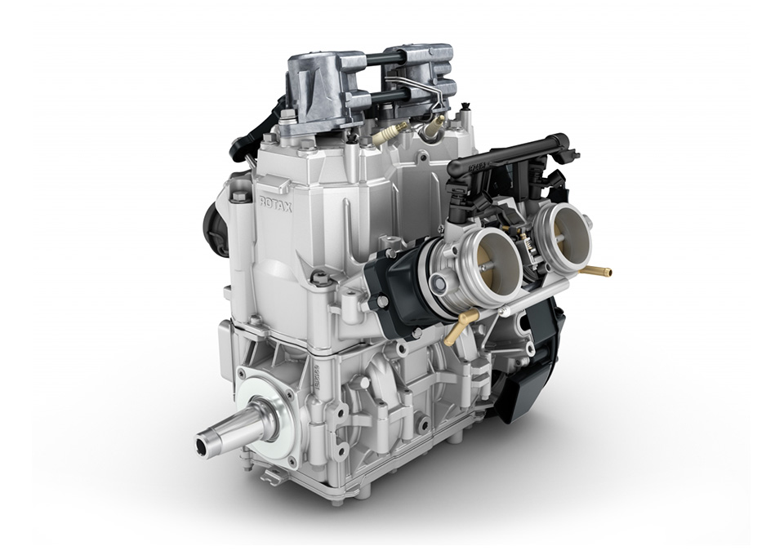
outline
Pass around engine
Basic angine architecture
Four Stroke Quick Look
Two Stroke Basic Operation
Tuned Pipe use
RAVE valve
Reed valve

Slide 3
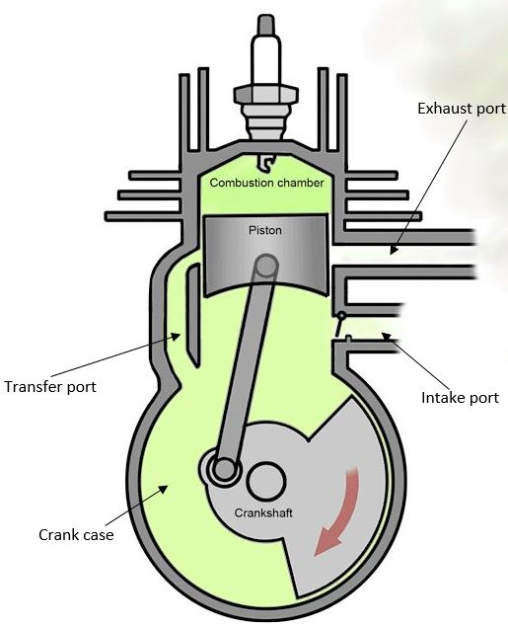
Basic architecture
Block
Head
Piston
Connecting rod
Crank case
Crank shaft
Spark Plug

Slide 4
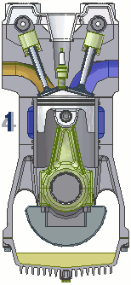
4 strokes
Overhead cam configuration
Most common
Cars, lawn mowers, generators, motorcycles
4 strokes are:
Intake
Compression
Ignition
Exhaust
Poppet valves are activated via camshaft with cam lobes
Either overhead cams or pushrods
Able to run extremely high RPM
Easier control of emissions
Lower frequency seems quieter

Slide 5
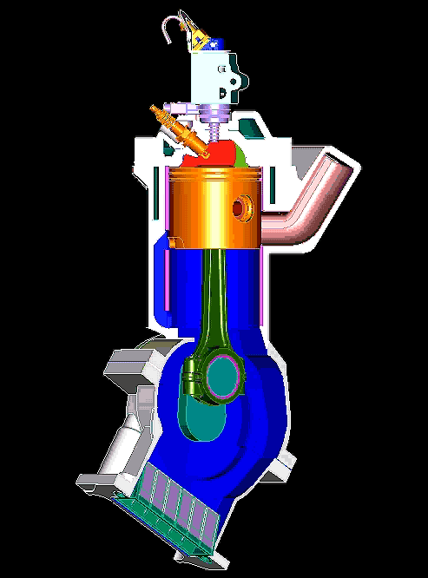
Two strokes
What we run
Intake/exhaust in first stroke
Compression/ ignition in second stroke
Twice as often ignition
Higher frequency sound
Quicker throttle response
No camshaft reduces weight
Greater power per volume

Slide 6
Tuned pipe
AKA expansion chamber
Gasses exit while pressure waves reflect back to exhaust port
Keeps pressure in cylinder before ports are closed
Shown is throttle body injection
Blue: fresh air
Green: air/ gas mixed
Grey: exhaust mixture (burned)
Useful for us?
Lower RPMs need more time between port closures
Longer pipe allows this

Slide 7
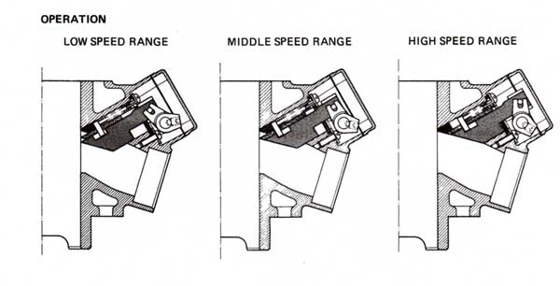
RAVE valve
Electronic control
Smaller port size increases gas velocity for lower RPM
Larger port allows volumetric flow for higher RPM
Without, the engine would only make power at one RPM

Slide 8
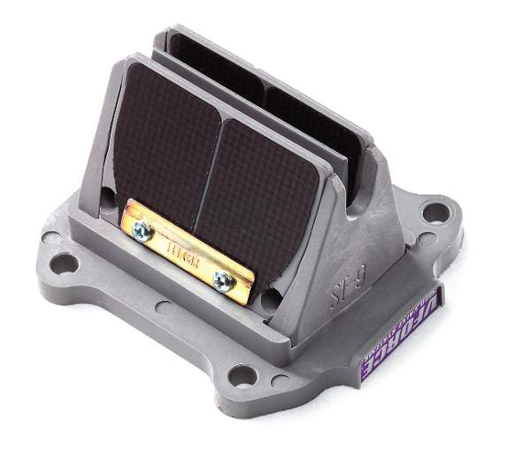
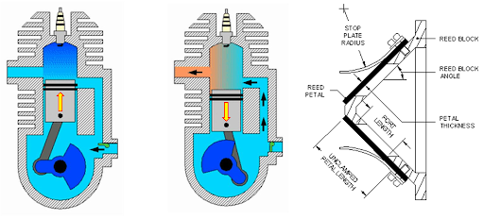
Reed valve
intake
Passive system
Made of rubber, plastic, and carbon fiber
Acts as a check valve for air
Closes with pressure in cylinder
Opens with suction

Slide 9
Sources
Yes, what a concept
https://blog.amsoil.com/how-does-a-two-stroke-power-valve-work/

