Slide 1

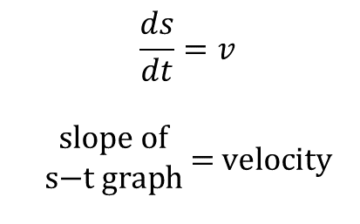
Relationship Between s-t, v-t, and a-t Graphs
Big picture, you have a good feel for how position, velocity, and acceleration are related mathematically. But I want to help you build a little more intuition about how they are related visually.
In days of old, computers were slow, and the Internet was still a rogue idea in Gore’s head. But engineers were becoming good at graphical solutions to math problems that had no known analytical solution. This was particularly true of calculus and differential equations problems.
You know that:
$$\frac{ds}{dt}=v$$ $$\begin{matrix}\text{slope} \text{of} \\ \text{s}\text{−}\text{t} \text{graph}\end{matrix} \text{=} \text{velocity}$$
$$\frac{dv}{dt}=a$$ $$\begin{matrix}\text{slope} \text{of} \\ \text{v}\text{−}\text{t} \text{graph}\end{matrix} \text{=} \text{acceleration}$$
In theory, if I gave you a plot of a position vs. time, and some grid paper, you could probably draw me a pretty accurate velocity vs. time plot. Or, at least that’s what I’d like you do to.

Slide 2
Relationship Between s-t, v-t, and a-t Graphs
“But Dr. Dan…..why would we want to learn a skill like that? When would it ever be useful in modern times?”
- Imaginary Dynamics Student
That’s an excellent question, young grasshopper. The answer is:
Outside of a ‘Fluids Lab’ working problems on a napkin, you probably never will.
But if you replace ‘plot’ with ‘data’ and ‘grid paper’ with ‘phenomenal (computational) power’ then the answer is: All the freaking time.
Besides, this is a tool that also serves as another great way to check your (or someone else's) work. You should get so good at comparing these kind of charts that you can do it with very little mental effort.

Slide 3
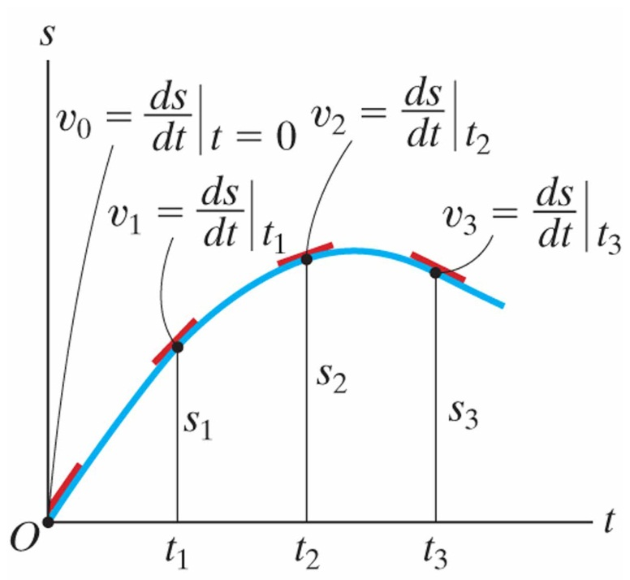
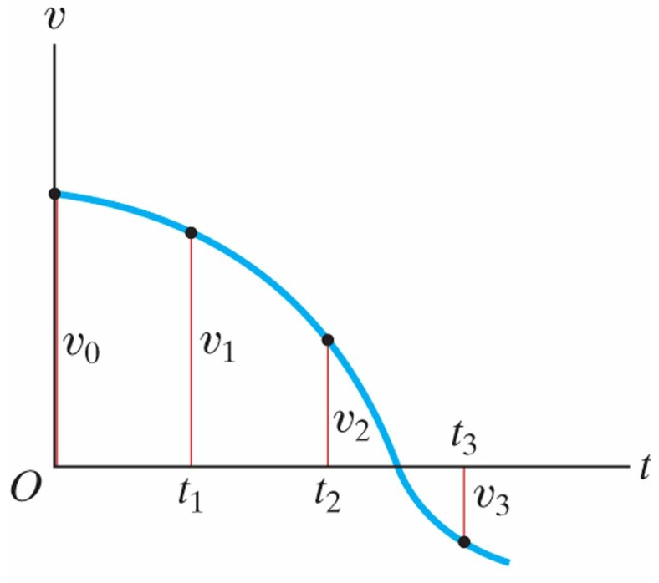
Rectilinear Kinematics: Erratic Motion
12.3
In many cases the position, velocity, and acceleration of a particle cannot be described by a continuous mathematical function along its entire path.
The s-t and v-t graphs:

Slide 4
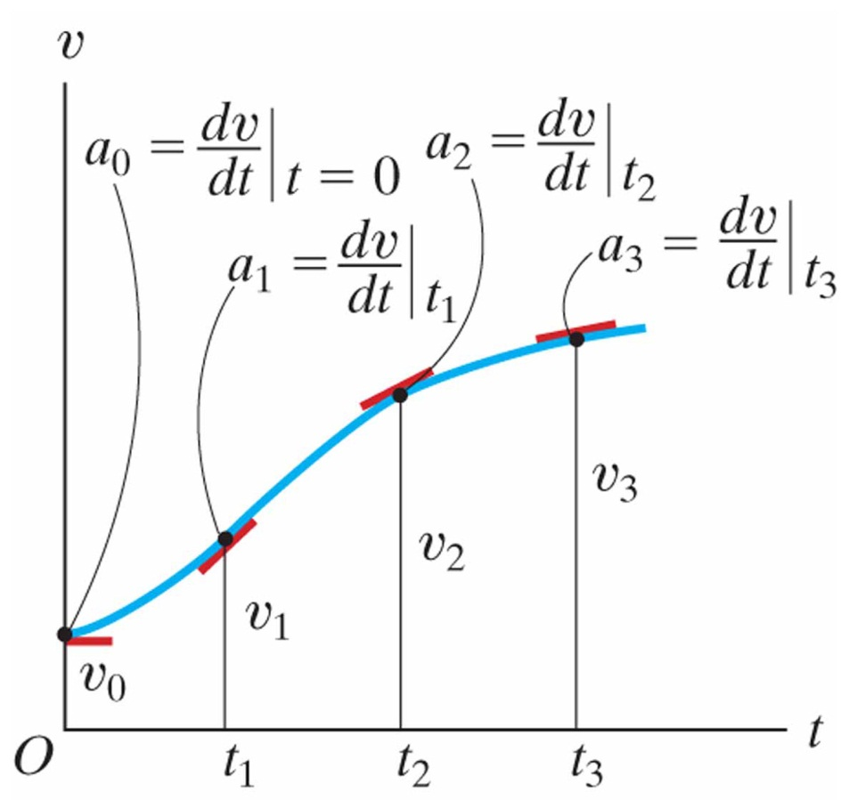
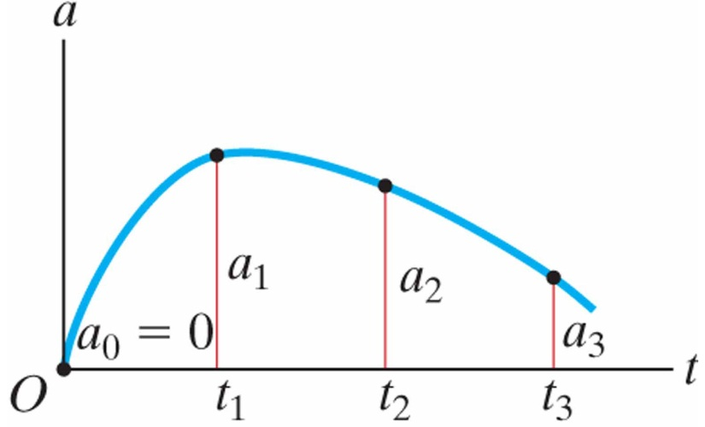
Rectilinear Kinematics: Erratic Motion
12.3
In many cases the position, velocity, and acceleration of a particle cannot be described by a continuous mathematical function along its entire path.
The v-t and a-t graphs:

Slide 5
Relationship Between s-t, v-t, and a-t Graphs
How about the other way? What if you have a plot of acceleration as a function of time? How to you get to velocity? Or position?
You know that:
In theory, if I gave you a plot of acceleration vs. time, and some grid paper, you could probably draw me a pretty accurate velocity vs. time plot.

Slide 6
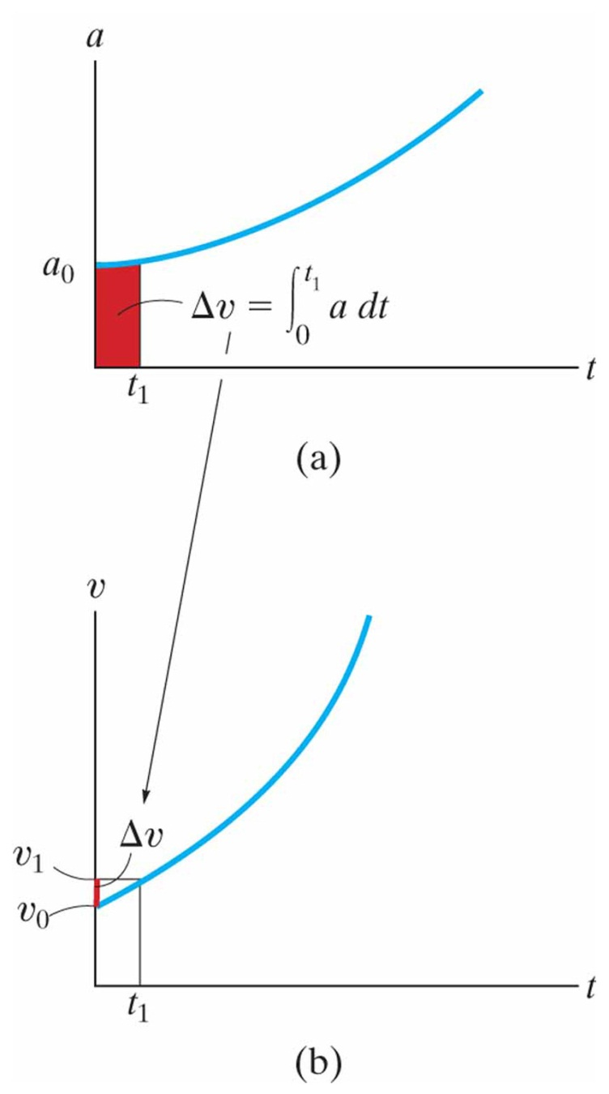
Rectilinear Kinematics: Erratic Motion
12.3
In many cases the position, velocity, and acceleration of a particle cannot be described by a continuous mathematical function along its entire path.
The a-t and v-t graphs:

Slide 7
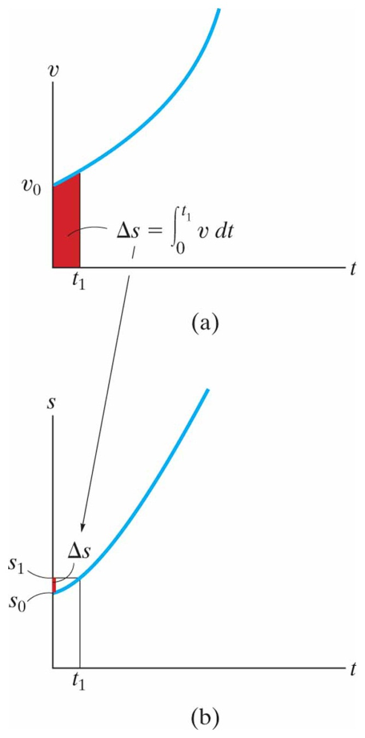
Rectilinear Kinematics: Erratic Motion
12.3
In many cases the position, velocity, and acceleration of a particle cannot be described by a continuous mathematical function along its entire path.
The v-t and s-t graphs:

Slide 8
Relationship Between s-t, v-t, and a-t Graphs
Group Discussion:
With those around you see if you can come to some agreement on the following scenerio:
Suppose you wanted to know the position, velocity, and acceleration of an object as a function of time. You have a device that will record data (time stamped), but you can only choose one sensor. You can record position, velocity, or acceleration. What sensor would you choose, and why?

Slide 9
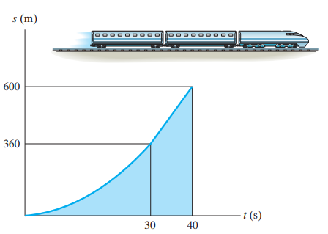
In-Class Practice Problem 1
What do you notice?
Key words?
How to you approach the problem?
What do you predict about the answer?
What are the units for velocity and acceleration going to be?

Slide 10
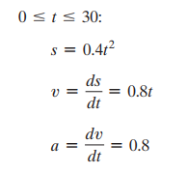
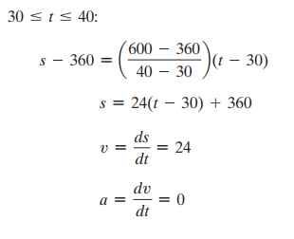
In-Class Practice Problem 1
Mathy Solution

Slide 11
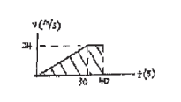
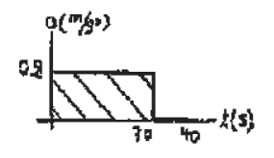
In-Class Practice Problem 1
Napkin Solution

Slide 12
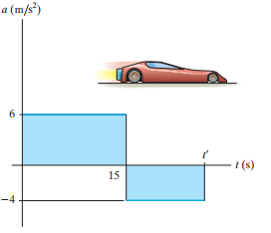
In-Class Practice Problem 2
What do you notice?
Key words?
How to you approach the problem?
How big are these accelerations? What can you compare them with?
What do you predict about the answer?
What are the units for velocity and position going to be?

Slide 13
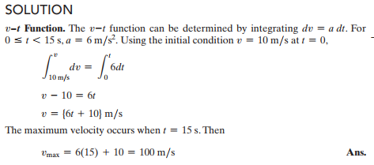
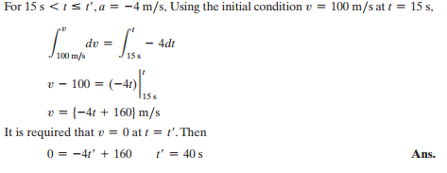
In-Class Practice Problem 2

Slide 14
In-Class Practice Problem 2

Slide 15
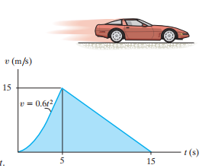
In-Class Practice Problem 3
What do you notice?
Key words?
How to you approach the problem?
How fast is 15 m/s in mph?
Is this something a mid 80’s to early 90’s Vette could do?
What do you predict for average acceleration?
What do you predict for average deceleration?

Slide 16
In-Class Practice Problem 3
How fast is 15 m/s in mph?
→ A little over 30 mph
Is this something a mid 80’s to early 90’s Vette could do?
→ Yes. Maybe a bicycle too.
What do you predict for average acceleration?
What do you predict for average deceleration?
→ Acceleration is slope of v-t. Straight line from origin to peak
is about 15 [m/s] / 5 [sec] = 3 m/s².
Deceleration is 15 [m/s] / 10 [sec] = 1.5 m/s²

Slide 17
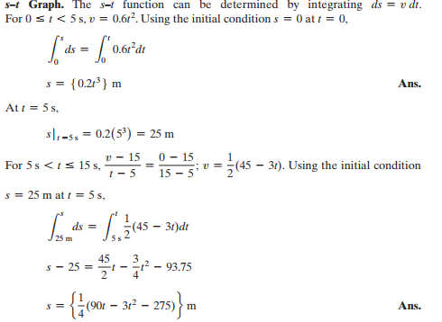
In-Class Practice Problem 3

Slide 18
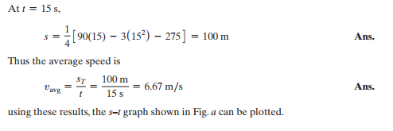
In-Class Practice Problem 3

Slide 19
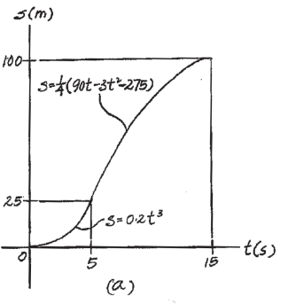
In-Class Practice Problem 3

Slide 20
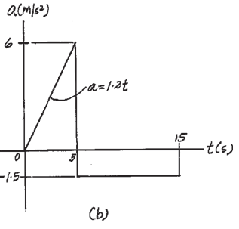
In-Class Practice Problem 3

