Slide 1
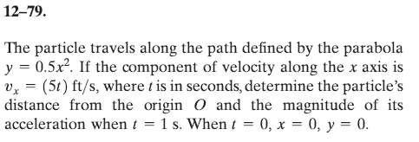
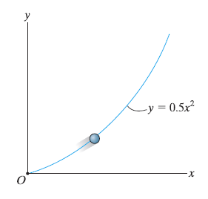
Problem 12-79
So, this problem kicked your butt? Clearly you aren’t alone. Even with a few tips, this one proved to be a little rough for most of you. I think the reason is that there wasn’t an existing equation that made this problem work. You need to make the calculus work for you. There are two approaches to this problem, and I think we should explore both of them.

Slide 2
Problem 12-79 – Solution Path 1
You have position relationship for y as a function of x. But you don’t have a relationship for y(t) or x(t). But you do have a relationship for v_{x}(t). You know that:
$v_{x}=\frac{dx}{dt}$ and you also know that $v_{x}=5t$
Rearrange the above to get:
$$dx=v_{x} dt$$
We can integrate both sides to get: $\int_{0}^{x}{dx=\int_{0}^{t}{5t dt}}$
Which becomes: $x=2.50t^{2}[ft]$

Slide 3
Problem 12-79 – Solution Path 1
$$x=2.50t^{2} [ft]$$
Most of you got this far. The trouble became what to do next.
Option 1 is to use substitution to get y(t). Then take derivatives to get v_{y} a_{y} and a_{x}.
$y=0.5x^{2}$ so by substitution, $y=0.5{∗(2.50t^{2})}^{2}$, which is
$$y=3.125t^{4} [ft]$$
Now you have x(t) and y(t).
To find the distance from the origin at t = 1 sec:
$x=2.50{(1)}^{2} \left[ft\right]$, so x_{(1 sec)} = 2.5 ft
$y=3.125{(1)}^{4} [ft]$, so y_{(1 sec)} ⁼ 3.125 ft
Distance from the origin: $d=\sqrt{{2.5}^{2}+{3.125}^{2}}=4.0 ft$

Slide 4
Problem 12-79 – Solution Path 1
$$x=2.50t^{2} [ft]$$
$$y=3.125t^{4} [ft]$$
Now, to find acceleration we need to find v_{x}(t), v_{y}(t), a_{x}(t), and a_{y}(t)
$v_{x}=5t$ ← given in the problem
$v_{y}=\frac{dy}{dt}=\left(4\right)3.125t^{3}$, or $v_{y}=12.5t^{3}$
$a_{x}=\frac{{dv}_{x}}{dt}=5 [\frac{ft}{s^{2}}]$
$a_{y}=\frac{{dv}_{y}}{dt}=\left(3\right)12.5t^{2}$, or $a_{y}=37.5t^{2}$
To find the magnitude of acceleration at t = 1 sec:
$a_{x}=5 \left[\frac{ft}{s^{2}}\right]$
$a_{y}=37.5{(1)}^{2} =37.5 \left[\frac{ft}{s^{2}}\right]$
Magnitude of acceleration: $\left|a\right|=\sqrt{5^{2}+{37.5}^{2}}=37.8 \left[\frac{ft}{s^{2}}\right]$

Slide 5
Problem 12-79 – Solution Path 2
What about the posted solution? I can’t even follow what they did!
You may remember from calculus classes:
If a = f(b), and b = f(c), then the derivative of a must use the chain rule
$$\frac{da}{dc}=\frac{da}{db}\frac{db}{dc}$$
In this specific case you have:
y = f(x), and x = f(t). To get the time derivative of y → use the chain rule
$$\frac{dy}{dt}=\frac{dy}{dx}\frac{dx}{dt}$$
Further, to get the second time derivative of y you get
$$\frac{d^{2}y}{{dt}^{2}}={\frac{d^{2}y}{{dx}^{2}}\left(\frac{dx}{dt}\right)}^{2}+\frac{dy}{dx}\frac{d^{2}x}{{dt}^{2}}$$

Slide 6

Problem 12-79 – Solution Path 2
$$\frac{d^{2}y}{{dt}^{2}}={\frac{d^{2}y}{{dx}^{2}}\left(\frac{dx}{dt}\right)}^{2}+\frac{dy}{dx}\frac{d^{2}x}{{dt}^{2}}$$
Remember that $y=0.5x^{2}$
$$\frac{dy}{dx}=\left(2\right)0.5x=x$$
$$\frac{d^{2}y}{{dx}^{2}}=1$$
So the top equation becomes
$$\frac{d^{2}y}{{dt}^{2}}={(1)\left(\frac{dx}{dt}\right)}^{2}+x\frac{d^{2}x}{{dt}^{2}}$$
$$\ddot{y}={\dot{x}}^{2}+x\ddot{x}$$

Slide 7
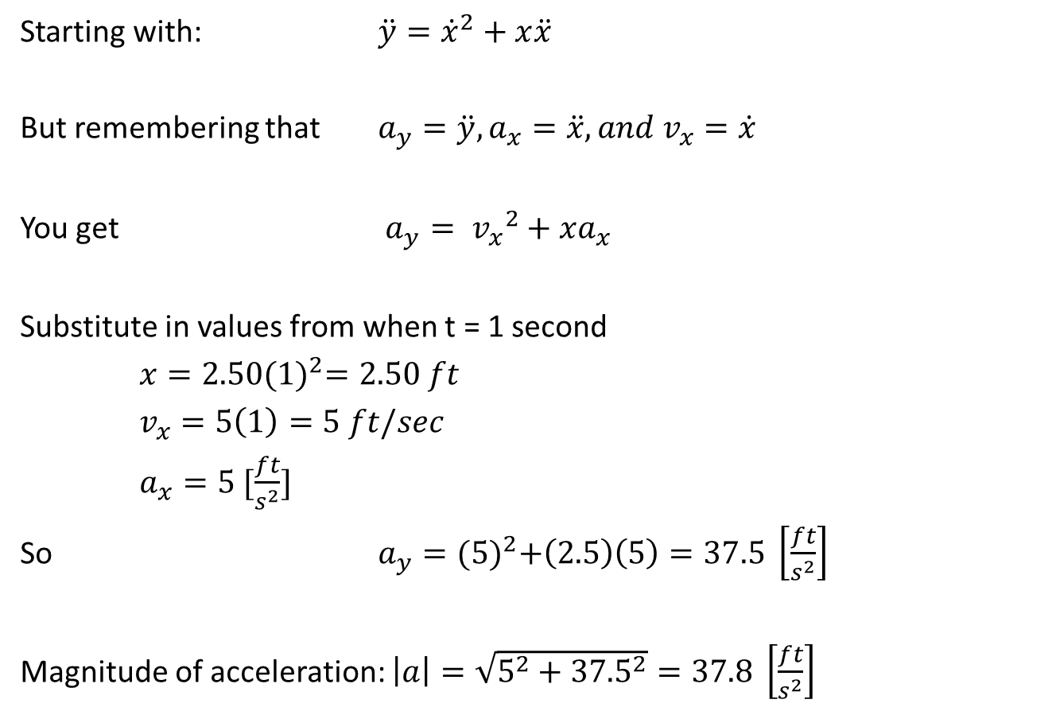
Problem 12-79 – Solution Path 2
Starting with: $\ddot{y}={\dot{x}}^{2}+x\ddot{x}$
But remembering that $a_{y}=\ddot{y}, a_{x}=\ddot{x}, and{ v}_{x}=\dot{x}$
You get $a_{y}={{ v}_{x}}^{2}+xa_{x}$
Substitute in values from when t = 1 second
$x=2.50{(1)}^{2}=2.50 ft$
$v_{x}=5\left(1\right)=5 ft/sec$
$a_{x}=5 [\frac{ft}{s^{2}}]$
So $a_{y}={(5⁡)}^{2}+\left(2.5\right)\left(5\right)=37.5 \left[\frac{ft}{s^{2}}\right]$
Magnitude of acceleration: $\left|a\right|=\sqrt{5^{2}+{37.5}^{2}}=37.8 \left[\frac{ft}{s^{2}}\right]$

Slide 8
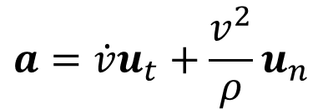
Curvilinear Motion: Normal and Tangential Components
12.7
Velocity:
Acceleration:
$$a=\dot{v}u_{t}+\frac{v^{2}}{ρ}u_{n}$$
magnitude:

Slide 9
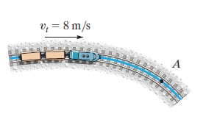
In-Class Practice Problem 1
What do you notice about this problem?
Key words?
What information do you know?
What are you trying to find?
How to you approach the problem?
What equation(s) will you use?

Slide 10
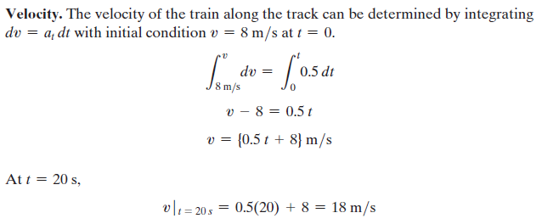
In-Class Practice Problem 1

Slide 11
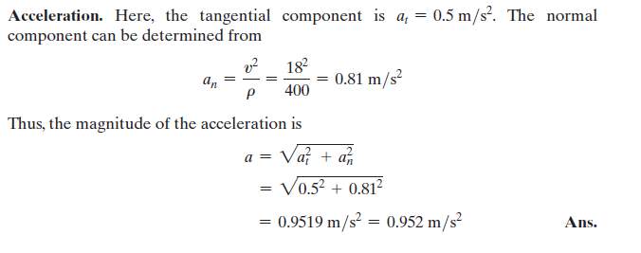
In-Class Practice Problem 1

Slide 12
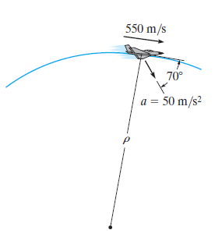
In-Class Practice Problem 2
What do you notice about this problem?
Key words?
How to you approach the problem?
Since a isn’t pointing at the radius of curvature, what does this say about the speed of the plane?
What do you do with the acceleration vector?
What equation(s) will you use?

Slide 13
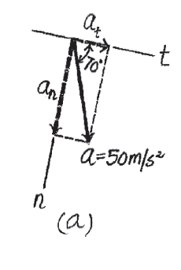
In-Class Practice Problem 2

Slide 14
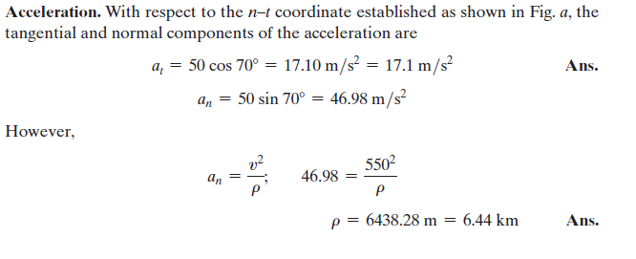
In-Class Practice Problem 2

Slide 15
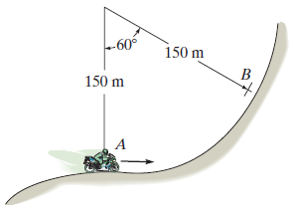
In-Class Practice Problem 3
What do you notice about this problem?
Key words?
What information do you know?
What are you trying to find?
There is no time in this problem at all ☹
Note: s in –(0.05 s) is not seconds. It is path length
How to you approach the problem?
What equation(s) will you use?

Slide 16
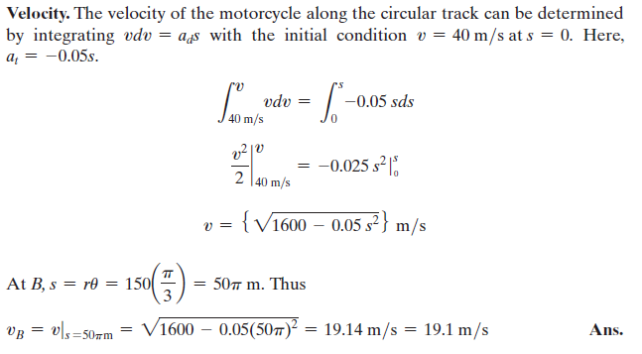
In-Class Practice Problem 3

Slide 17
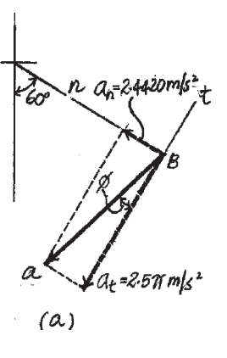
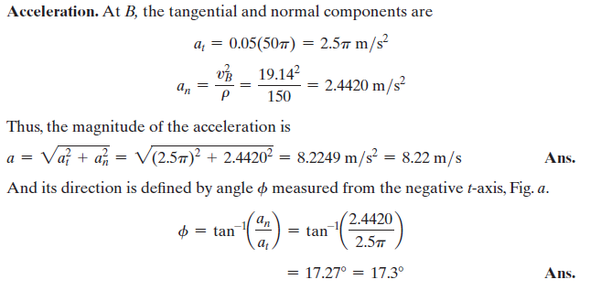
In-Class Practice Problem 3

