Slide 1
Cylindrical Coordinate System (r-θ)
Yay! Another coordinate system! You’ve played with this one in calculus classes already. Now we are going to use this system to describe curvilinear motion.
At first glance the r-θ coordinate system (polar) may seem similar to the n-t system. This is somewhat true, in that the unit vectors *do* change orientation. However, in this coordinate system the origin is fixed. Rather than describe the particle location using x and y we are going to describe it using r and θ.
In 2D we call r-θ coordinate system “Polar Coordinates”.
In 3D we call r-θ-z coordinate system “Cylindrical Coordinates”.
Pop Quiz?:
Are Polar and Cylindrical coordinate systems
Eulerian viewpoints
Lagrangian viewpoints
Observations from a fixed coordinate system
Observations from a moving coordinate system

Slide 2
Cylindrical Coordinate System (r-θ)
So, when should you choose to use polar coordinates?
If you want to describe motion from a fixed position, x-y and r-θ are both fine choices.
If the motion you are describing is rotating around a fixed point, then polar is a great choice.
If the motion is described in relation to a rotation (angle change) then polar is a necessary choice.
A vehicle going around a curve makes for an interesting argument
You know almost all of 12.7 practice problems are Lagrangian vehicle problems.
But if you were standing at the radius of curvature you would probably choose polar coordinates to describe the motion, velocity, and acceleration.
How about a vehicle racing down a drag strip?
Lagrangian n-t analysis is pretty simple (v and a in just the tangential direction) Driver Perspective
Eulerian x-y analysis is pretty simple (v and a in just one direction) Pit Crew observer on track behind vehicle
Eularian r-θ analysis is less simple (v and a change in both r and θ) Spectator in the stands

Slide 3
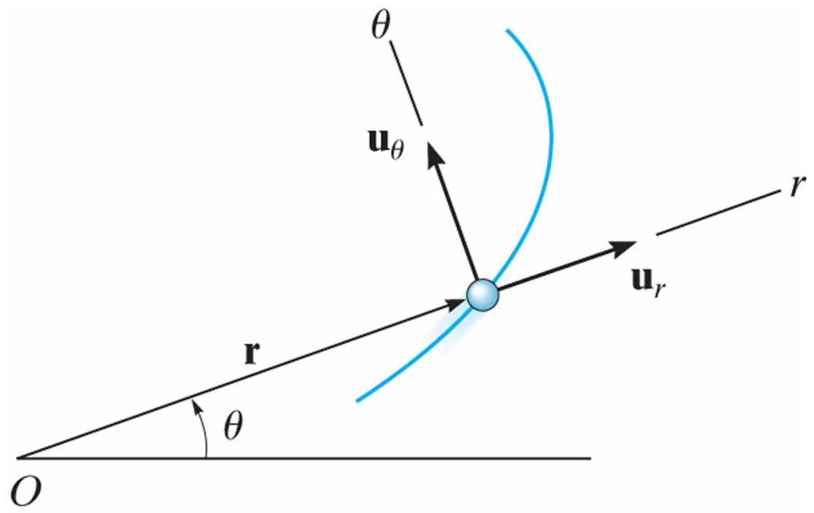
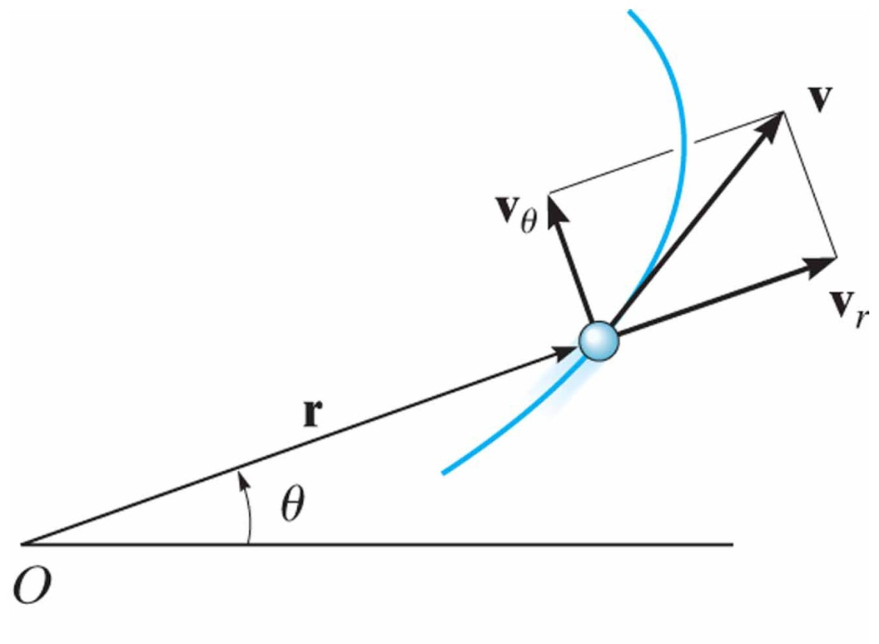
Curvilinear Motion: Cylindrical Components
12.8
Polar Coordinates:
Position:
Velocity:
velocity magnitude:

Slide 4
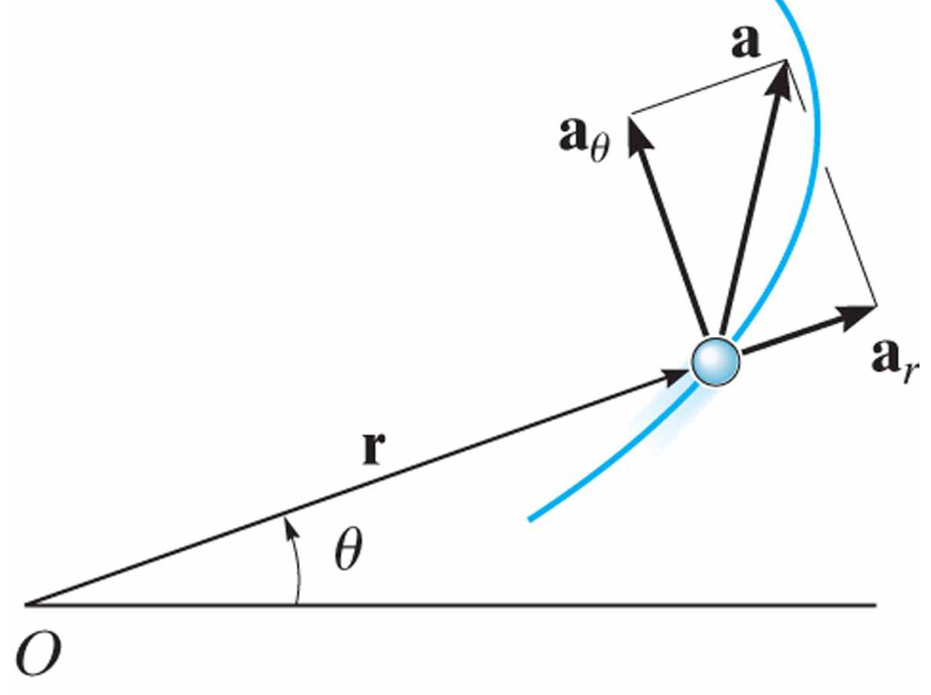
Curvilinear Motion: Cylindrical Components
12.8
Polar Coordinates:
Acceleration:
Acceleration magnitude:

Slide 5
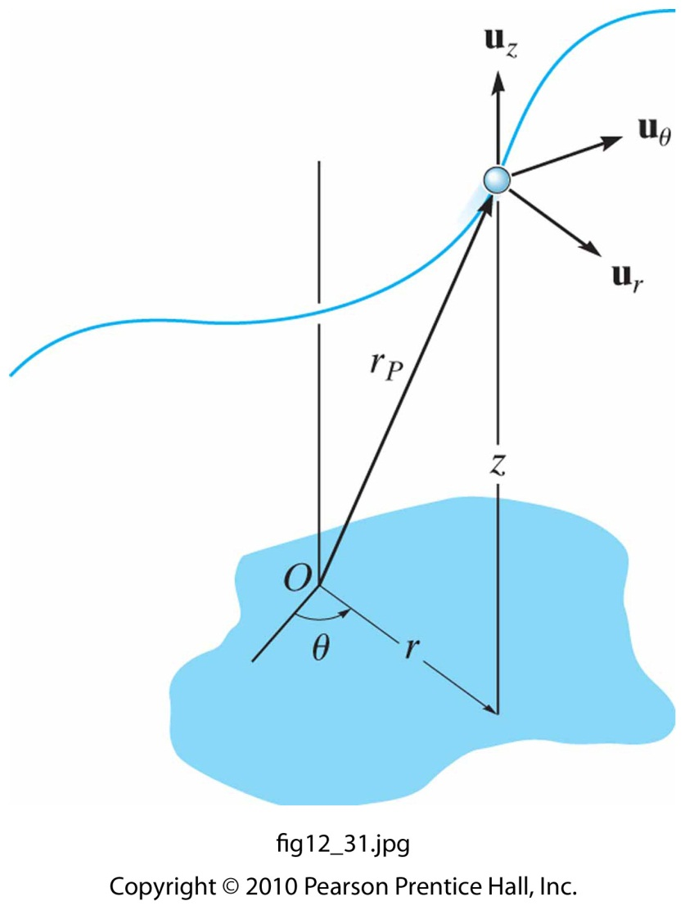
Curvilinear Motion: Cylindrical Components
12.8
Cylindrical Coordinates :
Position:
Velocity:
Acceleration:

Slide 6
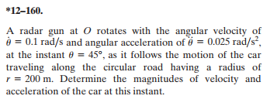
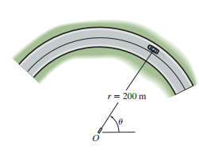
In-Class Practice Problem 1
What do you notice about this problem?
Key words?
What information do you know?
What are you trying to find?
Why use polar coordinates for this problem?
What equation(s) will you use?
Is the car accelerating in the tangential direction? If so, how to you know?

Slide 7
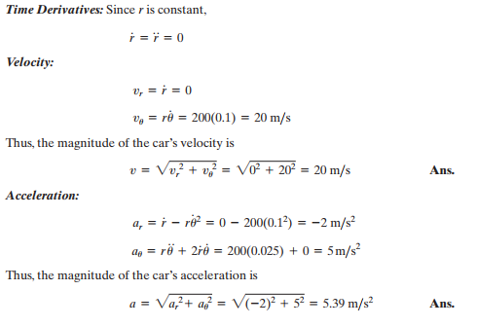
In-Class Practice Problem 1

Slide 8
In-Class Practice Problem 1 (checking answer)
Let’s check part of our answer to the previous problem using n-t coordinates
Assume constant velocity of 20 m/s (what direction?)
Calculate normal acceleration (what direction)?
$$If \dot{v}=0, a_{t}=0$$
$$a_{n}=\frac{{20[m/s]}^{2}}{200 [m]}=\frac{400 [{m^{2}}/{s^{2}}]}{200 [m]}=2 \left[\frac{m}{s^{2}}\right]$$
In polar coordinates we got -2 m/s². Why is this version positive?

Slide 9
In-Class Practice Problem 2
No picture? ☹
You want *me* to draw the picture? ☹ ☹
What do you notice about this problem?
Key words?
What information do you know?
What are you trying to find?
Why use polar coordinates for this problem?
What equation(s) will you use?

Slide 10
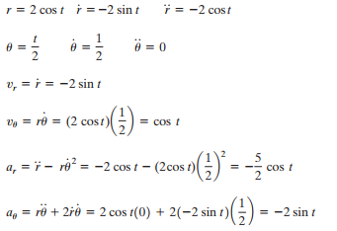
In-Class Practice Problem 2
Solution doesn’t even include the plot → Typical
Graduate students responsible for most solution manuals
Ain’t nobody got time fo dat!

Slide 11
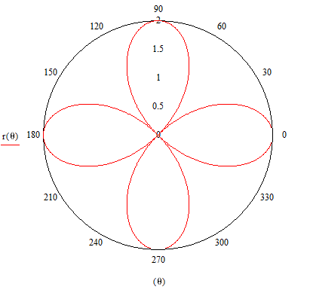
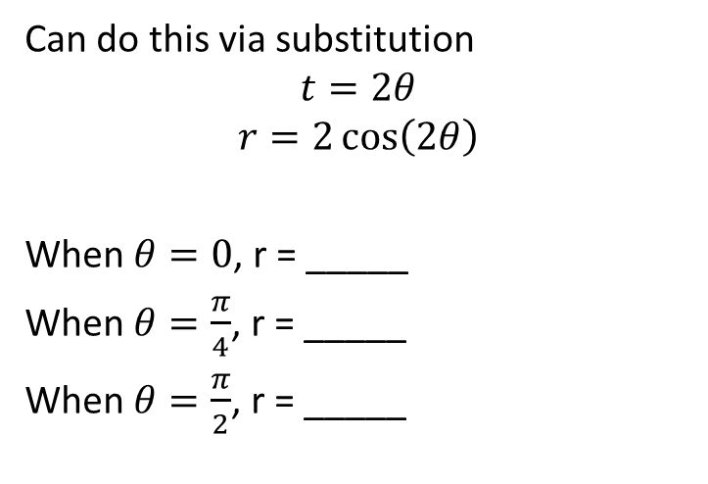
In-Class Practice Problem 2
Can do this via substitution
$$t=2θ$$
$$r=2\cos\left(2θ\right)$$
When $θ=0$, r = _____
When $θ=\frac{π}{4}$, r = _____
When $θ=\frac{π}{2}$, r = _____
2
0
-2

Slide 12
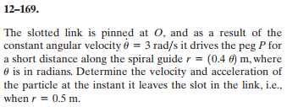
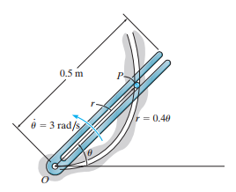
In-Class Practice Problem 3
Have you seen mechanisms like this?
Key words?
What information do you know?
What are you trying to find?
Why use polar coordinates for this problem?
What equation(s) will you use?

Slide 13
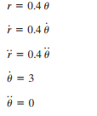
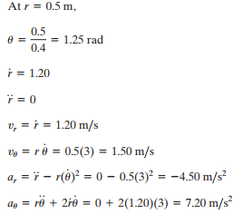
In-Class Practice Problem 3

Slide 14
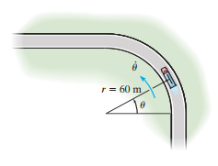
In-Class Practice Problem 4
What do you notice about this problem?
Key words?
What information do you know?
What are you trying to find?
Why use polar coordinates for this problem?
What equation(s) will you use?

Slide 15
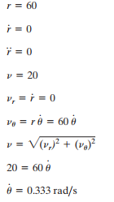
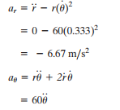
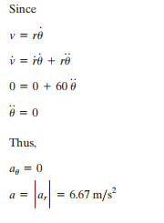
In-Class Practice Problem 4

Slide 16
In-Class Practice Problem 4
Let’s check part of our answer to the previous problem using n-t coordinates
Constant velocity of 20 m/s (what direction?)
Calculate normal acceleration (what direction)?
$$\dot{v}=0, a_{t}=0$$
$$a_{n}=\frac{{20[m/s]}^{2}}{60 [m]}=\frac{400 [{m^{2}}/{s^{2}}]}{60 [m]}=6.67 \left[\frac{m}{s^{2}}\right]$$
In polar coordinates we got a_{r} = -6.67 m/s².
Why is this version positive?

