Slide 1
ME 433 Internal Combustion Engines
Professor:
Dr. Dan Cordon (AKA Dr. Dan)

Slide 2
Four Stroke SI Engine
Stroke 1: Fuel-air mixture introduced into cylinder through intake valve
Stroke 2: Fuel-air mixture compressed
Stroke 3: Combustion (~constant volume) occurs and product gases expand doing work
Stroke 4: Product gases pushed out of the cylinder through the exhaust valve
A
I
R
FUEL
Ignition
Fuel/Air
Mixture
Combustion
Products
Intake
Stroke
Compression
Stroke
Power
Stroke
Exhaust
Stroke

Slide 3
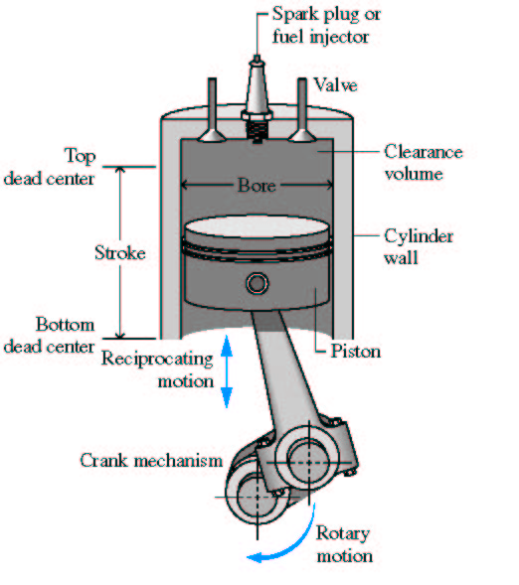
Cylinder Components
Spark plug for SI engine
Fuel injector for CI engine
Valves
Top Center
(TC)
Clearance
volume
Cylinder wall
Stroke
Bottom
Center
(BC)
Piston
TC
0º
θ
Crank shaft
270º
90º
180º
BC

Slide 4
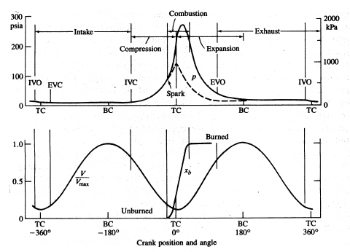
Four-Stroke SI Engine
Exhaust gas
residual
IVO - intake valve opens, IVC – intake valve closes
EVO – exhaust valve opens, EVC – exhaust valve opens
X_{b} – burned gas mole fraction

Slide 5
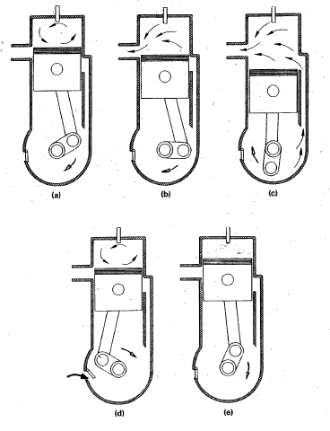
Two Stroke SI Engine
Exhaust
port
Fuel-air-oil
mixture
compressed
Check
valve
Expansion
Exhaust
Intake (“Scavenging”)
Crank
shaft
Fuel-air-oil
mixture
Compression
Ignition

Slide 6
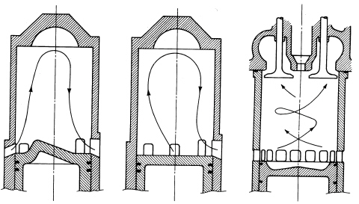
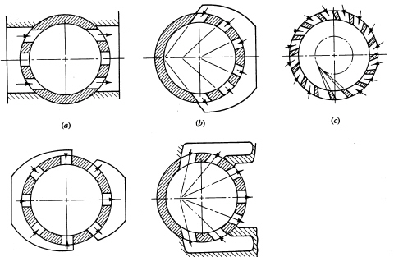
Two-Stroke Scavenging
Cross Loop Uniflow

Slide 7
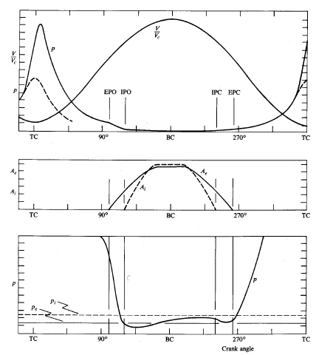
Two-Stroke SI Engine
EPO – exhaust port open
EPC – exhaust port closed
IPO – intake port open
IPC – intake port closed
scavenging
Exhaust area
Intake area

Slide 8
Cylinder Arrangement
Single-cylinder engine gives one power stroke per crank revolution
(2 stroke) or two revolutions (4 stroke). The torque pulses are widely
spaced, and engine vibration and smoothness are significant problems.
Used in small engine applications where engine size is more important
Multi-cylinder engines spread out the displacement volume amongst
multiple smaller cylinders. Increased frequency of power strokes
produces smoother torque characteristics. Engine balance (inertia forces
associated with accelerating and decelerating piston) better than single
cylinder.
Most common cylinder arrangements:
In-line 4-cylinder
In-line 6-cylinder
V-6 and V-8

Slide 9
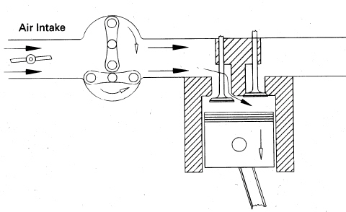
Power Regulation (Throttling)
An IC engine is basically an air engine, the more air you get into the
cylinder, the more fuel you can burn, the more power you get out.
The initial pressure in the cylinder is roughly equal to the pressure in the intake manifold.
Pressure in the intake manifold is varied by opening and closing the
throttle plate to change the pressure drop. Maximum air flow (and power) achieved at wide-open-throttle (WOT). Minimum air flow at idle
Fuel
P_{atm}
P_{int} < P_{atm}
Idle
Intake manifold
WOT

Slide 10
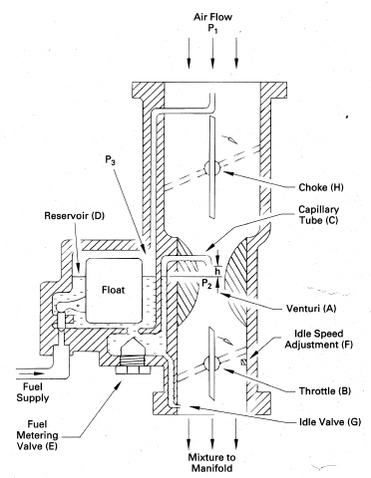
Basic Carburetor Design
Air Flow
Venturi
Fuel
Throttle
Mixture to manifold

Slide 11
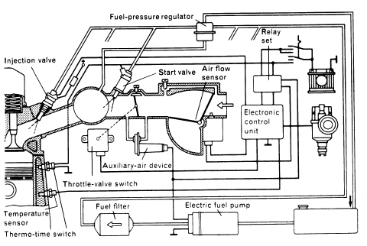
Fuel Injection System
Air intake
manifold
Throttle
Fuel tank
During start-up the components are cold so fuel evaporation is very slow, as a result
additional fuel is added through a second injecting valve

Slide 12
Superchargers are compressors that are mechanically driven by the engine crankshaft and thus represent a parasitic load.
P_{atm}
P_{int} > P_{atm}
Compressor

Slide 13
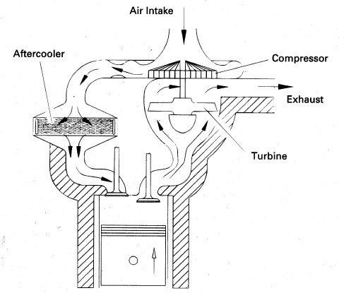
Turbochargers couple a compressor with a turbine driven by the exhaust
gas. The compressor pressure is proportional to the engine speed

Slide 14
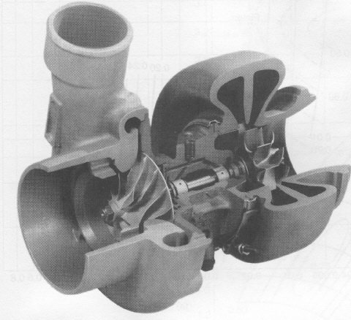
The peak pressure in the exhaust system is only slightly greater than
atmospheric – small ΔP across turbine.
In order to produce enough power to run compressor the turbine speed
must be very fast (100k-200k rev/min). It takes time for the turbine to get up to speed so when the throttle is opened suddenly there is a delay in achieving peak power - Turbo lag.
Waste gate valve controls the exhaust gas flow rate to the turbine.
It is controlled by the intake manifold pressure
EXHAUST
FLOW
INTAKE
AIR

Slide 15
Four Stroke Compression Ignition (CI) Engine
Stroke 1: Air is introduced into cylinder through intake valve
Stroke 2: Air is compressed
Stroke 3: Combustion (roughly constant pressure) occurs and product gases expand doing work
Stroke 4: Product gases pushed out of the cylinder through the exhaust valve
A
I
R
Fuel Injector
Air
Combustion
Products
Intake
Stroke
Compression
Stroke
Power
Stroke
Exhaust
Stroke

Slide 16
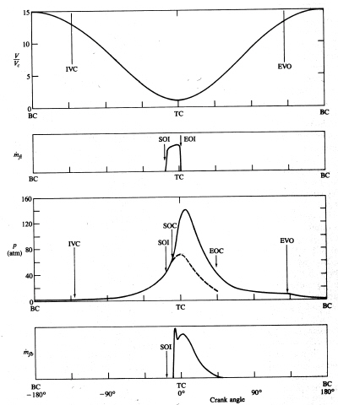
Four-Stroke CI Combustion
SOI – start of injection
EOI – end of injection
SOC – start of combustion
EOC – end of combustion
Fuel mass
flow rate
Fuel mass
burn rate

Slide 17
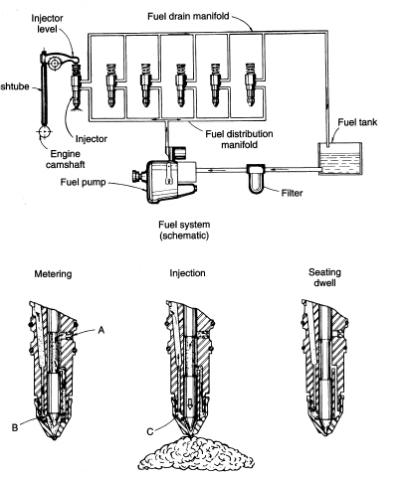
Diesel Fuel Injection System

