Slide 1
Introduction to Standard Geometrical Tolerance
This presentation includes the following concepts
Datum and Tolerance Accumulation
Possible Tolerance Conditions
Block Example
Specific Tolerances for Slip and Press Fits
Machine Tolerances
Tolerance Block

Slide 2
Tolerance Accumulation
Chain Dimensioning
.
This allows the most variation in the distance from A to B, giving a total tolerance accumulation of “.015” giving AB a maximum length of 3.515”.
.
Chain dimensioning can be used when the tolerance accumulation won’t affect the function of the object.

Slide 3
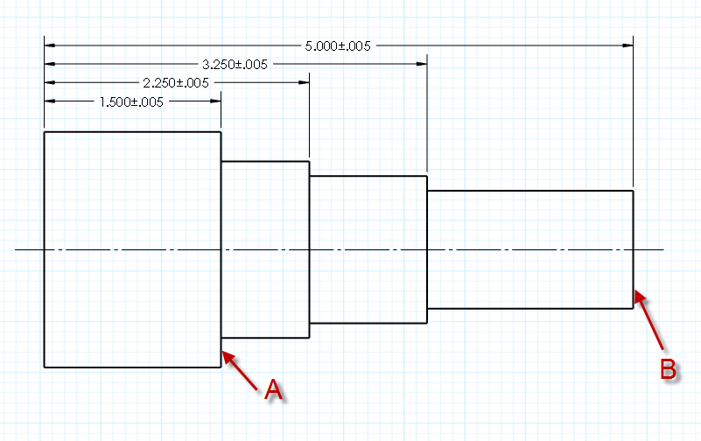
Base Line Dimensioning
.
This allows a total tolerance accumulation of .010” in the distance from A to B, giving AB a max length of 3.510”.
.
Base line dimensioning is the easiest to follow when machining a part, but you must know the allowable variation between points of interest.

Slide 4
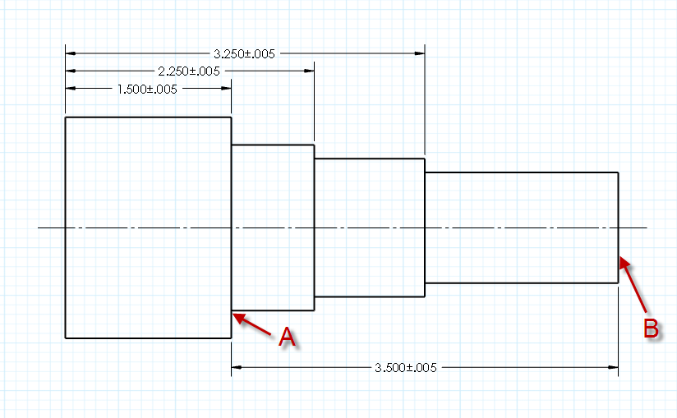
Direct dimensioning
.
This allows the least variation in the distance from A to B, giving a total tolerance accumulation of .005” and a maximum distance AB of 3.505”
.
Direct dimensioning should be used to note the distance between two critical points like A and B. “A” does not lye on the edge, so baseline dimensioning would not specify the desired length AB within the tolerance needed.

Slide 5
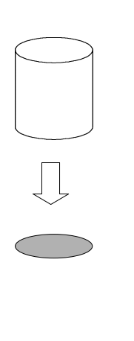
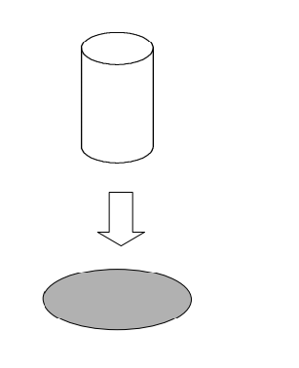
Possible Tolerance Conditions
Maximum Material Condition (MMC)- The shaft is the largest allowable size, and the hole is the smallest allowable size based on tolerance.
Least Material Condition (LMC)- The shaft is the smallest allowable size, and the hole is the largest allowable size based on tolerance.
The shaft tolerance should be (-), in relation to the maximum shaft size, to prevent the shaft from being to large to fit the hole .
The hole tolerance should be (+), in relation to the minimum shaft size, to prevent the hole from being to small for the shaft to fit.

Slide 6
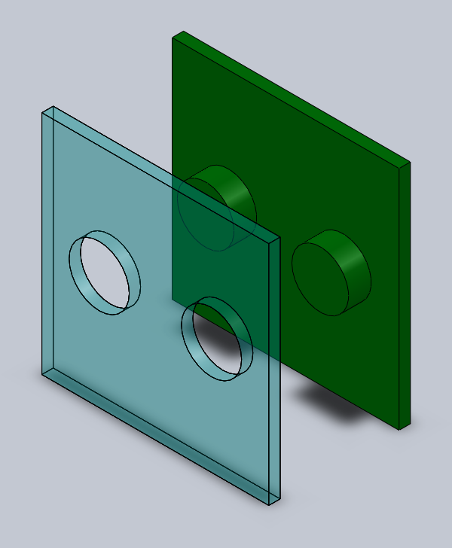
Block Example
This example is a visual aid that helps explain why tolerances are important, and how they can be used to insure pieces will fit together.
Dimensions For Blocks
Component | Dimension (in) | Tolerance (in)
Hole diameter | unknown | (+) .005
Hole center to center distance | 1 | ($±$) .005
Hole distance from edge | .5 | ($±$) .005
Hold distance to bottom | 1 | ($±$) .005
Pin Diameter | .5 | (-) .005
Pin center to center distance | 1 | ($±$) .005
Pin distance from edge | .5 | ($±$) .005
Pin distance to bottom | .5 | ($±$) .005

Slide 7
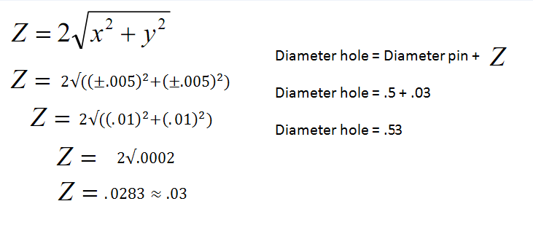
Unknown Hole Diameter
How do we find the diameter of the hole needed, that will make sure the part fits every time, and all other dimensions are any value within our tolerance?
We Must account for the total tolerances in the distance from the edge (X) and distance from the bottom (Y) directions. This will give us the maximum distance (Z) the center can be offset.
Now we can check this solution by solid modeling in Solidworks.

Slide 8
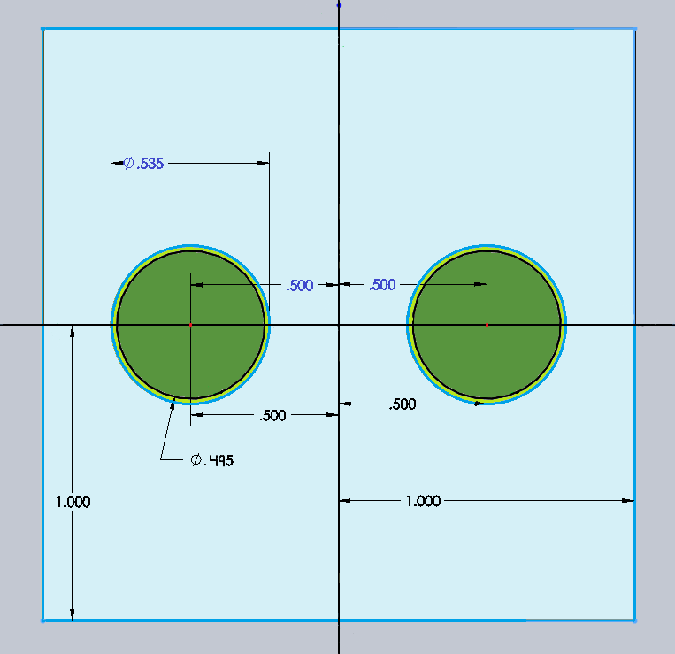
Example Blocks 1
-LMC
-Tolerances allow widest fit
The different shades of blue are used to represent the block with holes in it. The dimensions of the block with holes are also in blue and are on the top half of the drawing.
The different shades of green are used to represent the block with pins. The dimensions of this block are noted in black and are found on the bottom half of the drawing.

Slide 9
Example Blocks 2
-MMC
-Maximum tolerance offset condition
Notice that all the dimensions are offset in apposite directions. Meaning the block with pins are as wide apart and large as possible. While the block with holes is i as close and small as possible.
Although the tolerance of each dimension is offset, and the is the maximum amount of material possible, The block with pins should still be able to fit inside of the block with holes.

Slide 10
Specific Tolerances
Slip Fit Info
Tight Slip Fit
RC1 Really tight slip fit used for accurate location of parts.
RC2 Sliding fit that can turn easily and is used for accurate location. Not intended to run freely and may seize with temperature.
RC3 closest fits that can run freely and used as a light journal entry at low speeds.
RC4 close running fits, used on accurate machinery with moderate surface speeds.
RC5 and RC6 Medium running fits intended for higher running speeds and or heavy journal pressures.
RC7 Free running fits where accuracy is not essential or where large temperature variations are likely to be encountered.
RC8 and RC9 Loos running fits that is intended for use were wider commercial tolerances may be necessary.
Loose Slip Fit
Press and Shrink Fit Info
Least overlap
FN1 Light drive fit for light assembly pressures and are less permanent of assembly.
FN2 Medium drive fit for ordinary steel parts. These are about the tightest fits to be used with high grade cast iron members.
FN3 Heavy drive fits that are used for heaver steel parts
FN4 and FN5 Highest stress on material, and should only be used if FN3 can’t work.
Most overlap

Slide 11
Machine Tolerance
Each machine has a tolerance grade that relates the nominal size of the part to an achievable tolerance.
After you have the tolerance grade for any given machine. You use or part size to find the tolerance that the machine is actually capable of achieving.

Slide 12
Tolerance Block
With this tolerance block, it is saying that Linear Dimensions with:
0 decimal places is ± .25
1 decimal place is ± .1
2 decimal places is ± .01
3 decimal places is ± .001
These tolerances is what will be used for all of the dimensions of the drawing of the part unless it is otherwise specified.

