Slide 1
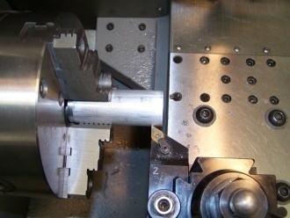
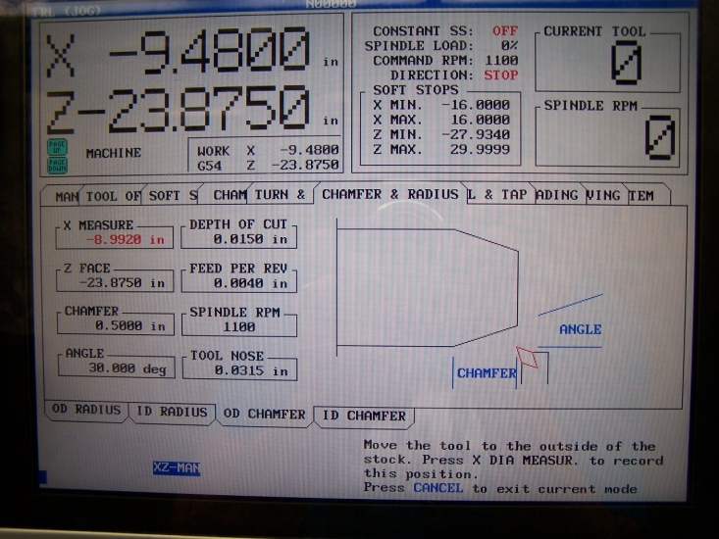
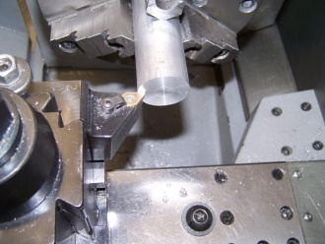
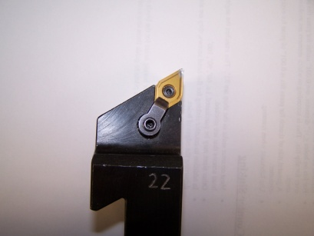
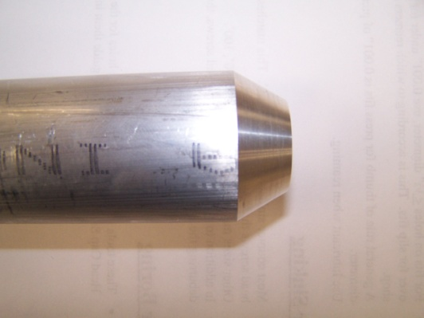
Summer 2008
Ryan Mathews
Armen Dibble
Chamfer Canned Cycle
X-Diameter Touch Off
Begin by powering up the machine. Refer to the startup manual located behind the machine interface. Once zeroed, select the chamfer and radius mode and press enter. The below screen will now appear.
With spindle turning, touch tool to x-diameter of part...press x-diameter button to set.
Depth of Cut
This is the amount of material that the tool will remove with each pass. If not familiar with proper cutting depths, refer to a machinists reference handbook.
Ex. 6061 Aluminum ≈ .015 in
Z-Face Touch Off
Feed per Revolution
This is how far the carriage will move per revolution of the spindle. If not familiar with proper feed rates, refer to a machinists reference handbook.
Ex. 6061 Aluminum ≈ .004 in/rev
With spindle turning, touch tool to z-face of part...press z-face button to set.
Tool Nose
Chamfer and Angle
Length of Chamfer
Spindle RPM
Refer to the chart on the wall for correct spindle speed. Make sure to find the proper speed for the material that your tool is made of and also the material of your part.
A great place to start is by taking an average diameter of the chamfer and referencing that number.
Measure the radius of the tool nose.
Once you have set all variables, begin the cycle with a 5% rapid to ensure proper motion. Once verified, you can move to 100% rapid.
Always Prepare for Stopping Cycle
In Case Tool Interference!
Angle of Chamfer
(Degrees)

