Slide 1
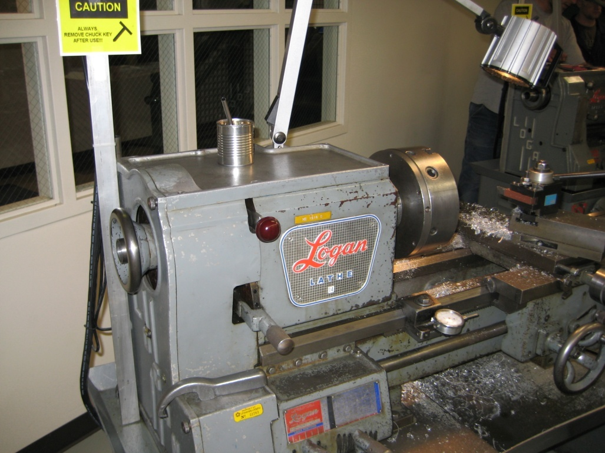
Changing Gears On Logan Manual Lathe
Back Gear Shift Knob
Spindle
Back Gear Hand Wheel
When Trying to Accomplish the next Few Tasks if Lathe Will Not go in to Gear Smoothly Rotate the Spindle Manually and Gear Changes will be Much Easier

Slide 2
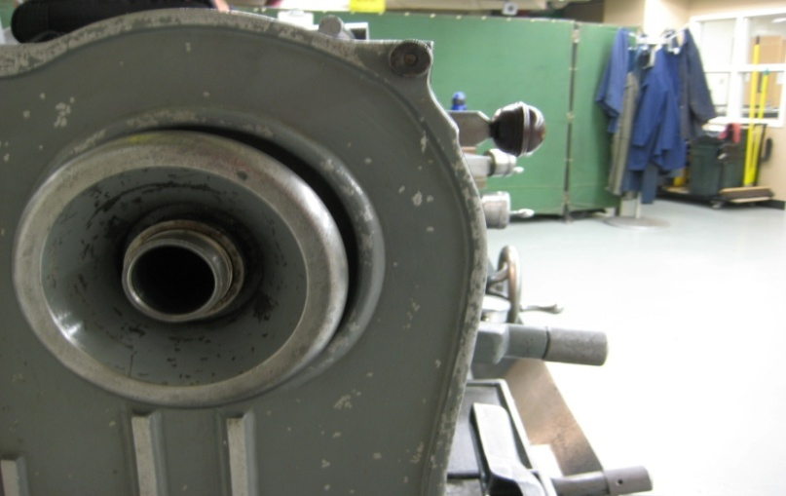
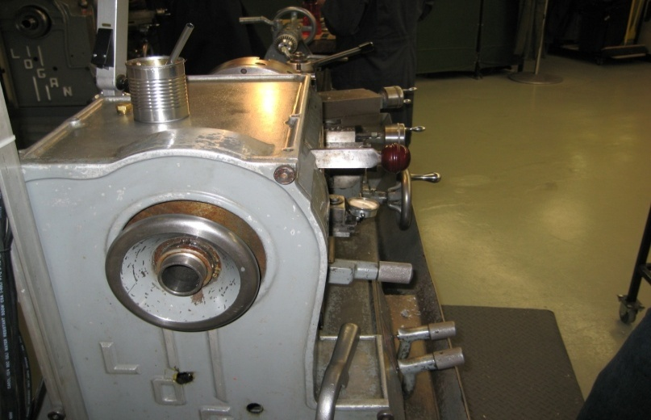
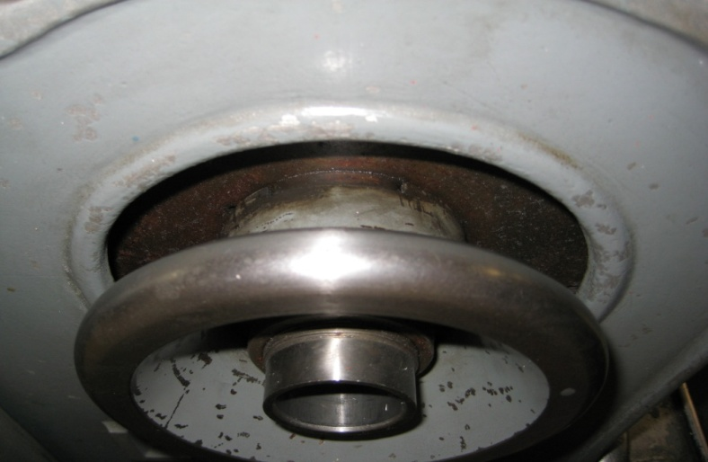
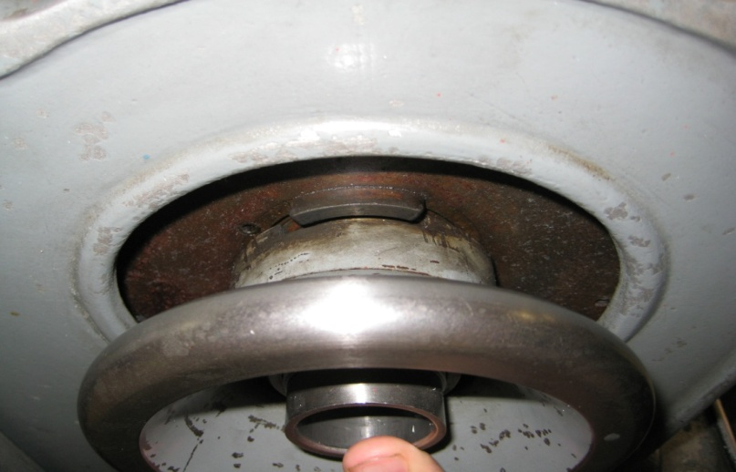
Switching Spindle Gear to Low
Switching Spindle Gear to High
For Low Gear Back Gear Shift Knob Must
be Pressed into the “IN” Position
For High Gear Back Gear Shift Knob Must
be Pressed into the “OUT” Position
Also for Low Gear the Back Gear Hand Wheel Must be in the “IN” Position
Also for High Gear the Back Gear Hand Wheel Must be in the “OUT” Position

