Slide 1
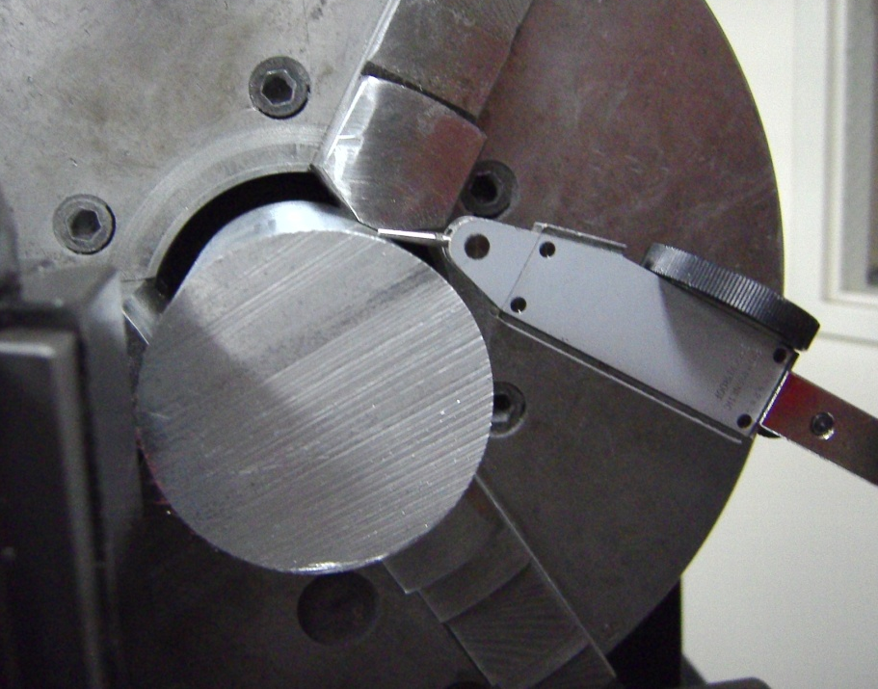
Using Dial Indicator On a Lathe
To check that a part is centered:
Insert part into chuck, and mount magnetic dial indicator onto carriage
Position needle so it is tangential to surface of stock
Zero the dial indicator
Rotate chuck 180° by hand and observe dial reading
If reading is not 0, move dial indicator away from stock, and use a lead hammer to tap part towards center
-Check again with dial indicator to see if reading is zero.
-Repeat above process if necessary

Slide 2
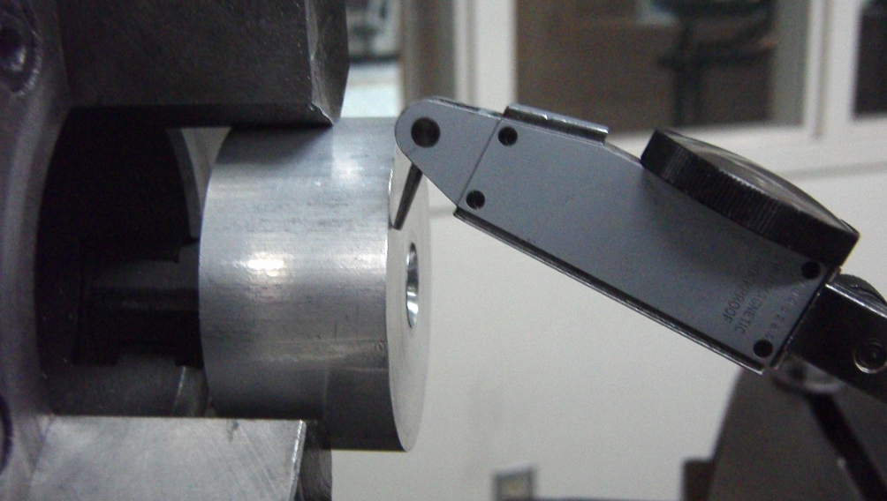
Using Dial Indicator On a Lathe
To check if a surfaced part is centered:
-Insert parallels into the back of the chuck, then insert part into chuck and tighten
-REMOVE PARALLELS!
-Position dial indicator on the carriage so needle is touching part as shown in picture
-Zero the indicator
-Spin chuck by hand and observe any movement of dial
-If dial does not read zero, tap high point with lead hammer to set face perpendicular to axis of rotation and check with dial indicator again

