Slide 1
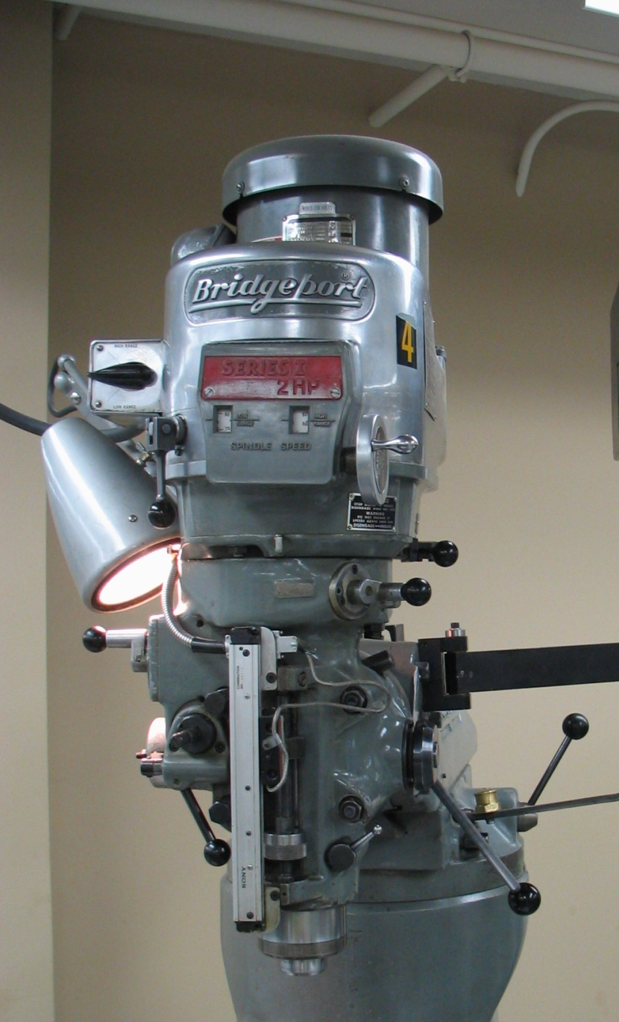
Z-Axis Power Feed Operation
Z-Axis Power Feed Components
Z-Axis Feed Selector Switch
Cutting Depth Stop
Feed Rate Selector
Z-Axis Feed Engage
1
Z-Axis Feed Tips
Use with a boring head.
Use when drilling through soft
materials that “pull” drill bit when
finishing cut. Commonly affected
materials: copper, brass, Plexiglas.
2
3
4

Slide 2
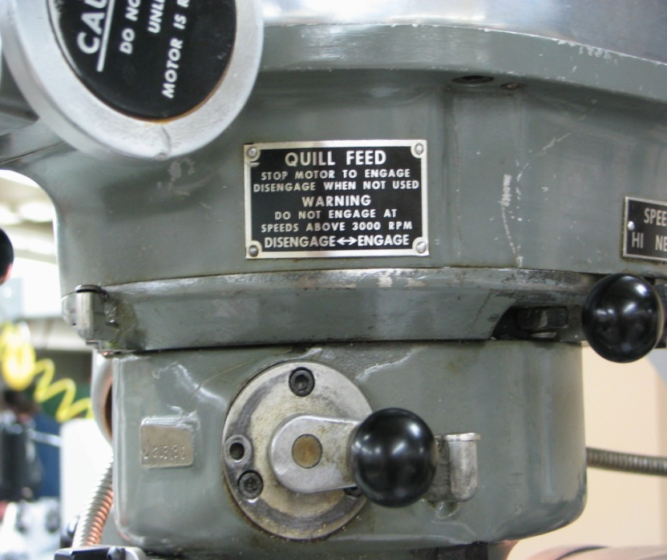
Z-Axis Feed Selector Switch
2) Cutting Depth Stop
2
1
Set for total depth of cut.
Will automatically disengage
quill feed when desired depth
reached.
Engages power to the quill
feed drive.
Motor cannot be running
when engaged.

Slide 3
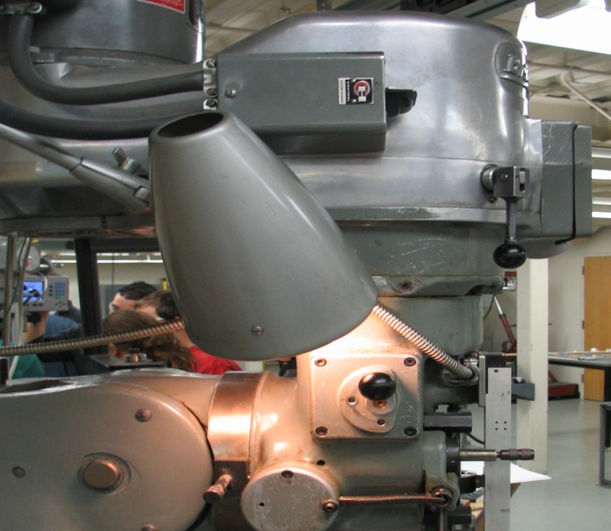
3) Feed Rate Selector
4) Z- Axis Feed Engage
4
3
Three feed rates: 0.0015”, 0.003”
and 0.006” per revolution.
Use the 0.006” rate for soft
materials, the 0.003” rate for hard
materials and the 0.0015” rate for
all finishing cuts.
May be changed while still or
running.
Swing handle to left to engage
quill feed.
Can manually disengage by
moving handle back to the
right side or will disengage
when reaches depth of cut
stop.

