Slide 1
Heat Treating Steel
By:
Louie Mysse
Brandon Okerlund

Slide 2
Heat Treatment Processes
Tempering
Annealing
Stress Relieving
Normalizing
Quenching

Slide 3
Tempering
Reheating a Hardened Material
Increases Ductility and Toughness
Three Components
Temperature
Time
Cooling Rate

Slide 4
Annealing
Heating and holding a suitable temperature followed by an appropriate cooling rate.
Quenching has to occur
Produces desirable changes in the material properties or microstructure

Slide 5
Stress-Relief
Relieves stresses that remain locked in a structure as a consequence of a manufacturing sequence
Welding
Cutting with a torch
Machining

Slide 6
Normalizing
Both Thermal and Microstructure point of view
Thermal
Heating then cooled in still or slightly agitated air

Slide 7
Quenching
Rapid cooling of steel from an elevated temperature
Typical Quenching techniques
Water
Oil
Air

Slide 8
How To Heat Treat In Shop
What is the hardness required?
Refer to Heat Treater’s Guide
How Deep do You Need the Treatment?
Case
Through
What type of Heat Treatment is required?
Tempering, Annealing, Stress-Relief, Normalizing, Quenching

Slide 9
How To Heat Treat In Shop
Turn On Furnace
Set To Appropriate Temperature
Determine from references
Place Metal In Furnace When Up to Temperature
Leave for determined time
Remove and Immediately Quench
Quench in appropriate fluid
Oil, Water, Air
Re-Set Furnace Temperature (Tempering)
Place Metal Back in Furnace (Tempering)
Leave for determined time
Remove and Cool at Designated Rate (Tempering)

Slide 10
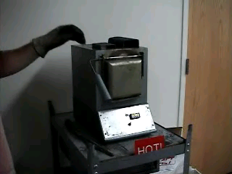
Sample Annealing Video

Slide 11
Ordering Heat Treating Processes
Establish the type of steel that will be used
Determine the desired properties
Hardness
Case/Through
Choose the proper quenching technique

Slide 12
References
Metals Handbook Desk Edition, Second Edition.
JR Davis, Davis and Associates, 1998, ASM International
Steel Aluminum Stock List and Reference Book,
Jorgensen Steel, Earle M. Jorgensen Co., 1998. (Section S.)

