Slide 1
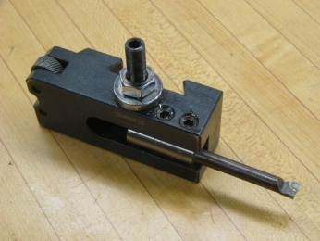
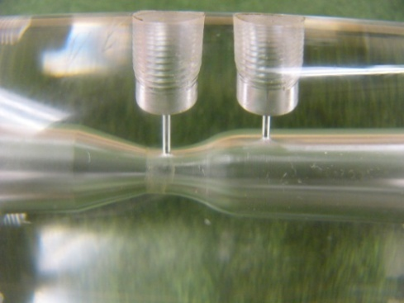
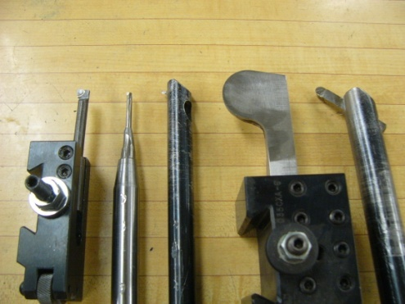
Boring Bars
Purpose
Boring bars are used to size a hole when there is not a drill or reamer that can meet the appropriate tolerance.
Boring bars come in various shapes and sizes. They can be used to cut contours such as those found in nozzles.
Tips
-Always use cutting oil.
-Stop periodically to remove chips if they are building up in the part.
-Cuts are made to the diameter, not the radius.
-Initial cuts are made to slightly less than the desired depth. A finishing cut is made to the final depth.
-Reduce the protruding length of the boring bar as much as possible to reduce deflection.
-Borings bars are universal, however the tool mounts are different for CNC and manual lathes.
by Bryce Winterbottom & Beth Madsen
Nozzle
Types of Boring Bars

Slide 2
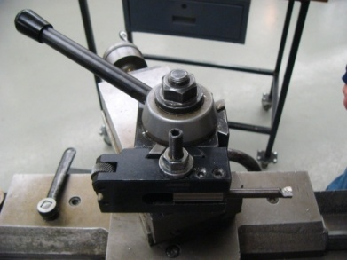
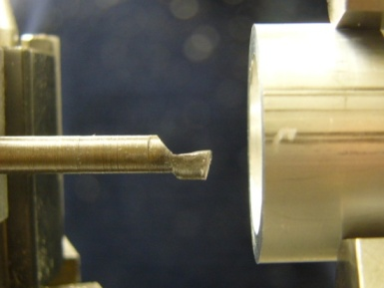
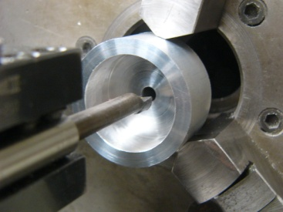
Boring Bars (cont’d)
Setup
Choose a size that is relative to the size of the hole in which you are boring.
Mount the boring bar in the tool holder using the Allen screws to secure it in place.
Place the mounted boring bar on the lathe with the tool parallel to x-axis. Lock the tool in place with the handle shown.
The tool needs to be centered vertically on the part as shown.
Mounted Boring Bar
Operation
Use a standard drill or reamer to cut the hole as close to the actual size as possible.
Zero the lathe measurement controls for the y-axis on the cutting surface.
Cut with the bar traveling into the part, cutting .005” to .030” per pass, to a depth slightly short of the desired final depth.
Decrease the speed of the lathe as the cutting diameter becomes larger.
Cut .002” on the final pass.
Centered Bar

