Slide 1
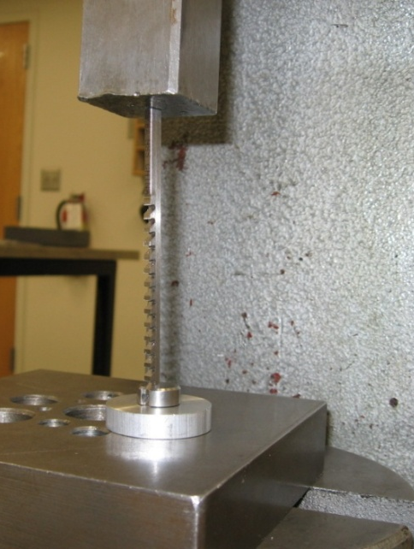
BROACHING
Purpose: cut keyway in a gear or related component
Location: Cabinet #4 (Haas Mill Cabinet)
Safety: Beware of sharp edges
Tools: Broach Bushing Shims
Broach
Guide
Steps : 1. Ream hole to size specified on bushing
2. Slip bushing into hole where keyway is desired
3. Insert appropriate broach into bushing guide,
flat side of teeth facing down, and lightly oil teeth
4. Set up under press to push the broach through bushing
5. Test keyway and add shims if necessary
Setup on Press:
Add a shim to deepen keyway
Make sure broach is vertical in all directions before pressing through

