Slide 1
Mechanics of Materials Engr 350 - Lecture 0
Some references taken from: Philpot, Timothy A. Mechanics of Materials: An Integrated Learning System, 4rd Edition. Wiley

Slide 2
Approved calculators
Casio FX-115 HP 33s and HP 35s TI -30X and TI-36X

Slide 3
Engineering Problem-Solving Documentation
Given: (Background information about the problem being solved, figures, etc.)
Find: (The parameters you are being asked to solve for in the problem)What
Expected Solution: (What do you know about the solution before calculating anything? This might include bounds of expected values, a direction, an expected failure mode, etc.)
Plan and Assumptions: (What steps are you going to take to solve this problem? What equations or principles will be used? Do you have enough equations to solve for all the variables? Any engineer should be able to follow your plan and come up with the same results that you do.)
Solution: (This is just crunching the numbers. Your solution should have units on every value, and conversions as necessary.)
Check: (Come up with some way to validate that your solution makes sense. This may be an alternate calculation or method, a simplification that shows you are in a reasonable range, or comparison to known/accepted values)
Reflection: (This is taking a broad look after you have thought through and implemented the solution. What did you learn from this, and how might you use that in future problems? What additional things would you want to know about this problem if you were working on it as a paid engineering analysis? What insights did you gain about the system while working on this problem?)

Slide 4
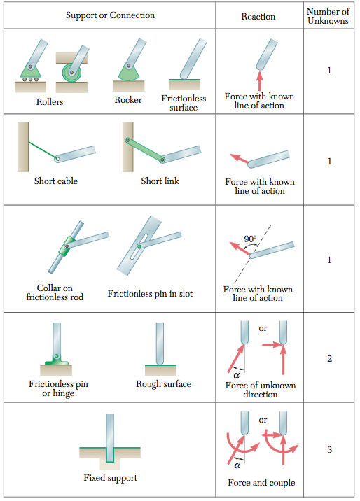
FBDs
Establish a coordinate system, and moment sign convention
Decide which bodies are to be included and detach these from all others
Indicate all forces and moments on the FBD, including:
Those external and applied
Those resulting from the contact
Those resulting from removed bodies
Indicate magnitude and direction of any forces or moments if known
Include important dimensions

Slide 5
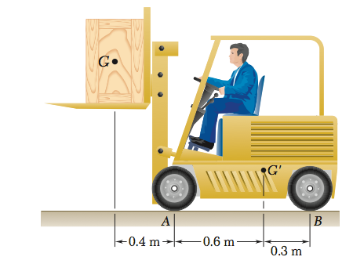
FBD Example
Draw the approriate FBD of the forklift and crate.
Notes:
smmbjp144

Slide 6
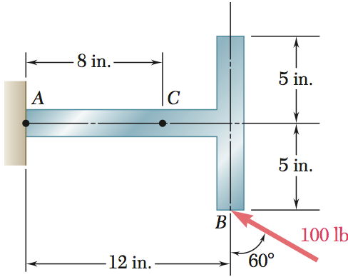
FBD
Draw the appropriate FBD of the bracket
Notes:
smmbjp80

Slide 7
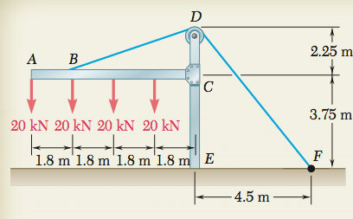
FBD
Draw the appropriate FBD of the crane arm and cable

Slide 8
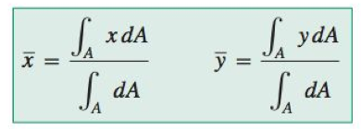
Review centroids
The centroid is the geometric center of an area and can be determined with the following formula
for composite areas use the formula
along with the centroids of common areas, Table A.1
Notes:
from philpot 3rd ed appendix A p820

Slide 9
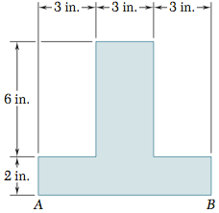
Centroids example
Determine the centroid location y_bar
Where do you predict the centroid will be?
 | A_{i} | y_{i} | y_{i}*A_{i}
1
2
𝛴
Notes:
statics and mechanics beer johnson p7.35

Slide 10
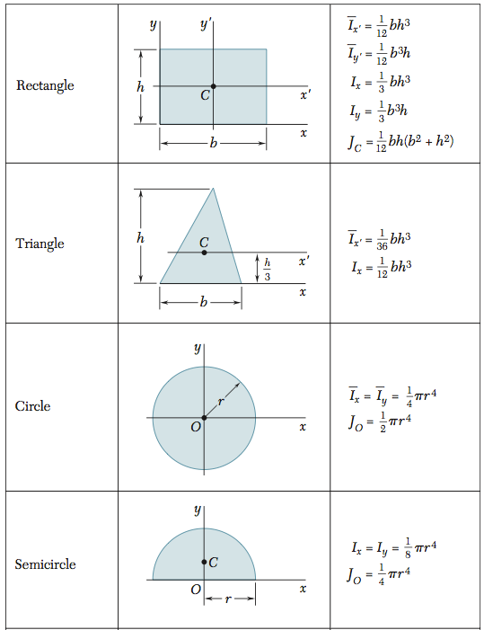
Moment of inertia
Also known as the second moment of an area
Notes:
Philpot 824
statics and machics beer and johnston p289

Slide 11
Parallel axis theorem
States that the moment of inertia for an area about an axis is equal to the area’s moment of inertia about a parallel axis passing through the centroid plus the product of the area and the square of the distance between the two axes.
For composite sections
Notes:
Philpot Appendix A

Slide 12
Moment of inertia for composite sections example
Determine the moment of inertia for the composite section
 | Ici | di | di²Ai | Ib=Ici+di²Ai
1
2
𝛴

