Slide 1
Mechanics of Materials Engr 350 - Lecture 1

Slide 2
Stress - Normal/Direct shear
Mechanics of Materials
Study of internal effects caused by external loads
Considers real bodies that deform (statics assumes no deformation)
3 main concerns
Strength - Will it _____________________?
Stiffness - Will it _____________________?
Stability - Will it ______________________?

Slide 3
Stress
Defined as the intensity of an internal force
In equation form: stress =
Note: scalar - just a number
vector - quantity with magnitude and direction
tensor - has magnitude & direction as well as a plane
Stress is a tensor
First subscript is the direction of area normal
Second subscript is direction of the stress component
force
area

Slide 4
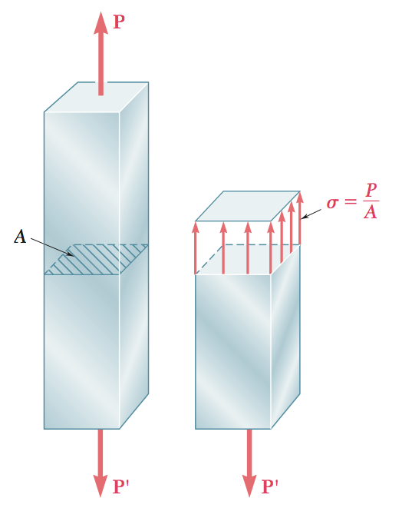
Normal Stress
Use method of sections to consider a rectangular bar with an axial load
We “cut a section” through the bar
Now the whole cut surface
is resisting the load

Slide 5
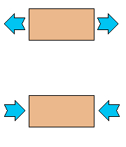
Normal stress
The stress is acting normal to the cut surface therefore it is called a normal stress
We use the symbol “σ” for normal stress
Sign convention for normal stress
Positive (tension):
Negative (compression):

Slide 6
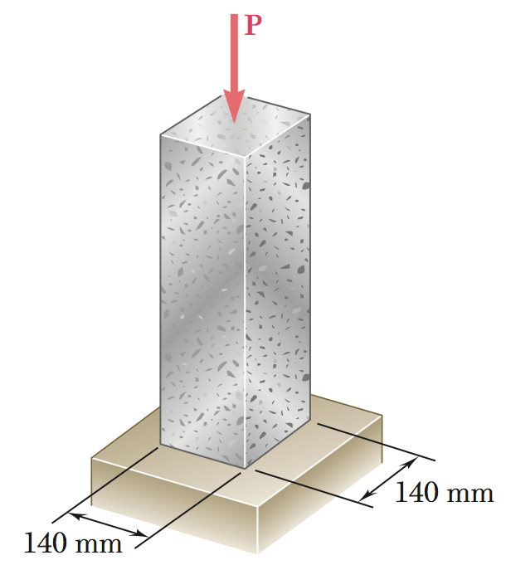
Stress Example
Determine the stress in the concrete pilar

Slide 7
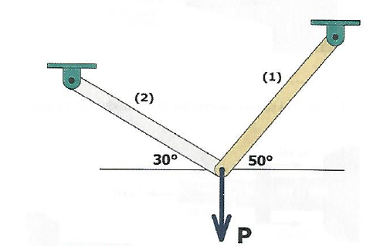
Two-bar loading
How to find load carried by each bar?
Sum x and y forces at joint → Two equations, three unknowns
Why not sum moments?
Calculate F_{1,allowable} based on max stress and area
Solve for F₂ and P based on F_{1,allowable}
Check if F₂ is higher or lower than F_{2,allowable}
If necessary, repeat using F_{2,allowable} to solve for F₁ and P

Slide 8
Demo TK Solver?
Use the following:
A₁ = 2.0 in²
A₂ = 1.5 in²
σ_{1,max} = 12,000 psi
σ_{2,max} = 18,000 psi
At the joint, what are these equations?
ΣF_{x} = 0
ΣF_{y} = 0
What are the max allowable forces for F₁ and F₂?

Slide 9
Stress on inclined plane (TB Section 1.5)
What if we cut the bar at an angle?
What stresses are acting on that surface?

