Slide 1
Mechanics of Materials Engr 350 - Lecture 4

Slide 2
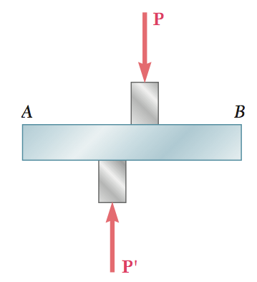
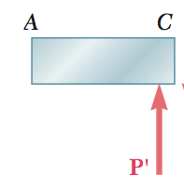
Shear Stress
Defined as the intensity of internal force acting parallel to an internal surface
We use the symbol 𝜏
Cut a section to see what we are talking about

Slide 3
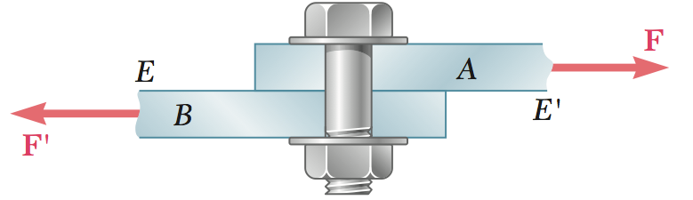
Shear stress visualized
Which component is experiencing a shear stress?

Slide 4
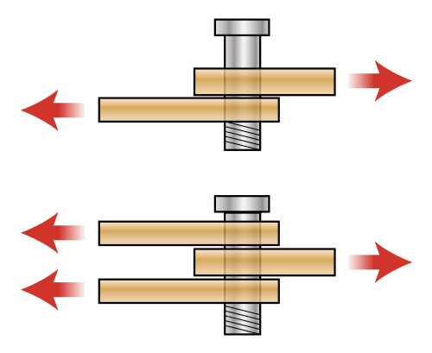
Shear stress
shear force
shear area
V
Av
𝜏avg = =
Single Shear vs. Double Shear
Make sure to use the right area for shear calculation
Q: When is it desirable to use single shear instead of double shear?

Slide 5
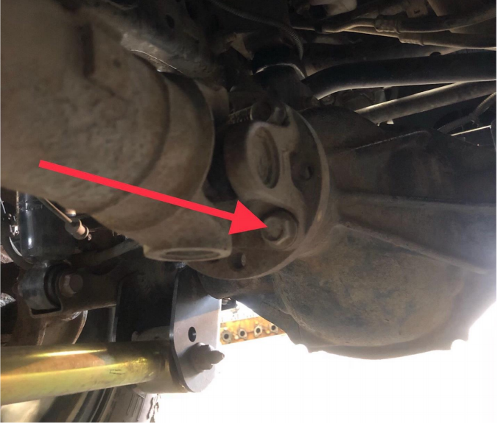
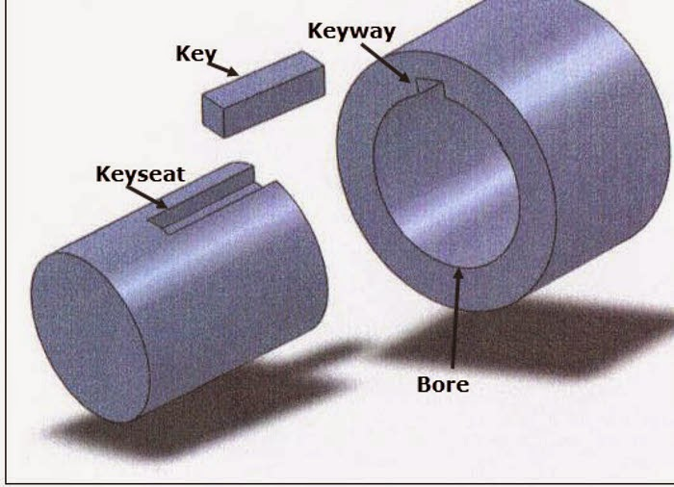
Shear stress
Where else do we see shear stress?
Keys on a shaft
Bolted flanges holding a torque (driveshaft, flywheel, etc.)
Most pinned connections with axial forces
Almost any adhesive joint (tape, bonded sheets, etc.)
Punching presses

Slide 6
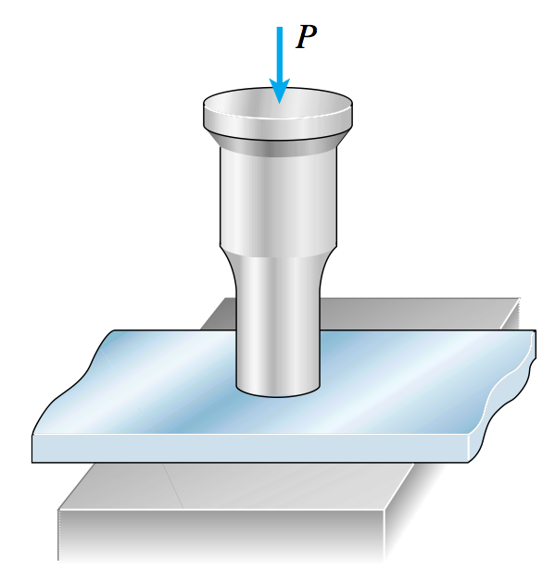
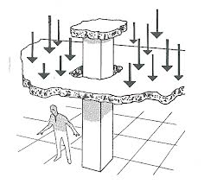
Punching shear
The average shear stress defined by the perimeter of the punch and the thickness of the punched member
Q: On the figures above, what are the shear forces (V)? What are the shear areas?

Slide 7
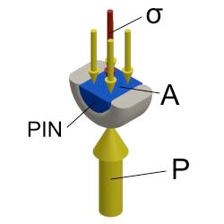
Bearing Stress
Stress that occurs on the surfaces of contact between two interacting members
Special kind of compressive normal stress
Defined as 𝜎b=
F
Ab
Notes:
photoelasticity, polarized light

Slide 8
Example bearing stress

Slide 9
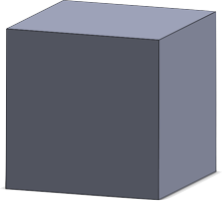
Equality of shear stresses on perpendicular planes
Consider an element with a shear stress as shown
Is this element in static equilibrium?
If not in static equilibrium, what additional shear stresses should be present so that it is in static equilibrium?
How would these shear stresses deform the stress element?
Y
X
Z

Slide 10
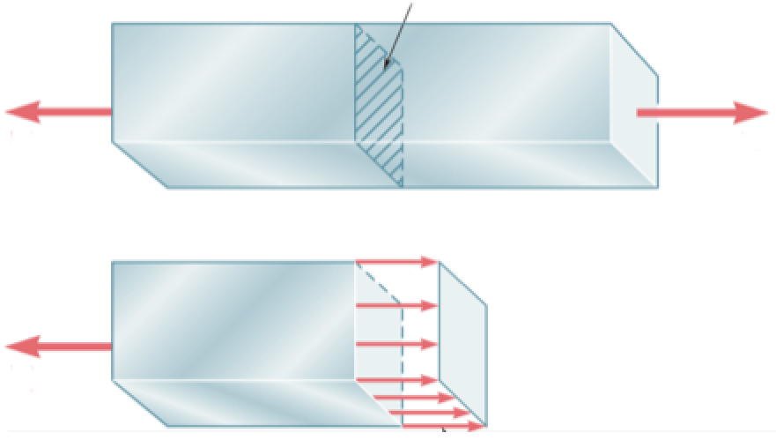
Stresses on inclined sections (Bonus Topic)
Consider a uniaxially (one-axis) loaded bar
Like before we cut a section and can calculate the normal stress
But what happens if our plane is not normal to the loading???
A

Slide 11
Area of inclined face

Slide 12
Stresses on inclined sections
P
P
A/cos 𝜃
$$σ_{n}$$
𝜃
𝜃
$$τ_{nt}$$

Slide 13
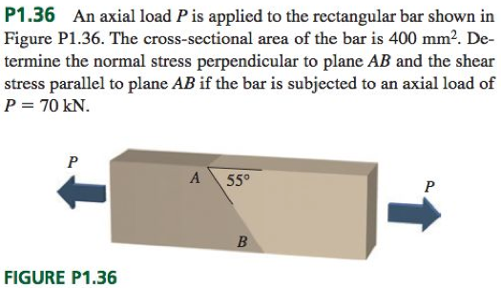
Example problem - Stresses on inclined planes

