Slide 1
Mechanics of Materials Engr 350 - Lecture 5
Displacement, Deformation, and Normal Strain

Slide 2
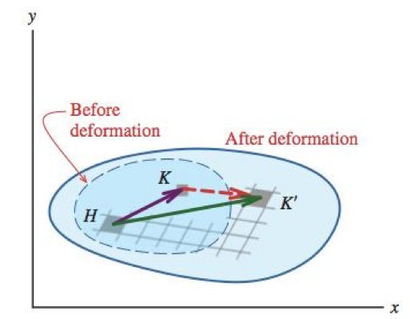
Strain - background
Displacement: movement of a point relative to a frame of reference
one response to the application of loads
displacement is a? scaler, vector, or tensor
On a rigid body, can be due to? translation, rotation
Foam example
Deformation: individual points on a non-rigid body move relative to each other in response to applied loads
Generally non-uniform
Common to use Greek symbols
ε – normal strain, γ – shear strain
Foam example

Slide 3
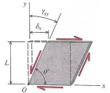
Strain
Strain is the measure of intensity of deformation
Deformation per unit of length of materials
Two types of strain
Normal strain, ε, used for elongation/contraction between orthogonal lines
Shear strain, γ, used for change in angle between orthogonal lines

Slide 4
Strain Units
$ε_{ave}=\frac{∆L}{L}=\frac{δ}{L}$
May seem like strain is dimensionless
Even dimensionless numbers can have dimensions
Common Strain Units:
in/in, m/m, mm/mm
Microstrain, micros, με, which is 1*10⁻⁶ in/in or 1*10⁻⁶ m/m

Slide 5
Normal Strain
Consider a bar loaded by a force, P
Sign Convention for 𝛆
+ :
- :
If L = 7,800 m, and 𝛆avg = 0.01 m/m
Find:
- δ, the displacement of the tungsten cable - Total length of the elongated cable

Slide 6
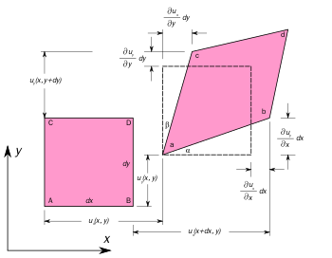
Orientation of Normal strain
Consider a rod in tension
The equation for normal strain gives you an average strain in a member of homogeneous material of constant cross-sectional area.
On the stress to the right, what location and direction do we need to apply load P to get the deformation shown?
P

Slide 7
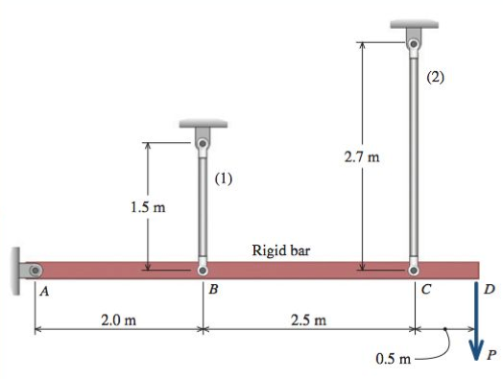
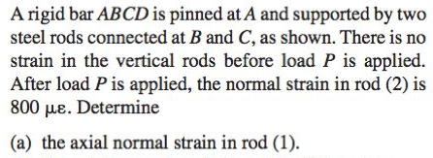
Student problem
Work in a group to solve example
Notes:
Example 2.1 in philpot p34

