Slide 1
Mechanics of Materials Engr 350 - Lecture 6
Shear and Thermal Strain

Slide 2
Shear strain
If an element is subjected to a shear stress it responds by undergoing a shear strain
Initially (before deformation) the two reference planes need to be orthogonal.
$γ_{origin}= \frac{δ_{x}}{L}= \frac{π}{2}−θ′$
Y
Y
𝛿x
L
𝜃'
X
X

Slide 3
Shear strain
Units of strain: Unitless (kind of)
$γ_{origin}= \frac{δ_{x}}{L}= \frac{π}{2}−θ′$
Shear strain is a dimensionless angular quantity
Can have units of radians [rad] or microradians [μrad]
1 μrad = 1 x 10⁻⁶ rad
Sign convention
+ if the angle gets smaller at the point of interest
- if the angle gets larger at the point of interest

Slide 4
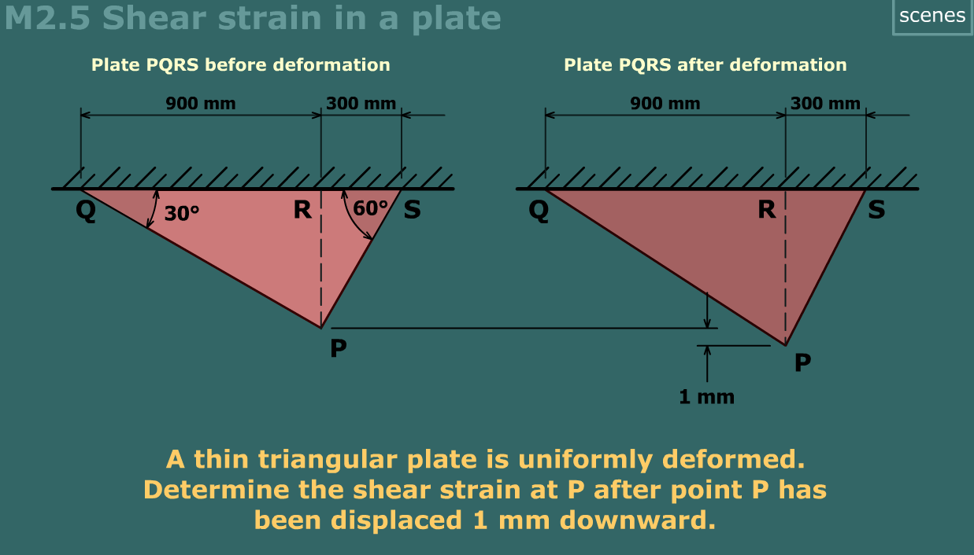
Example, MM Module M2.5

Slide 5
Thermal strain
Most engineering materials strain with temperature change
What happens when heated?
What happens when cooled?
The coefficient of thermal expansion, 𝛼, is the unit of strain produced per unit of temperature increase
$$ε_{thermal}= α∗∆T$$
For a solid isotropic homogenous material, 𝛼, is a constant and applies in all directions (See Appendix D)

Slide 6
Total strains
It does not matter what causes a strain, the result is the same. The strains are _________.

Slide 7
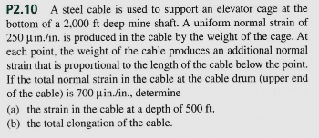
Example- Philpot P2.10

Slide 8
Thermal Strain Example – Differential Ring Gear
At T=75 °F ring gear inner diameter is 8.992 in and carrier outer diameter is 9.004 in
α_{steel} = 6.0 x 10⁻⁶ 1/°F
α_{cast iron} = 5.0 x 10⁻⁶ 1/°F
T_{freezer} = 0.0 °F
T_{oven} =300 °F
Find ID of ring gear coming out of oven
Find OD of carrier coming out of freezer

