Slide 1
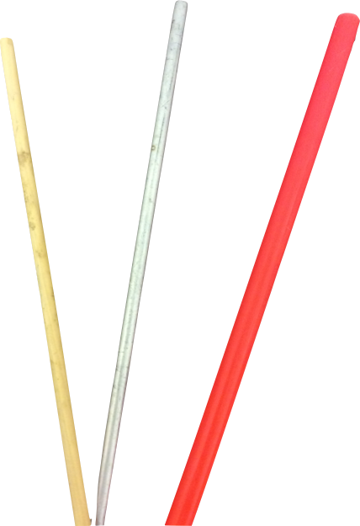
Mechanics of Materials Engr 350 - Lecture 7
Mechanical Properties

Slide 2
Mechanical properties testing
A specimen of standardized size and geometry, usually round or flat bar
A machine pulls the specimen apart (single-axis tension) at a controlled rate of deflection (not controlled force)
The force causing the deflection is measured as a function of the displacement of the test section of the specimen
F
𝛿

Slide 3
Uniaxial Tension Test
See Also: https://www.youtube.com/watch?v=D8U4G5kcpcM

Slide 4
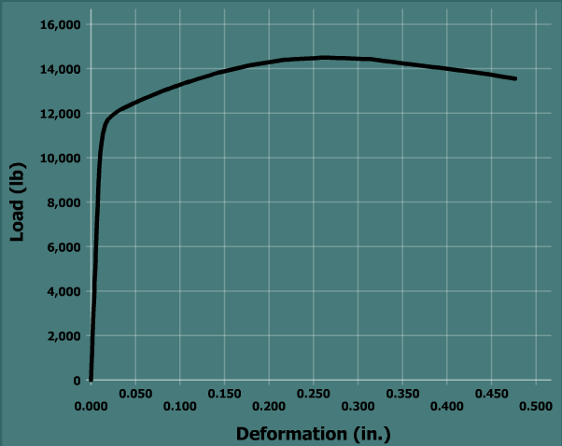
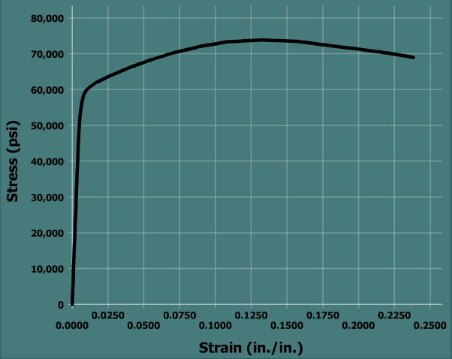
Stress vs. strain curve
The load vs. deformation curve is dependent on geometry (dimensions of the specimen. A more general and useful plot it the stress-strain curve. Can convert F-𝛿 to 𝜎-𝜀.
$$σ=\frac{F}{A}$$
Where A is the original cross-sectional area
$$ε=\frac{δ}{L}$$
Where L is the original length of the test section

Slide 5
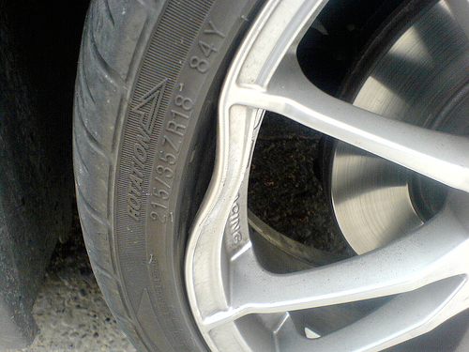
Elastic and Plastic Deformation
Plastic region
Elastic region
Elastic region
When load is removed material will return to its original shape
Plastic Region
When load is removed material will rebound in direction of original shape, but will have some deformation
Work Hardening
Repeated deformation changes the yield strength!

Slide 6
Parameters on Stress-Strain Diagram
Proportional Limit
Stress where elastic region ends
Elastic Modulus
Slope of elastic line
Same for a material family
$E= \frac{∆σ}{∆ε}$
Yield Strength
Increase in strain without notable increase in stress
Not applicable for fatigue!
Not every material has one
0.2% offset method (0.002 ε)
Ultimate Strength
Highest stress value on the curve
Due to strain hardening as material is plastically deformed

Slide 7
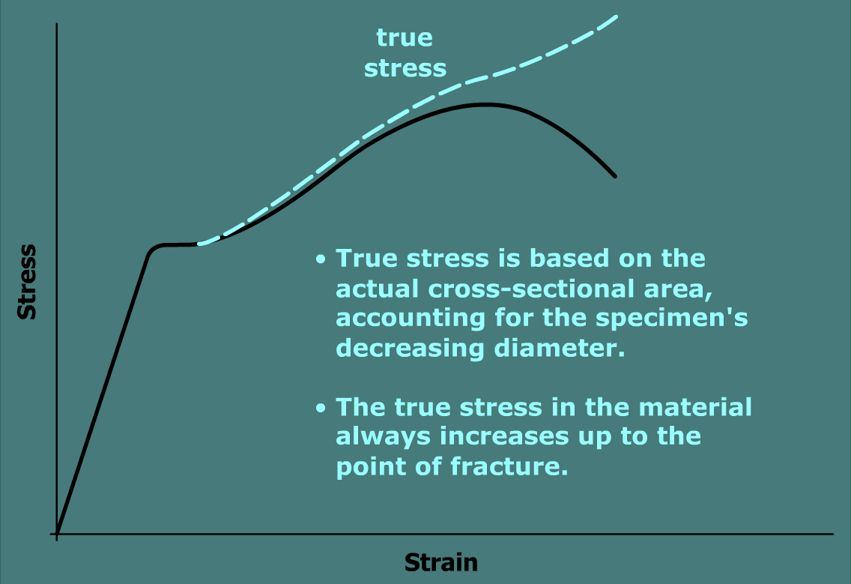
Engineering Stress vs. True Stress
$$σ=\frac{F}{A}$$
Engineering Stress
A is the original cross-sectional area
True Stress
A is the actual cross-sectional area
A decreases slightly during plastic deformation
A decreases drastically during necking

Slide 8
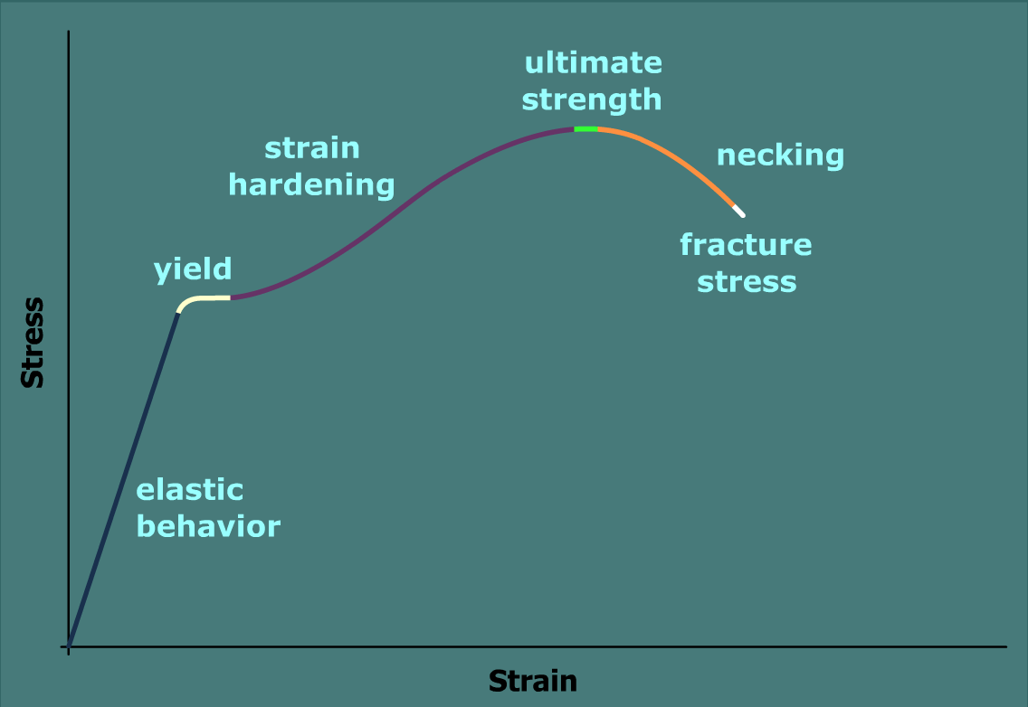
Summary Stress-Strain Diagram

Slide 9
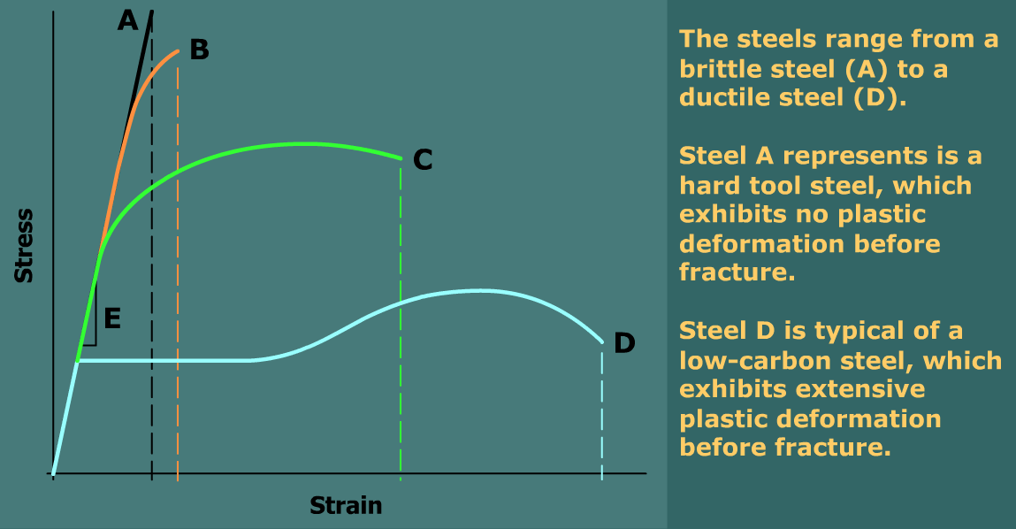
Ductility
Ductility measured by:
Percent elongation (strain) at fracture
Percent reduction of cross-sectional area at fracture

