Slide 1
Mechanics of Materials Engr 350 - Lecture 8
Mechanical Properties #2

Slide 2
Hooke’s Law (pronounce like ‘hook’)
The initial portion of the stress-strain curve is linear
𝜎
Hooke’s Law gives us the relationship of stress and strain ONLY in the elastic region of the curve
$σ=E∗ε$
where E is the modulus of elasticity
Hooke’s Law also applies to shear stress and shear strain
$τ=G∗γ$
where G is the modulus of rigidity (also known as the shear modulus)
Hooke’s Law
Hooke’s Law
𝜀

Slide 3
Poisson’s ratio (rhymes with ‘boy-john’)
If a solid body is subjected to an axial tension, it contracts in lateral directions
If a solid body is compressed, it expands in lateral directions
$v=−\frac{ε_{lateral}}{ε_{longitudinal}}=−\frac{ε_{lat}}{ε_{long}}=−\frac{ε_{transverse}}{ε_{axial}}$ $=−\frac{ε_{t}}{ε_{a}}$
Only applies to a state of uniaxial stress
Typical values → 1/4 to 1/3
Max value → 0.5 (rubber, etc.)
Demonstration?

Slide 4
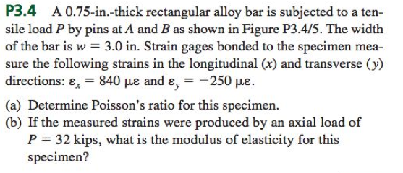
Example Philpot 3.4
$v=−\frac{ε_{lateral}}{ε_{longitudinal}}=−\frac{ε_{lat}}{ε_{long}}=−\frac{ε_{transverse}}{ε_{axial}}$ $=−\frac{ε_{t}}{ε_{a}}$
$v= \frac{−(−250 με)}{840 με}=0.2976$ ← within expected values
$σ=E∗ε= \frac{F}{A}$ → $E= \frac{F}{ε∗A}$
$E= \frac{F}{ε∗A}= \frac{32,000 lbf}{\left(840∗{10}^{−6}\frac{in}{in}\right)∗(0.75in∗3.0in)}=16.9 Mpsi$
What has Young’s modulus of ~17 Mpsi?
Copper red brass alloy

Slide 5
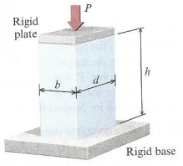
Another in-class problem
Polymer bar with dimensions:
b = 50 mm
d = 100 mm
h = 270 mm
Load P of 135 kN results in a reduction in height of Δh = -2.50 mm and depth changes by Δd = 0.38 mm
When unloaded the bar returns to original shape. Calculate:
Modulus of Elasticity (Young’s Modulus)
Poisson’s Ratio
Change in dimension b

