Slide 1
Mechanics of Materials Engr 350 - Lecture 9
Design/Safety
“Design is a funny word. Some people think design means how it looks. But of course, if you dig deeper, it's really how it works.”
-Steve Jobs

Slide 2
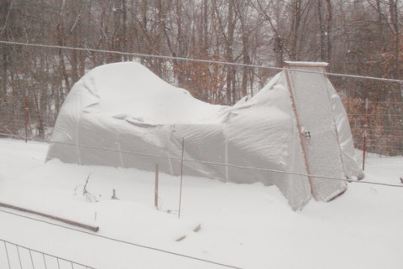
Design considerations
We generally must make many assumptions in design in order to make calculations.
4 Types of Loads
Dead Loads
Live Loads
Snow Loads
Wind Loads

Slide 3
Design approaches - Allowable Stress Design (ASD)
Component is designed so that elastic stresses do not exceed a percentage of the yield strength
Usually accomplished by applying a factor of safety.
$σ_{allowable}= \frac{σ_{failure}}{FS}$
where σ_{failure} may be σ_{ultimate} or σ_{yield}
FS:
~2.0 for buildings
~3.5-4.0 for pressure vessels
~3.0 for automobiles
~1.5 aerospace (but frequent inspections)
~4-10 loss of life failures
𝜎
115ksi
𝜎allow= 76.7ksi
0.2%
𝜀

Slide 4
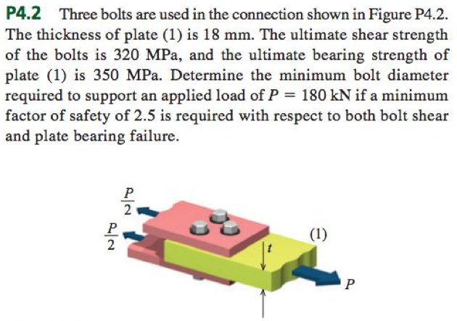
Example

Slide 5
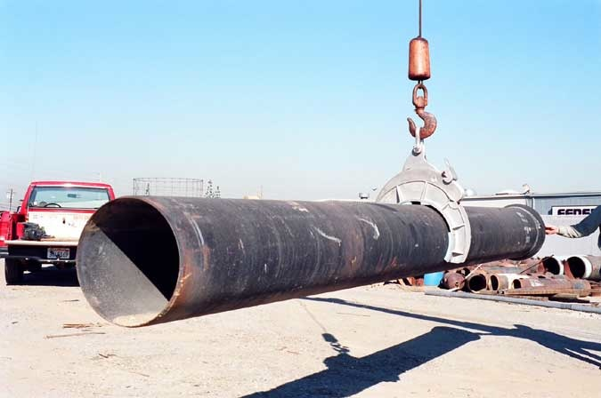
Design approaches - Load And Resistance Factor (LRFD)
Probabilistic design concept - Uses statistical probabilities to optimize risk of failure
Chain hook example

Slide 6
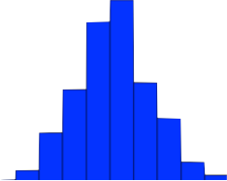
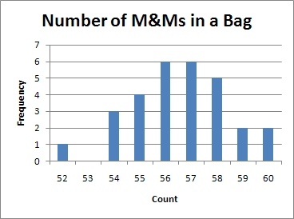
Statistics Background Frequency Distribution Plot (histogram)
Frequency
(# times data observed)
The whole data set (many replicates)
Mean of data set

Slide 7
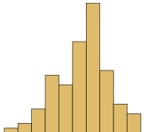
Load and Resistance Factor - LRFD cont.
Strength data from testing many different hooks off the production line.
Measure forces (or stress/strain) in hooks as used by customers
Resistance (R*)
Strength of the part in question
Load Effects (Q*)
Effect of observed loads on the part in question

Slide 8
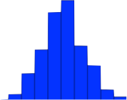
LRFD cont.
Plot the actual strengths (resistance) and the actual loads together
Load Effect (Q*)
Resistance (R*)
Can shift the position of these distributions with the load factor (𝛾), and the resistance factor (𝜙)
Probability of Failure
$$P_{F}={\# overlap}/{\# data points}$$
In general we want
𝜙Rn>𝛾Q1+𝛾Q2+….+𝛾Qn
Overlap = Failure!!!

Slide 9
LRFD cont.
Load Effect (Q*)
Resistance Factor (R*)
Common Load and Resistance Factors
𝜙Rn>𝛾Q1+𝛾Q2+….+𝛾Qn
Load Factors (usually > 1)
Dead Loads → γ = 1.2
Live Loads → γ = 1.6
$P_{F}$ = 0.001 is the notional failure rate (higher than actual, considered safe)
$P_{F}$ = 0.001 means 1 in 1000 chance of failure
Resistance Factors (often < 1)
Depends on likelihood of simultaneous conditions
ϕ = 1, simultaneous conditions likely
ϕ < 1, simultaneous conditions less likely
For instance, high snow load *and* high wind load unlikely

Slide 10
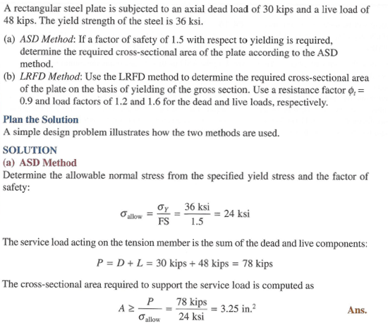
Example 4.3 – Compare ASD to LRFD

Slide 11
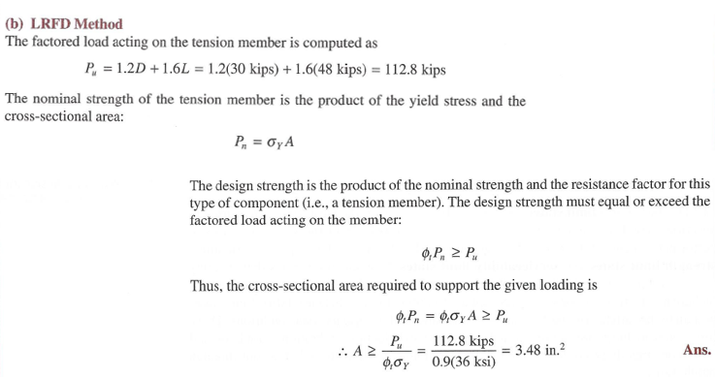
Example 4.3 – Compare ASD to LRFD

