Slide 1
Mechanics of Materials Engr 350 - Lecture 10
Axial Deformation #1

Slide 2
Axial Deformation
Mechanics of materials approach: real structural elements are analyzed as idealized models with simplified loads
Solutions are therefore approximations
Solutions are generally satisfactory (within 10% of actual)
Some reasons these approximations work is:
Allowable Stress Design (ASD) – Applying Factor of Safety
Load and Resistance Factor Design – Statistical analysis of strength and loads
Saint-Venant’s Principle

Slide 3
Saint-Venant’s principle
States that the stress, strain, and displacement fields due to two different but statically equivalent force distributions on parts of a body far away from the loading points are approximately the same
In other words….localized maximum stresses diminish rapidly as the distance from the point of loading increases
Consider Fig. 5.1 and 5.2 in Philpot
In future courses, consider application sites

Slide 4
Deformations of axially loaded bars
Consider a bar loaded by a force, F
Recall:
1) Normal strain:
2) Hooke’s law:
3) Normal stress:
F
F
$$ε_{axial}= \frac{δ}{L}$$
$$σ_{axial}=E∗ε_{axial}$$
$$σ_{axial}= \frac{F}{A}$$
Combine these to get the FLEA equation
$$δ=\frac{F∗L}{E∗A}$$

Slide 5
Deformations of axially loaded bars cont…
Same constraints as Hooke’s Law (linear-elastic region only!)
Fine point: The previously derived equation is only for homogeneous, prismatic member loaded by forces at the end
(Prismatic member means the combination of E*I is constant)
If multiple members are used, deformations are additive
$$δ=\sum_{i}{\frac{F_{i}∗L_{i}}{E_{i}∗A_{i}}}$$
Sign convention
𝛿 is + if the member elongates
𝛿 is - if the member compressed or contracted

Slide 6
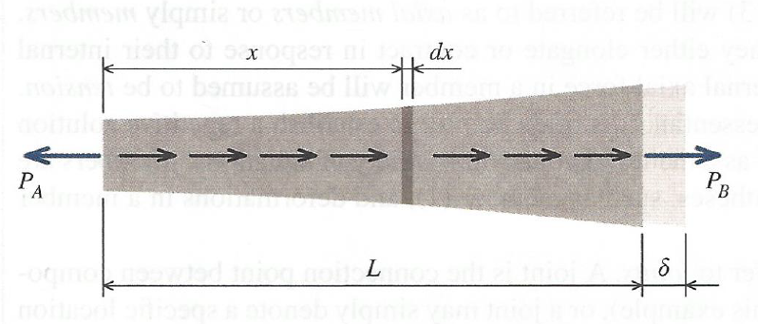
Non-prismatic members
What about cases where F, or E*I are not constant?
Consider a post such as a solid tapered concrete footing
A long slender hanging rod/wire here the mass cannot be neglected
In this case, each increment of length is subjected to either a different force and/or has a different cross-sectional area
Let the length of each section become infinitesimally small
$$dδ= \frac{F_{(L)}}{{E∗A}_{(L)}}dx$$
$$δ= \int_{0}^{L}{dδ}= \int_{0}^{L}{\frac{F_{(L)}}{{E∗A}_{(L)}}dx}$$

Slide 7
Practice Problem (MM Module M5.3)

Slide 8
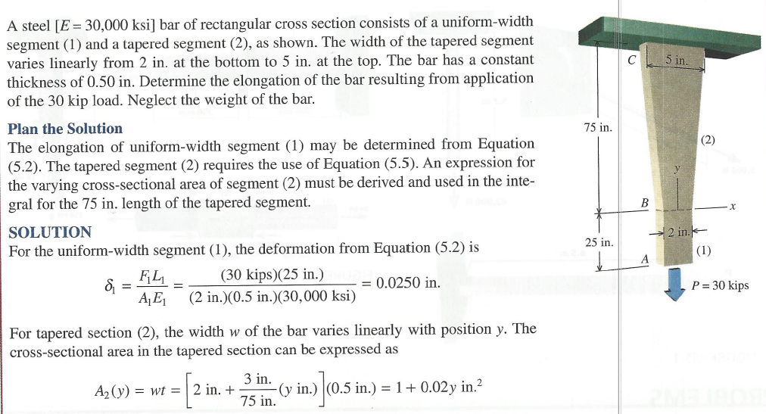
Example 5.2

Slide 9
Example 5.2

