Slide 1
Mechanics of Materials Engr 350 - Lecture 9
Axial Deformation 2 - Systems of Axially Deformed Members
“We cannot solve our problems with the same thinking we used when we created them.”
-Albert Einstein

Slide 2
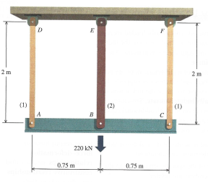
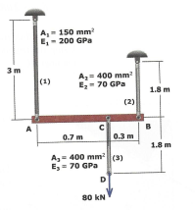
Deformations in a system of axially loaded bars
Consider deformations in more than one direction
Useful technique to analyze complex systems of homogeneous uniaxial bars loaded by forces at the end
We will assume some bars are perfectly rigid for now
2 Types
Statically determinate (covered in Philpot 5.4)
Statically indeterminate (section 5.5)
What’s the difference?

Slide 3
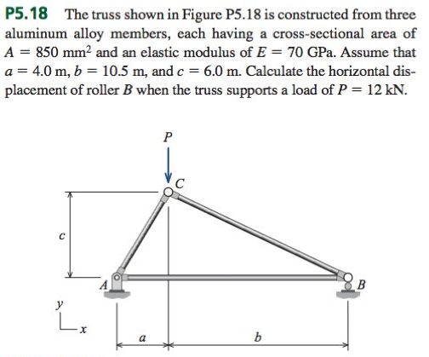
Statically Determinate Systems
1) Equilibrium equations
2) Find forces in members
3) Find deformations in members
4) Determine how structure as a whole deforms based on deformations in members - as necessary

Slide 4
Statically indeterminate systems
Solution procedure
1) Equilibrium Equations – Express in terms of unknown forces
2) Geometry of Deformation – Geometric relationship between various members (step unique to statically indeterminate system)
3) Force-Deformation Relationships – FLEA equation for each member
4) Compatibility Equation – Combine equations from Step 3 with Step 2, expressed in terms of unknown forces. Should have a closed set of equations after this step (equal number of knowns and unknowns)
5) Solve the Equations – by hand or via software

Slide 5
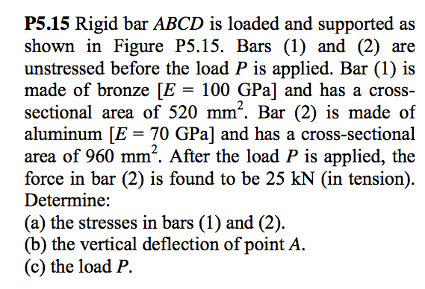
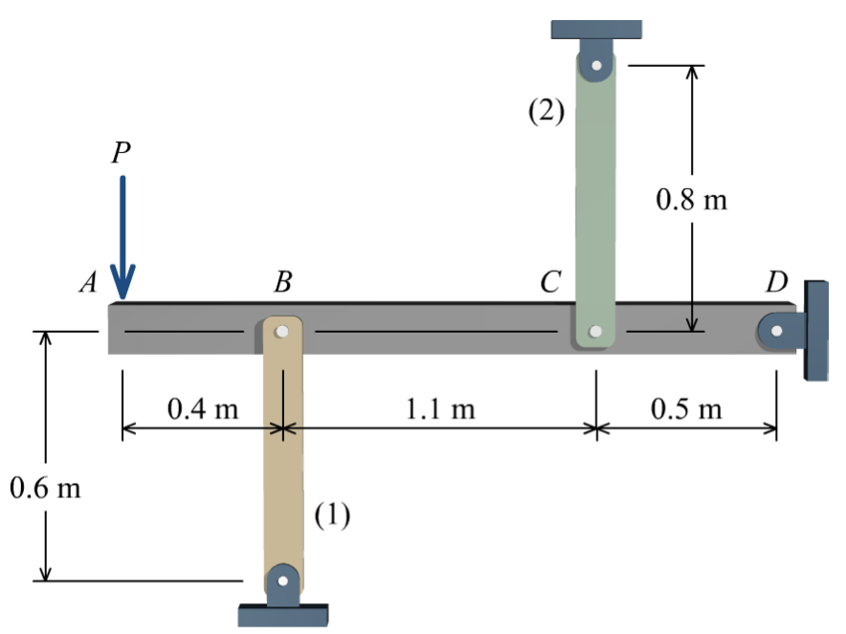
Practice problem P5.15
Write equilibrium equations
Equations from geometry of deformation
Force-deflection relationships
Create compatibility relationships: 2➞3

Slide 6
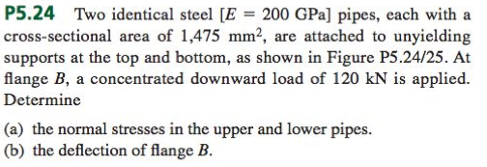
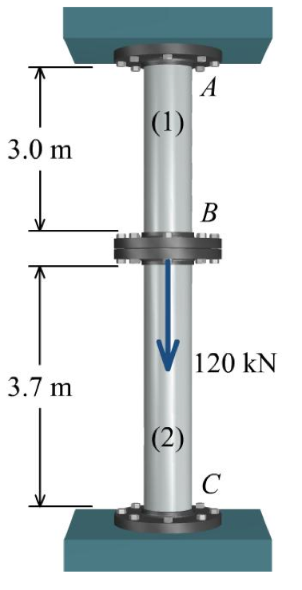
Example: Philpot P5.24
Write equilibrium equations
Equations from geometry of deformation
Force-deflection relationships
Create compatibility relationships: 2➞3
Solve 1 & 4 simultaneously
𝜎1=
𝜎2=
Deflection at B:
Given:
E=200GPa
A=1475mm²
Find: a) normal stress in the upper and lower pipes
b) the deflection of flange B

