Slide 1
Mechanics of Materials Engr 350 - Lecture 13 Coordinate Transformations
"Do not forget what you have learned of our past, Rodimus. From its lessons the future is forged."
- Optimus Prime

Slide 2
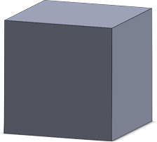
Equality of shear stresses on perpendicular planes
Consider an element with a shear stress as shown
Is this element in static equilibrium?
If not in static equilibrium, what additional shear stresses should be present so that it is in static equilibrium?
How would these shear stresses deform the stress element?
Y
τ_{xy} is the shear on the face orthogonal to x, in the direction of y.
τ_{yx} is the shear on the face orthogonal to y, in the direction of x.
Summing forces and moments it can be shown that τ_{xy} = τ_{yx} = τ
Shear stress on each face must be of equal magnitude
τ_{yx}
τ_{xy}
τ_{xy}
X
Z
τ_{yx}

Slide 3
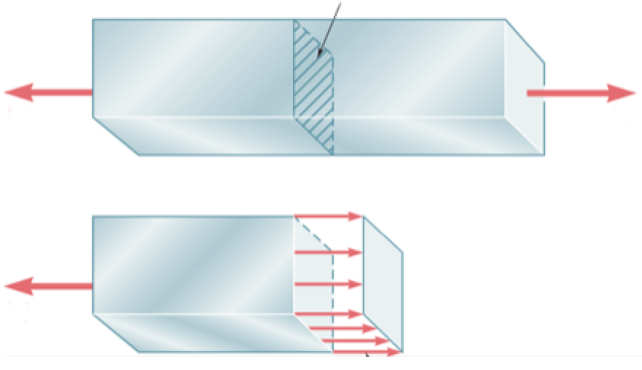
Stresses on inclined sections – Textbook 1.5
Consider a uniaxially (one-axis) loaded bar
Like before we cut a section and can calculate the normal stress
But what happens if our plane is not normal to the loading???
A

Slide 4
Area of inclined face

Slide 5
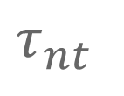
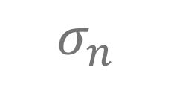
Stresses on inclined sections
P
P
A/cos 𝜃
$$σ_{n}$$
𝜃
Note how the angle θ is defined
Counterclockwise from the x-axis to the n-axis
The n and t axis are orthogonal to one another
𝜃
$$τ_{nt}$$

Slide 6
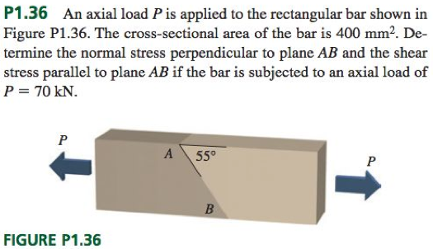
Example problem - Stresses on inclined planes
What is the angle θ in this problem?
What is σ_{n}?
What is τ_{nt}?
How does σ_{n} change as we let θ range from 0° to 90°?

